Slide 1
Summer Undergraduate
Research Fellowships
Gail P Taylor, Ph.D.
Associate Director of STEM Initiatives
UTSA MBRS-RISE
01/21/2014

Slide 2
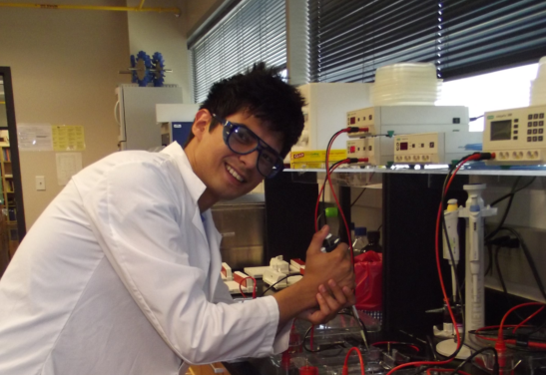
Summer Research Internships
Focus of Talk: Undergraduate Research Experiences
What are they?
  8 – 12 week funded summer research
  Often targeted for UR students
Held At:
  Throughout country and elsewhere!
  Universities
  Medical Schools
  Graduate (Ph.D.) Schools
  Government Research Organizations
  Companies
  Some International Partnerships

Slide 3
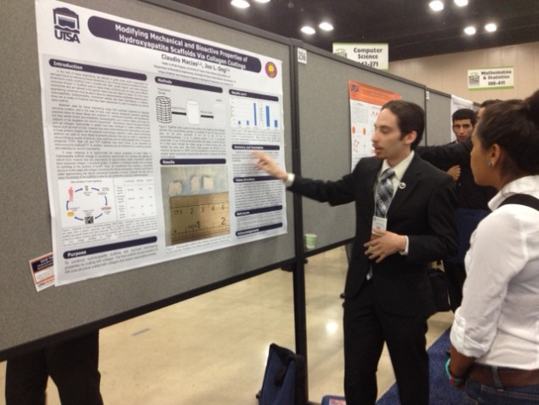
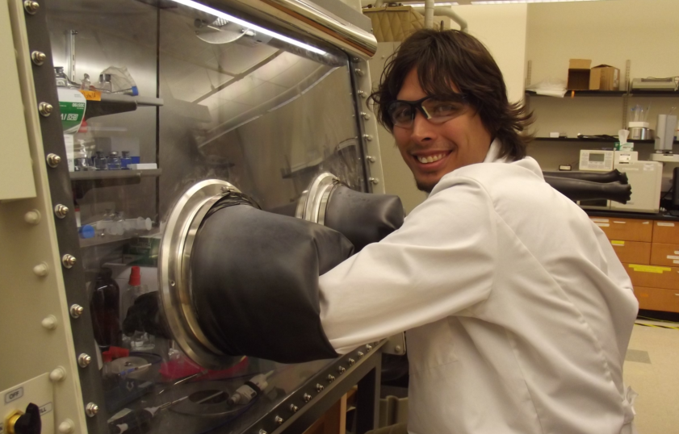
Costs:
They pay you!
  8 – 12 weeks funded research experience
    Stipend ~ $2500 - $5000
    Travel (usually up to $700 to and from)
    Housing (Frequently; will cost the school $2000+)
    Food (varies; some do it)
    Follow-up conference (occasional)

Slide 4
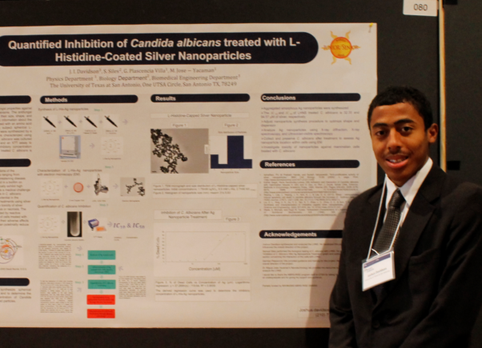
What Happens There? (Part I)
Research
  Small research project of your own
No Coursework
Professional development
  Seminars with faculty
  Professional Dev. Instruction (Paper Reading, CV, Posters)
  GRE Prep
  Research Careers Information
  Oral/Poster Presentation
LOR
  You, hopefully, earn a strong LOR

Slide 5
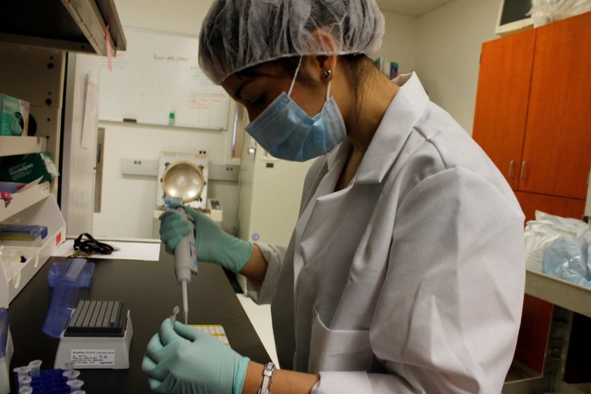
What Happens There II?
Networking!!!
  Them- Try before buy doctoral students
  You- Meet faculty and new friends
Recruitment by their Grad School
Fun!
  Parties/socials
  Trips to local spots of interest
    Ball games
    Amusement Parks
Final Presentation
  Scientific poster or oral

Slide 6
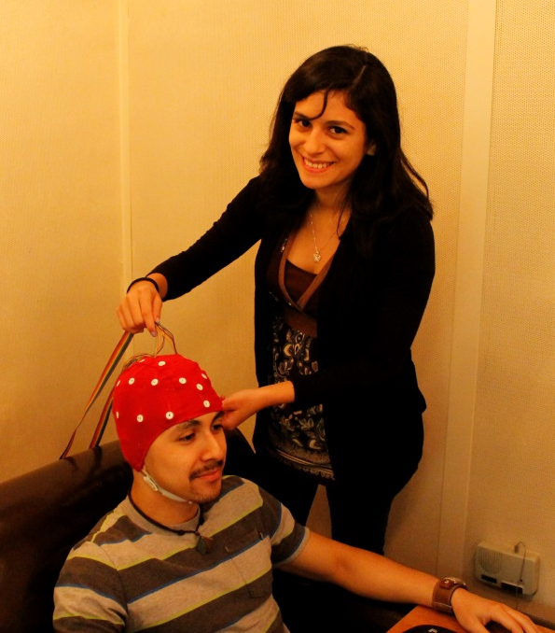
Why do this?
Broaden yourself
Broaden your experience
  Work Experience
    CV or resume
    Sets you apart - Ambition
  Graduate School Admission
    In general, research is required
    Will help to get into specific program
  Medical School Admission
    Very competitive Admissions
    Need to stand out
  Experience for Jobs
Letters of Recommendation!!

Slide 7






Who Funds Them?
Government
  NSF
    REU – Research Experience for Undergraduates (at schools)
  NIH
    On NIH Campus
    Community College Bridge
  CDC (campus)
Individual Graduate programs or Grad Schools
National Societies
Industry Leaders
Private Donations to Schools

Slide 8
Why Summer Programs Exist
Increase number of people in research careers
Increase diversity in U.S. Science and Engineering
Allow people to “sample” research as career
Promote doctoral education
Recruit students to their graduate schools
Help mentor/develop undergraduate students/Give back
Advertise their school for doctoral study
Advertise their school for MSTP study
Increase number of future MDs who participate in research
Allow faculty to “try out” future students
Allow companies to “try out” future employees

Slide 9
Targeted Applicants
Varies with program and funding agency
Undergraduates (or PhD or Med Students)
  Mostly prior to Jr./Sr. years
  Some younger (prior to Soph year)
Primarily underrepresented students
  NSF Funded:
    Hispanic; African American; Women in Chem, Math, Physics, Engineering; Disabled. {{but only percentage…}}
  NIH
    Hispanic; African American; now: disabled

Slide 10
Other Selection Considerations
Firmly committed to pursuing Ph.D. a plus
Also Pre-Med at NIH Campus or Pre-MD/PhD programs (more MDs performing research)
Disadvantaged
Prior research experience
Strongly considering their school for PhD
Sometimes require citizenship/permanent residency
NOT MD to program that seeks future PhDs
NOT MD/PhD to someone with GPA lower than 3.7
Targeted does not mean exclusively selected!

Slide 11
The Programs Want:
People with potential to enter and complete Ph.D., M.D., or MSTP programs
  Has background motivators/drive
  People with basic courses
  Can complete schoolwork
  Can think critically/analytically
  Seem to desire to pursue research (or whatever program is promoting)
“Sharp” person from underrepresented group, who may be persuaded into research
Ultimately will be a good time/money investment
*** These programs know that drive can count for more than undergraduate grades!***

Slide 12
Applications Require Effort
Some opportunities knock
Most require effort on your part
Required for Applications
  Application itself
  Letters of Recommendation (2-3)
  Personal Statement
  Transcripts
BIG ADVICE: LET THEM TURN YOU DOWN, DON’T EVER TURN YOURSELF DOWN!
Find reasons for them to accept you!

Slide 13
Application Specifics
Generally due Dec – April (most Feb 1)
Application
  Grades, courses, etc.
Official Transcripts (usually want 3.0 or above)
Statement of purpose
  Why do you want to do this?
  What makes you a good choice?
  Which mentor do you want to work with?
  What are your future plans?
Letters of recommendation
  Usually from tenure track faculty
  If did research before, use your mentor
  If no research, use course instructor
  Generally okay if these are a little late!
Look at the program goals!
  Career goals
  Correct majors
  Enough coursework background

Slide 14
How to Impress Faculty…
Strong grasp of your course work
Read before arrival
Read additional resources
Strong work ethic and productivity
Responsibly finish what is assigned to you
Work to solve own problems
Attitude- enjoyment of what you are doing
Teamwork
Respect self and others
Good communication
Engage with the lab (lab meetings & Outings)
Honesty/Integrity
High level critical thinking (take time to think!)
  How do you approach problems?
  What is the next step of your project?
  What are the implications of your project?

Slide 15
Example Programs
University of Michigan
  http://www.rackham.umich.edu/prospective-students/srop
UT Health Science Center at San Antonio
  http://uthscsa.edu/outreach/summer.asp
National Institutes of Health
  https://www.training.nih.gov/programs/sip

Slide 16
My List of Programs
http://www.utsa.edu/mbrs/internships.htm

Slide 17
More on Letters
Required at all levels of science
The better they know you, the better
For Summer program, might not be known
  Graduate school: “Can you write very good recommendation?
Prioritize:
  Research mentors
  Other researchers with whom you’ve worked
  Program directors/Advisors
  Course Instructors- Tenure track
  Teaching assistants
  Preferably not your mom….
Once they’ve written one, the next is easy

Slide 18
Letters…Continued
Ask early (3 weeks or more if possible)
Provide personal statement, CV
Set appt. to talk to them
Provide web links for programs and/or descriptions of programs
Provide schedule of due dates
Provide signed forms if needed
Gently remind as needed (PhDs procrastinate)

Slide 19
Personal Statement 101
Your only “voice” in application
Commonly are asked for as a
  Personal statement
  Statement of purpose
  Personal essay
  Statement of background and goals
  Expression of your qualities as an applicant
Either request one statement or several essays
  Why do you want to participate in summer research?
  What are your educational and career goals?
  Describe your research experience
  Describe your research interests
  Which mentors do you want to work with and why?
  Why do you want to do this at their school?
  What have you overcome; other things about you; why they should pick you

Slide 20
Possible Outline
General Personal Statement:
Each paragraph has a function and should contain only pertinent info!
Usually lasts 2 pages (then can tailor)
  Introductory paragraph + one more
    1 paragraph
    What motivated you to go into research
    What motivated you to pursue the summer research
  Personal attributes/schooling
    Usually 1 Paragraph, or mixed into paragraph 1
  Research experiences (STOP AUTOBIOGRAPHY)
    1 or 2 paragraphs
    NOT TECHNIQUES!
    Describe your research and your findings
  Why their school?
    1 paragraph
    Research Interests (make sure they match up with what’s at the school!)
    Mention several faculty
  Other things that they should consider
    Grade problems, URM/hardships, bad school district, friends all in prison, etc, illness in family, etc., commitment to community/education; I am NOT URM, but had these hardships, first generation college, etc.
  Aspirations/Closing
    Long term education and goals. This program will help me towards my goals of…

Slide 21
Personal Statement 101 (cont)
Follow page limits/length of essays
ABSOLUTELY PROOFREAD!!!!!
For entire statement (if not asked for as individual parts) 2 single spaced pages, 1 inch margins.
Sound realistic: No Nobel prize references
Avoid gimmicks (no fake magazine article)

Slide 22
Thinking more….
Why are YOU particularly suited to do it (with examples)?
  What are your strengths?
  Have you overcome barriers/circumstances?
  How are you doing academically?
  Can you balance job, school, volunteering, research, etc?
  What has made you resolved/strong?
Regarding Research Experiences…
  Talk about research project
    Sound like scientist, not a pair of hands
      See associated slide!
Why do you want to go to their school?

Slide 23
Non-URM Approaches
Find reasons that they will use to justify choosing you
Why you can’t do research as volunteer (or enough research as volunteer)
All of the ways that you’ve managed to get research experience
Hard things in life you’ve overcome - Disadvantage
  Family illness
  Single parent
  Started in CC due to no money
  How poor you are
  How you went to low-functioning schools
  Dropped out of school and climbing back
How you were in the military
You are totally committed to PhD
You are totally committed to PhD at their school
How hard you will work
How committed you are to minority advancement, community issues

Slide 24
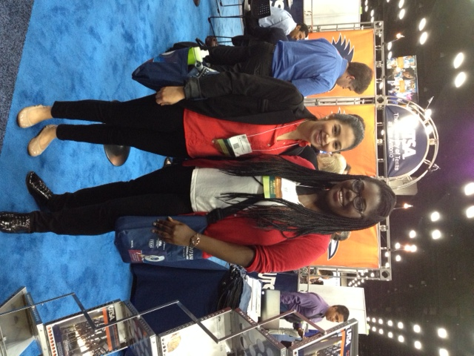
Research Experience
May go several paragraphs!
Mention all experience, focus on deepest
Show you understood…
  What you did
    Goals/hypothesis
    Your role in larger project
  What you learned
    Your research project results
    Various techniques (but not terribly specific)
    About research in general
  What it meant
    Significance to field/humanity
  Publications and acknowledgements, awards
  How this experience inspired you

Slide 25
How to Start?
Free write
  Answer the questions I listed above.
  Ask those who know you best
  Write without bothering with corrections
Re-Write
  Organize better paragraphs
  Organize into entire essay (see outline)
  Make sure to get rid of all spelling and grammar problems

Slide 26
What Not to Mention:
Mention but don’t dwell on High School experiences (except if it’s your only heavy-duty research exp)
Other schools you’re applying to
Controversial topics
  Religion or politics
  Things that are unusual, unconventional, illegal
  Mundane aspects of past research (buffers or descriptive methods)

Slide 27
Last Steps before Submission
Make it will organized, relevant, concise
Takes long to write- multiple drafts, read aloud
Grammatically correct
Good spelling, punctuation
Answer all questions
Follow all length requirements
Tailor for individual school
Reviewed by mentor and others before sent in!

Slide 28
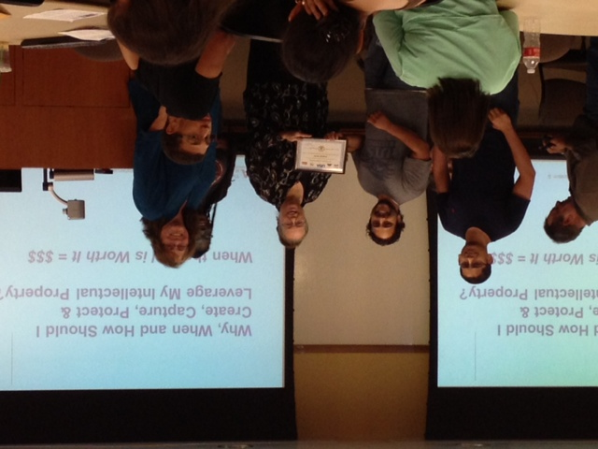
Overall…
It may take you a good while to complete, but a good statement can be considered artwork. Make sure to take the time to refine, so that you represent yourself well!

