Slide 1
Introduction to Pubmed
Gail P. Taylor, Ph.D.
University of Texas at San Antonio
RISE and MARC
Research Training Programs
3/2006
02/22/2008

Slide 2
Supplemental Materials:
Help File from Pubmed:
  http://www.ncbi.nlm.nih.gov/entrez/query/static/help/pmhelp.html#Index
Dalhousie Library Pubmed Tutorial:
  http://www.library.dal.ca/kellogg/guides/pubmed/INTROFRM.HTM

Slide 3
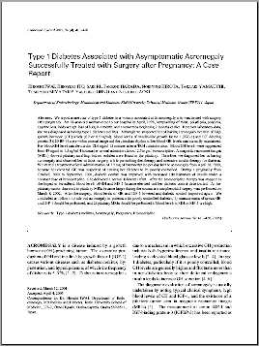
What is a Scientific Paper?
Culmination of scientific research
Report of original scientific findings
Published in scientific journal
Reviewed by peers
Widely available
Forms foundation for your research!

Slide 4
Each Paper can be Identified as a “Reference”
Taylor, G. P., Anderson, R. A., Reginelli, A . D. and Muneoka, K. (1994). FGF-2 induces regeneration of the Chick limb bud. Dev. Biol, 163(1), 282-284 .
Authors, Date, Title, Journal, Volume(issue), pages…

Slide 5
Citations
Within any scientific paper, other papers are cited (also can say “referenced”)
Gives credit for findings, ideas
More citations = more impact on field
Listed in references at end of paper

Slide 6
Why Do I want to Find References?
Record of what is current in field
Record of important “foundation” papers
Helps you to get overview of field
Tells you what articles to download
Can save in reference manager and link to actual pdf files of the original article that you’ve found
Can automatically insert ref into thesis

Slide 7
Historically: Pre-Computer
Biological Abstracts: Monthly publication of large, Indexed, books of abstracts:
  http://www.biosis.org/products/ba/
Science Citation Index: Who referenced what paper, through time…
  http://www.isinet.com/products/citation/sci/
Subscribe to the Journal
Go to Library that owns journal and xerox
Reprint request
Interlibrary loan

Slide 8
Medline
Computerized database
Over 12 million article references
  4300 biomedical journals and magazines
  From over 70 countries
Maintained by National Library of Medicine at the NIH
Can search for references to journal articles by using:
  Text words
  Medical Subject Headings (MeSH); keywords assigned by NLM
  Both…
Commonly covers 1966 - the present

Slide 9
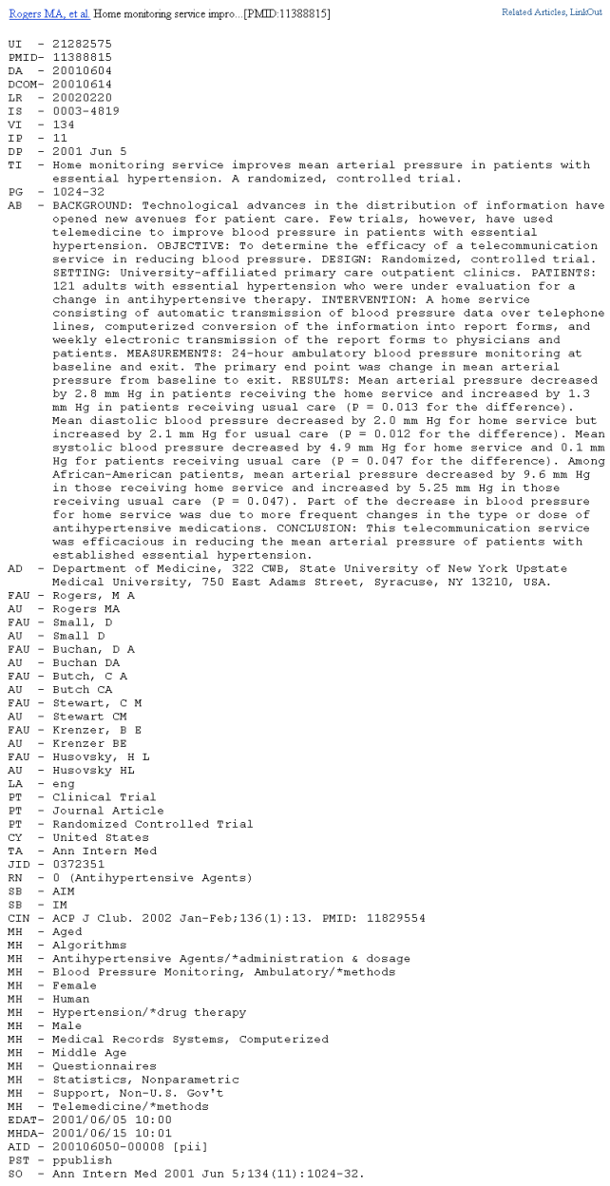
What is a Medline Record?

Slide 10
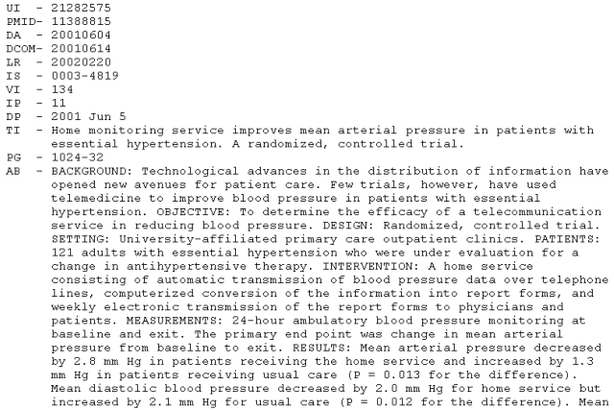
Looking Closer…
Can search any of these fields….
UI - Unique identifier - Medline number
TI - Title
PG - Pages
AB - Abstract

Slide 11
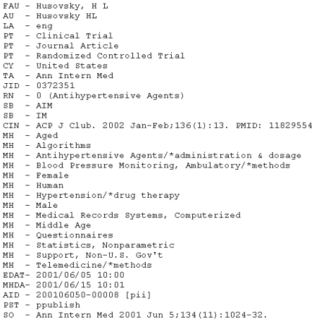
Another Close Look…
AU, FAU - Author
PT - Journal Article
CY - Country
TA - Journal
CIN - Complete ref.
MH - Mesh Headings
    For Organizing…

Slide 12
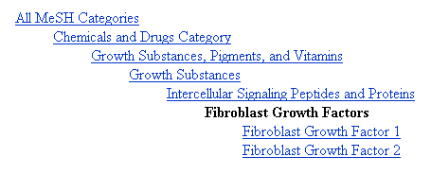
MeSH Headings (MH)
Sorting by content
Like the “keywords” associated with an article
Large “filing cabinet”
  Choose correct heading, get whole folder dumped into your search…
Topic: Fibroblast Growth Factors

Slide 13
How to Access Medline and Get Records?
Devise smart computer programs to search the different fields and mine the Medline database for information…

Slide 14
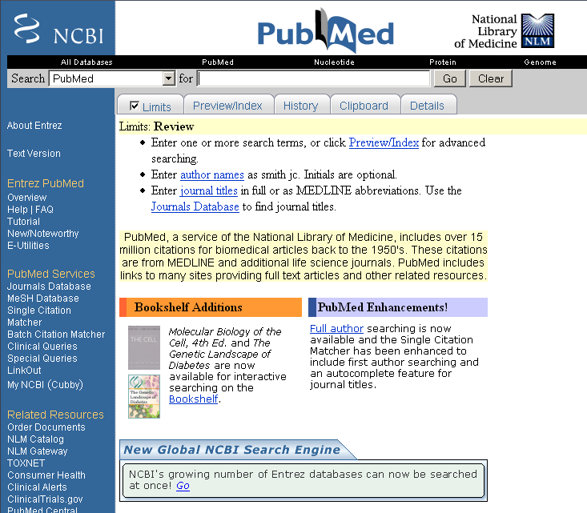
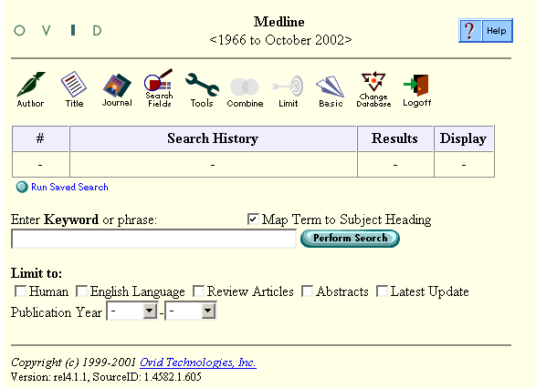
How to Access Medline?
Privately licensed search programs:
  Ovid
    UT System buys
    Access through library Resources
For free, over the Internet:
  PubMed - http://pubmed.gov

Slide 15
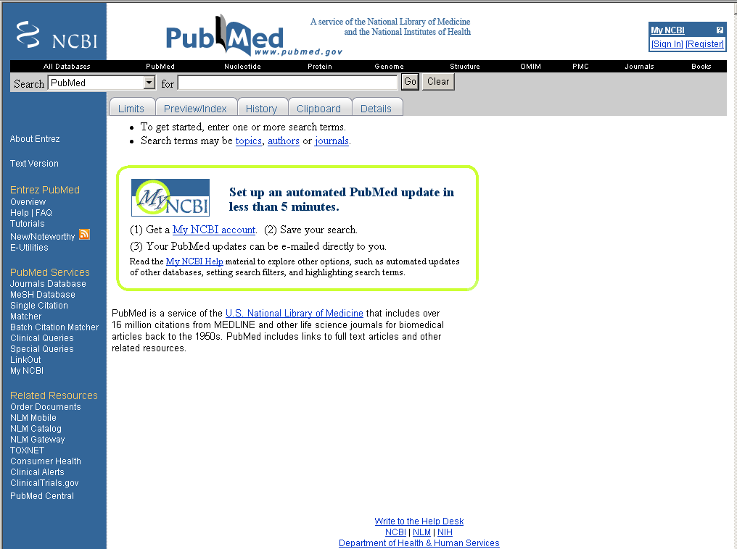
Pubmed

Slide 16
Pubmed -2
Pubmed

Slide 17
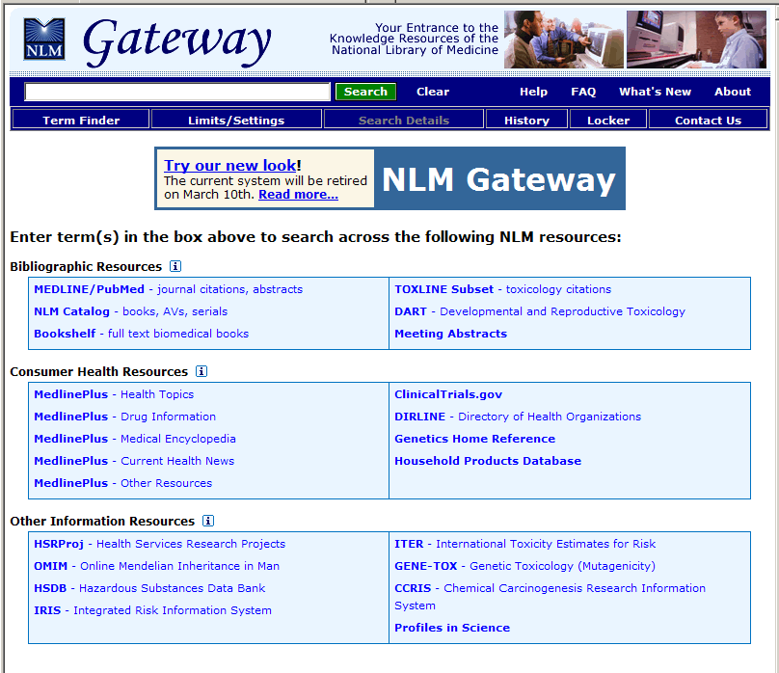
NLM Gateway

Slide 18
Pubmed -3
Pubmed

Slide 19
Pubmed -4
Pubmed

Slide 20
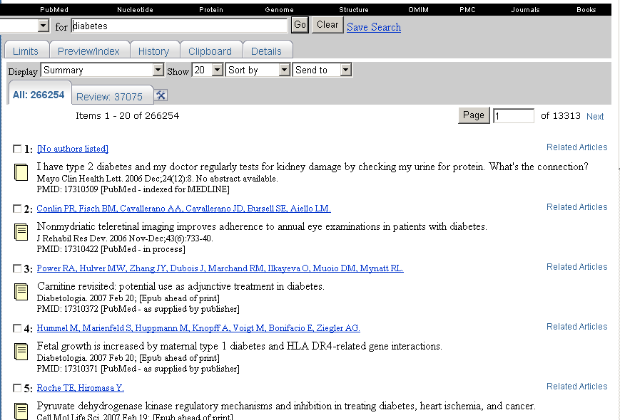
General Search

Slide 21
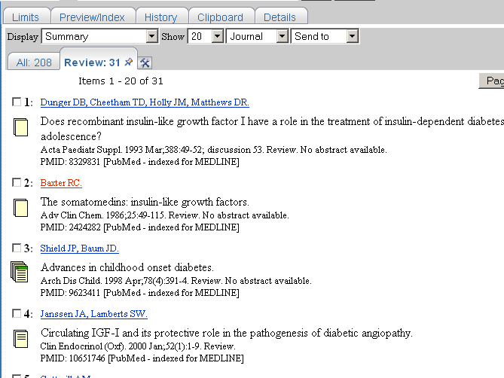
Linking Possibilities

Slide 22




Linking Possibilities cont’d
Not even an abstract
Abstract and sometimes more (Texas might have subscription)
Online Access
Online + Free on Pubmed Central

Slide 23
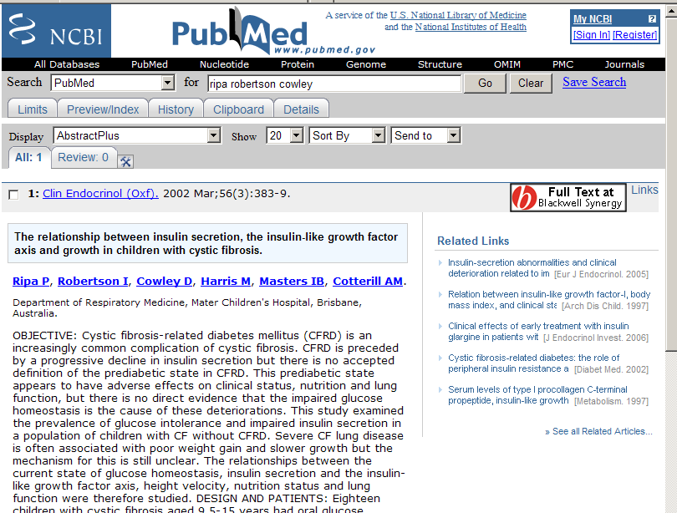
Up close…
The link is to Blackwell-Synergy Online
We do not have a subscription…but they DO give more details on the article.

Slide 24
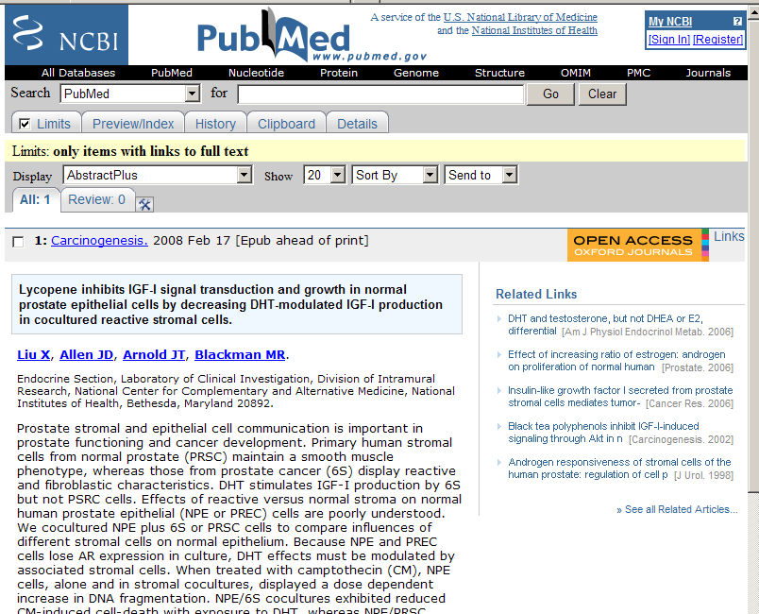
This Article is Available!

Slide 25
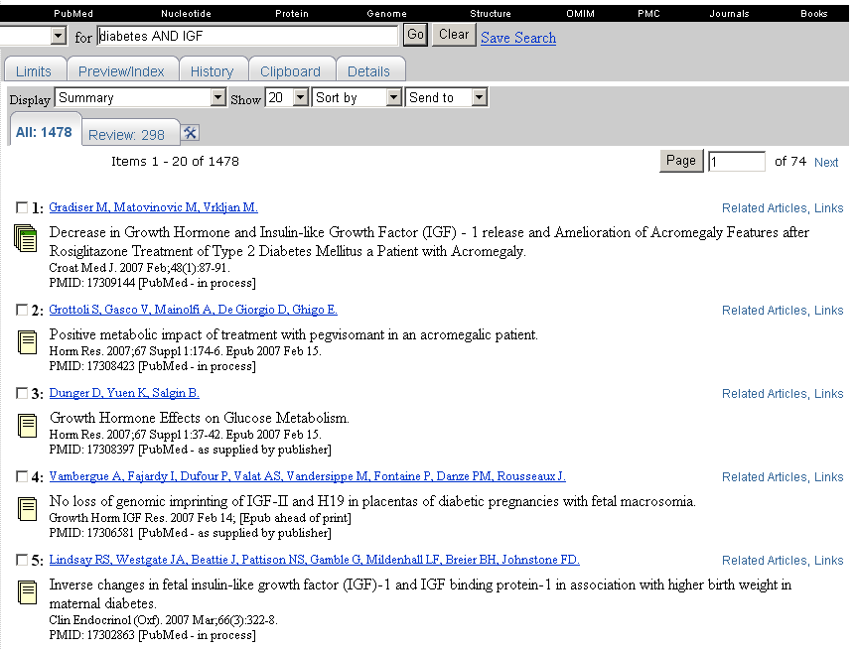
Adding in Boolean Logic
AND – Need to have both words
OR – Need either word
NOT – Cannot contain following word

Slide 26
Author Search….
http://www.nlm.nih.gov/bsd/viewlet/search/author/author.html
http://www.nlm.nih.gov/bsd/viewlet/search/autsub/author_and_subject.html
Can write whole name
Can go with last name, followed by initial
  Taylor g (will get all)
  Taylor GP (will get all GP Taylors….

Slide 27
Pubmed -5
Pubmed

Slide 28
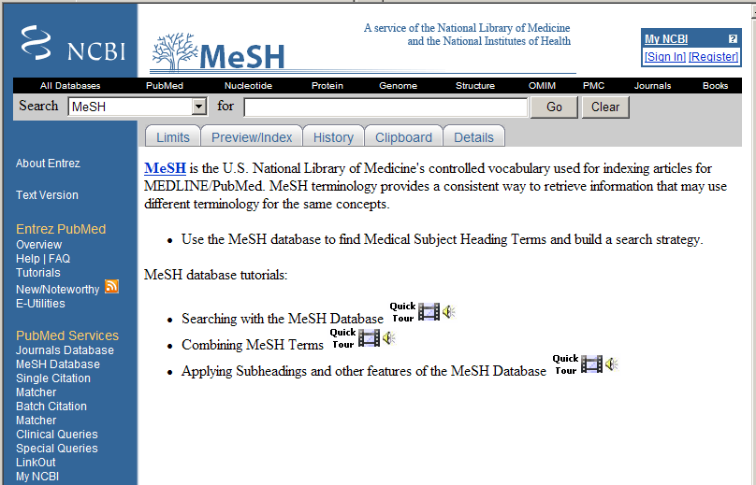
Mesh Search
http://www.nlm.nih.gov/bsd/viewlet/mesh/searching/mesh1.html

Slide 29
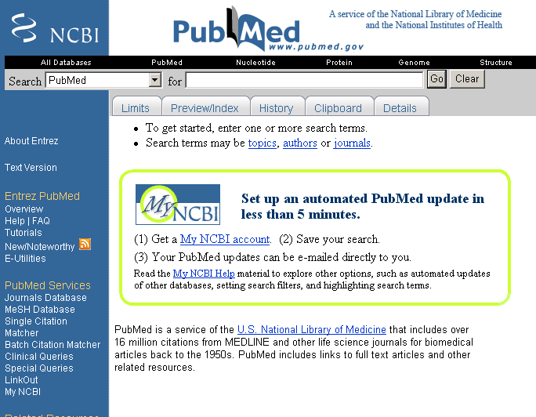
Looking at the Tabs…

Slide 30
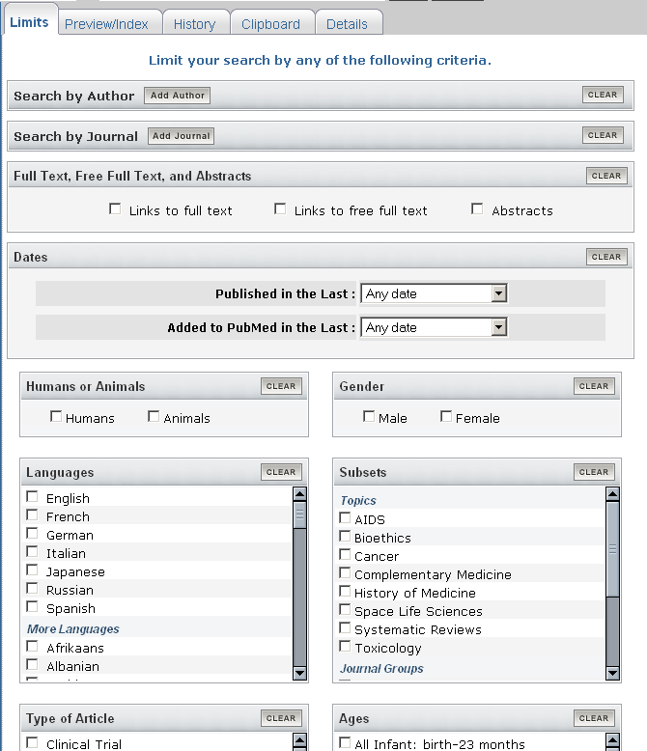
Check out the new Limit Tab…

Slide 31
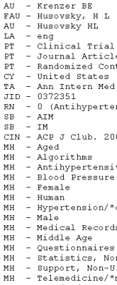
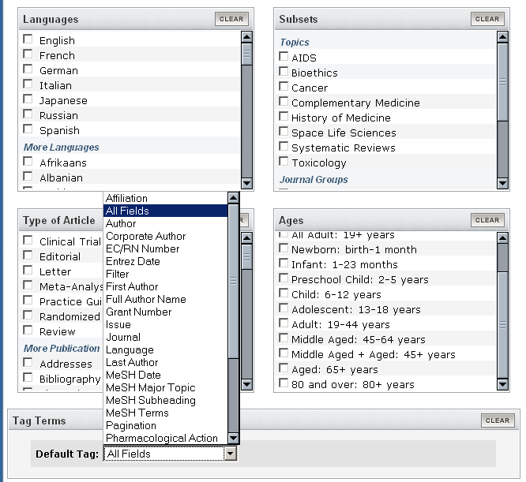
Field Limits…look familiar?
Choose between text or MESH searching…or Keep both!

Slide 32
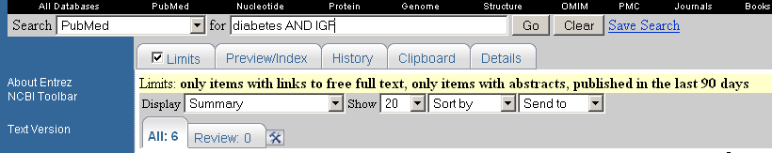
Limited Search

Slide 33
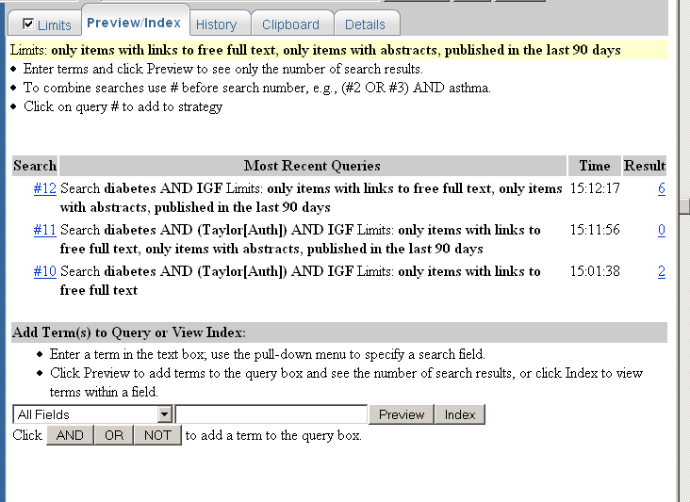
The Preview/Index Tab
Small summary of Results
Shows the total number of references that you’ve gotten…
Here, can also add conditions to your search…

Slide 34
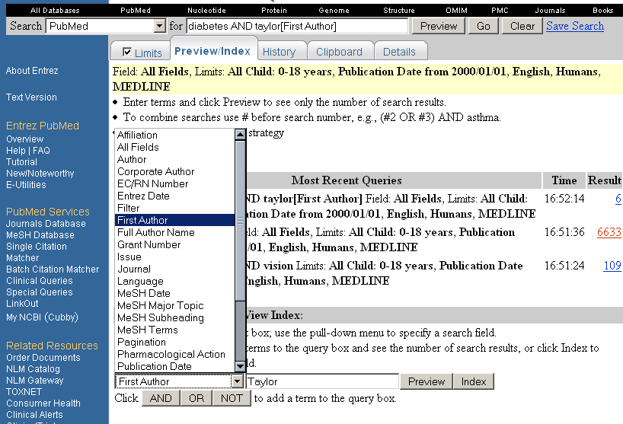
How to Further Limit…

Slide 35
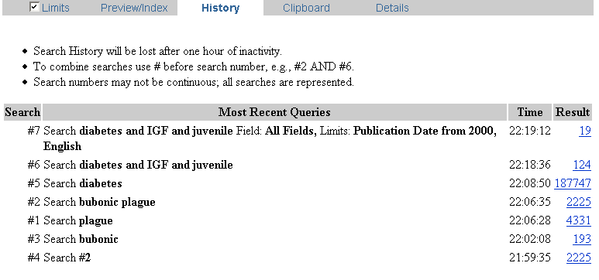
History - What have we done?
Shows searches you have done…
Can also type at top of page and do come refining to most recent search…

Slide 36
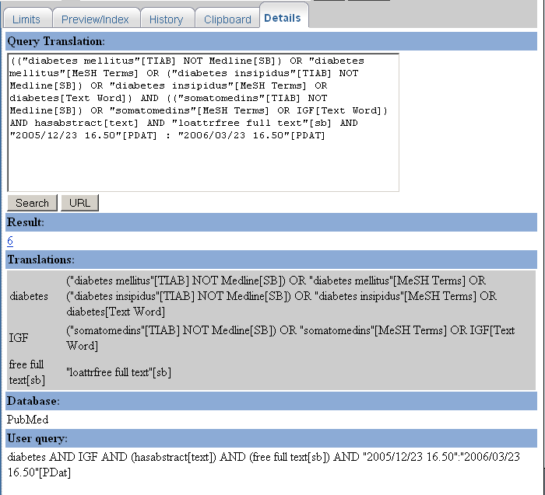
Details - Search Strategy
Can see that some words were from the MeSH, some were text words, the Lang limitation, publish date, etc….

Slide 37
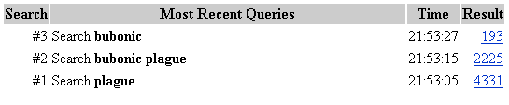
Getting what you ask for…
Why is this happening?
Shouldn’t you get the same number for bubonic and bubonic plague???

Slide 38



Plague Solutions…
No…remember the MeSH, as well as the fact that some references don’t have abstracts…
To look, bring the search to the top.
Go to “Details” to figure things out…

Slide 39
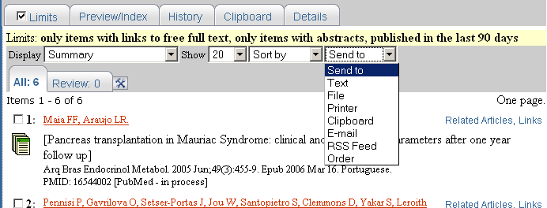
What do I do with Them?
Save your refs as a text file from your browser
Save your refs as a file directly on your computer
  Good when you have a whole list of them
  Display them as Medline, then save
  Import them into Endnote…
Save up to 100, making a personal compilation of desired files, for later download/text/ordering..
Order: Loansome doc allows you to buy a copy of the reference…

Slide 40
Indirect way of Accessing Journals:
Science Direct: http://www.sciencedirect.com/science/journals - HUGE assortment of 1700 scientific journals. Began with Elsevier (huge publisher) and has expanded. Try here first.
Wiley Interscience: http://www3.interscience.wiley.com/cgi-bin/browsepj
Springer Link: http://link.springer-ny.com/forum.htm
Nature Online: http://www.nature.com/nature/ - The entire Nature family of journals.
American Chemical Society Web Editions (Online Journals): http://pubs.acs.org/about.html - Journals published by the American Chemical Society

Slide 41
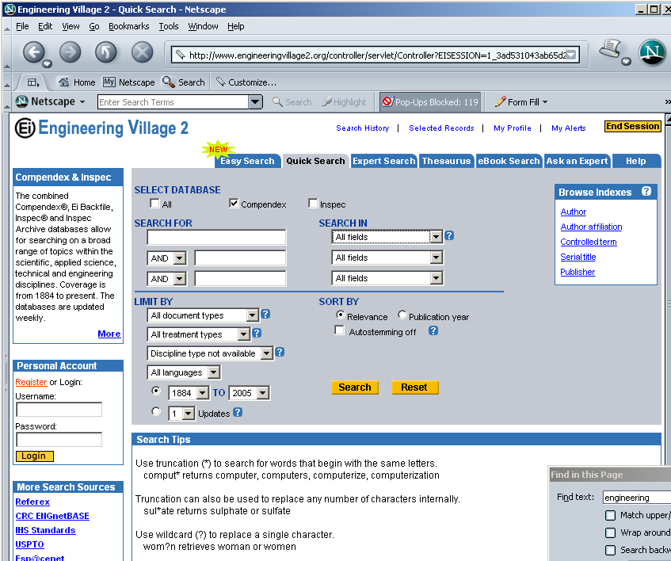
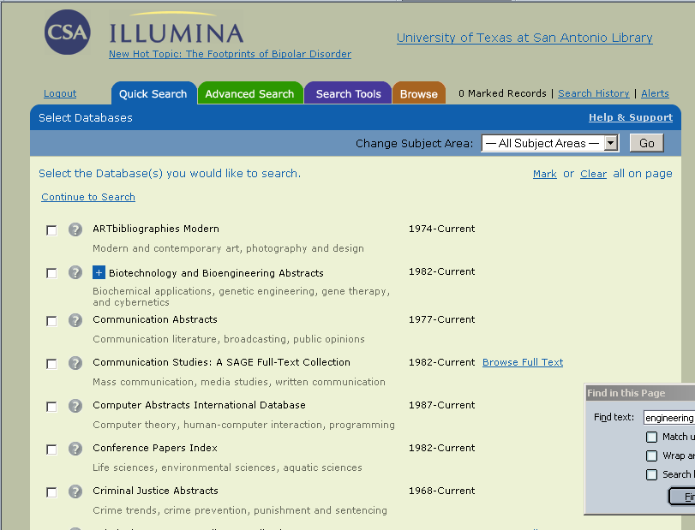
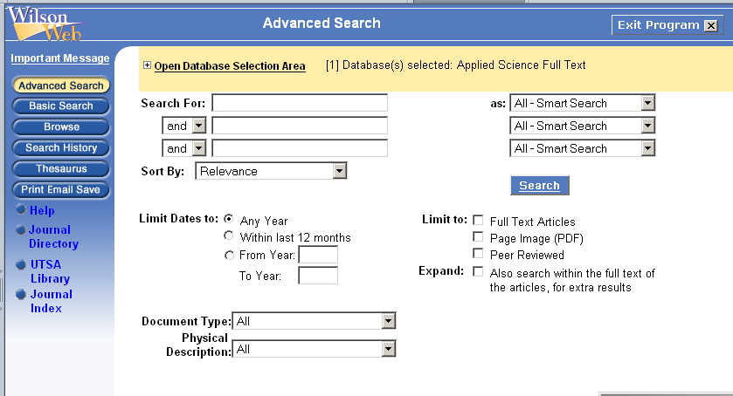
Other Databases
Many are accessible through UTSA’s Library
  http://www.lib.utsa.edu/Databases/List/OnALPHA.html
Bioengineering and Biotechnology Database: Illumina (library owns)
  http://oh1.csa.com/ids70/advanced_search.php?SID=f6ce4d7ae9d1e2ba64a18f571a5bca61
American Institute of Physics Journals:
  http://www.aip.org/ojs/service.html
Applied Science and Technology: Wilsonweb
  http://vnweb.hwwilsonweb.com/hww/shared/shared_main.jhtml;jsessionid=HMKMJJJVBM5JVQA3DIMCFGOADUNGIIV0?_requestid=40909
Engineering Village II (contains Compendex)
  http://www.engineeringvillage2.org/controller/servlet/Controller?CID=quickSearch&database=1
Wiley Interscience:
  http://www3.interscience.wiley.com/cgi-bin/browsepj

Slide 42
Other Interesting Resources
Annual Reviews Online: http://www.annualreviews.org/search/search.asp - Large, general review articles on particular topics. Look and see if there is one that interests you!
Lexis/Nexis: http://web.lexis-nexis.com/universe Popular Press, Newspapers, government publications, biographies, transcripts of shows….

