Slide 1
Postdoctoral Training – Research Careers Development
Gail P. Taylor
Spring 2006
08/2006

Slide 2
Acknowledgements
Beyond the Beakers: SMART Advice for Entering Graduate Programs in the Sciences and Engineering. Gayle R. Slaughter, Ph.D. Baylor College of Medicine/National Science Foundation. 2005
Survival Skills and Ethics Program:
  Beth Fischer
  Michael Zigmond
  www.pitt.edu/~survival
The Leadership Alliance –
Graduate School Guide
http://www.theleadershipalliance.org/pdf/grad_guide.pdf
Tips on Preparing for and Applying to Graduate School
http://www.theleadershipalliance.org/pdf/tips.pdf
Careers in Science and Engineering: A Student Planning Guide to Grad School and Beyond (1996). Committee on Science, Engineering, and Public Policy (COSEPUP) http://books.nap.edu/books/0309053935/html/11.html

Slide 3
Additional Class Expectations
We are adult professionals
Please arrive on time
Please turn off cell phones (minimal, vibrate)

Slide 4
Standard Ph.D. Training Path
Post Bacc
Research
Academics
Academic Postdoc
Government
Postdoc
Government
Undergrad
Studies
Doctoral
Studies
Industry Postdoc
Industry
M.S. Degree
Continue
Education
Other Career
Other

Slide 5
The Postdoc Years

Slide 6
What is a Postdoc?
Following earning Ph.D. degree
Full time period of Apprenticeship or training
  Scientific
  Professional
  Technical skills
Much greater autonomy
Arranged directly with faculty
http://recruit.sciencemag.org/feature/advice/foc_22803.shl

Slide 7
Purpose of Post-doc
Must deepen you as a scientist
Must broaden your background
  ? New field? Might be risky, if all new…
  Make sure you’re –master- of something!
Time for pure benchwork
Build your own reputation
Supervise/teach students
Experiences will carry on to faculty position

Slide 8
Positions Post-docs hold
Postdoctoral Fellow
Research Associates
Clinical Fellows
Misc. Fellows.
Warning! Benefits, stipends, responsibilities may vary!

Slide 9
Must Continue to Educate Yourself!
Lectures
Discussion
Independent reading
Attending conferences
Mentored experiences
  Reviewing papers
  Writing papers
  Writing grants

Slide 10
Peculiarities of Postdocs
Independently in lab, not in a program
Few standards of pay, treatment
Little oversight from institution or community
Conditions vary greatly!
  Self-funded
  Mentor-funded
  Vacation
  Medical
  Family medical
  Rights within organization
National Organization!
  http://www.nationalpostdoc.org/

Slide 11
Value of support group
type
lab & dept colleagues
outside individuals
  other departments
  other institutions
  other professions
activities
discussion of research
  published
  each others
general intellectual
social

Slide 12
The Postdoc Years -2
The Postdoc Years
Biosciences/Physical Sciences
  1-2 postdocs
  2-3 years each
  Gain expertise
  Can be “Holding pattern” for academic positions
  Pursue next position ~1 year prior to end!
Engineering
  Postdoc optional
Prospects?
http://www.nationalpostdoc.org/for_postdocs/postdoc_trends/

Slide 13
Decide how Many Postdocs…and how long!
Many people do two
Second (final) sets you up for professional job
Duration: 2 to 3 years, usually
If 2, are almost immediately looking for next

Slide 14
Developing a plan
make a list of what you must accomplish
add other things you would like to accomplish
determine how long you should stay
make up a realistic time table
consult regularly, revise as necessary

Slide 15
Separating from your advisor
discuss well in advance
  What projects will you take
  What to do with data
  Who will write up unfinished manuscripts
Ask for advice (even if you don’t need it)
Imagine advisor’s perspective (multi-hats)
Remember: maintaining positive relationship very helpful

Slide 16
How much does a Postdoc Make?
Generally set by how much NIH will allow on NRSA grants
1995 – 20K
Now:
  Starting: $ 35,5681
  1 year- $ 37,4762
  2 years- $ 41,7963
  3 years- $ 43,4284
  4 years- $ 45,0485
  5 years- $ 46,9926
  6 years- $ 48,8527
  more $ 51,036
http://grants.nih.gov/grants/guide/notice-files/NOT-OD-05-032.html

Slide 17
Where are Positions Advertised?
Commonly Word of Mouth
Individual Web Sites:
  http://www.postdocs.org/
  http://www.findapostdoc.com/firstmain.asp
Journals:
  Chronicle of Higher Education
    http://chronicle.com/
  Science Magazine
    http://sciencecareers.sciencemag.org/
  Nature
    http://www.nature.com/naturejobs/index.html

Slide 18
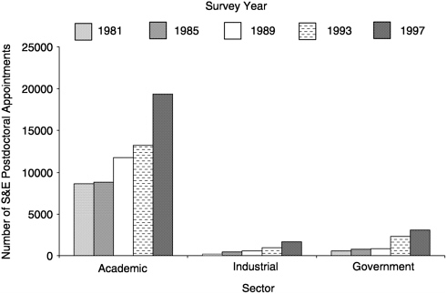
Postdoc Breakdown
~52,000 total 72% in academics

Slide 19
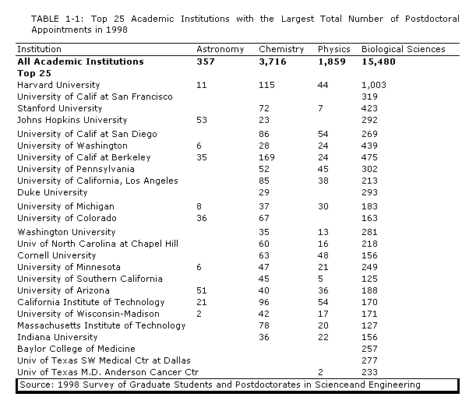
Where are the Postdocs?

Slide 20
Charting your Course
Fast Track: charting the course of your postdoc http://www.nature.com/cgi-taf/DynaPage.taf?file=/nature/journal/v431/n7012/full/nj7012-1126a_fs.html
Individual Development Plan - FASEB has helped to come up with individual development plans for Post-docs
http://www.faseb.org/opa/ppp/educ/idp.html
Annual review for Post-doc:
http://www.faseb.org/opa/ppp/educ/idp_annrev.html

Slide 21
Additional Types of Postdoc Experiences
Teaching Postdocs
http://recruit.sciencemag.org/feature/advice/nw0102.shl ...

Slide 22
Postdoc Resources
Science Nextwave Postdoc Network
  California Comes Through: http://nextwave.sciencemag.org/cgi/content/full/2005/01/06/9
  NSF Workshop on the Postdoc Experience Calls for "Culture Change"
  http://nextwave.sciencemag.org/cgi/content/full/2004/12/02/7
  Charting the course of your Postdoc: http://www.nature.com/cgi-taf/DynaPage.taf?file=/nature/journal/v431/n7012/full/nj7012-1126a_fs.html

