Slide 1
Powerful Presentations II
- Speaking Strategies, Practice and Presentation
Dr. Gail P. Taylor
Coordinator, RISE and MARC
Graduate Professional Development
University of Texas at San Antonio
08/2006

Slide 2
Acknowledgements
Beth Fischer & Michael Zigmond University of Pittsburgh Survival Skills and Ethics Program
C. Stuart – How to be an Effective Speaker
L. Schloff and M. Yudkin – Smart Speaking
C. Turk
M.H. Briscoe
Toastmasters
Notes:
1.5 hours
Questions

Slide 3
General – Content Planning
Must be interesting, easy to view, and understandable
  Focus material to audience
  Adjust material to facilities
  Create a strong foundation
Develop effective visual material
  Don’t present too much material
  Written
  Figures/Images
Develop logical/orderly presentation
  Clearly tell good story
  Develop transitions
  Avoid hopping back to prior slides
Anticipate Questions

Slide 4
How Do I Speak Well?
Stages of Development
“Four P’s”
Plan Content
Prepare
  Slides
  Speaking Strategies
Practice
Present

Slide 5
Review- Who Cares if You Speak Well?
Your audience does. It wants:
  Positive experience
  Worthwhile use of time
You do. It will help you to:
  Achieve your goals
  Leave audience with positive impression
    Your material
    You
Notes:
Think back to best speaker whom you have seen…what did they do?

Slide 6
Positive Impressions
You should lead others to conclude that you are:
  Enthusiastic
  Vital
  Sincere
  Competent
  Knowledgeable
  Trustworthy
  Approachable
  Confident
  Professional
  Inspiring

Slide 7
To Give a Positive Impression, You MUST Recognize Circumstances Unique to Speaking

Slide 8
Speaking vs Writing
You can be seen and heard (non-verbal)
  You and audience interact
You must capture and maintain attention
  Must tailor materials to audience
  Must minimize distractions
Your message must be presented clearly
  Low repetition…no rewind…

Slide 9
Seen and Heard –
It IS (almost) all about you
Most important for response:
  Your information?
  You yourself?
Impact of You…
  Words
  Visual impression
    Body Language
    Dress
    Hygiene
  Voice
7%
55%
38%

Slide 10
Words to Use
Content:
  Make accurate, complete statements
  Pronounce project-related words correctly
Use professional vocabulary
  Use proper terms (load gel)
  Language: Uh, You Know, OK, Right
Don’t speak over audience’s head
  Avoid Jargon/Acronyms
  Explain abbreviations

Slide 11
Attitude/Voice
Sound calm
  Continue after errors (don’t draw attn)
Use “heightened conversation” voice
  Personal, Warm
  Vivid
  Loudly enough
  Articulate
  Vary your tone - raise and lower voice for variety
Don’t rush

Slide 12
Non-Verbal Communication
*Exude enthusiasm, sincerity, vitality*
  You like research, and yours in particular
Look calm, in control
Physical- mannerisms, posture
  Professional dress
  Hide nervousness
  Hands composed but use gestures
  Roving eye contact
  Control laser pointer

Slide 13
Practice - Nonverbal Cues
I’ll get it for you…
Notes:
Debbie Cassil

Slide 14
Other Things to Consider
Nervousness curve
How to capture and maintain attention

Slide 15
More about Nervousness
It fades after initial time
Will always at least slightly be there
Usually audience can’t tell
Mid-levels can help performance
Performance
Nervousness

Slide 16
Capturing and Maintaining Attention –
Can Control:
  When you start
  Your projected mood
  Can’t understand (accent)
  Behavioral distractions
    (“uh…,” coins, movement)
    Tone – avoid monotony
    Don’t read off the screen
  Level of clarity
    Volume (sometimes)
    Level of difficulty
    Smoothness of transitions
    Pace – reasonable
    Organization – don’t lose
    Pause after new figure
  How you answer questions
Can’t Control
  Can’t see
  Background noise
  Questions about what you are saying
  Natural timing issues
  Varied backgrounds

Slide 17
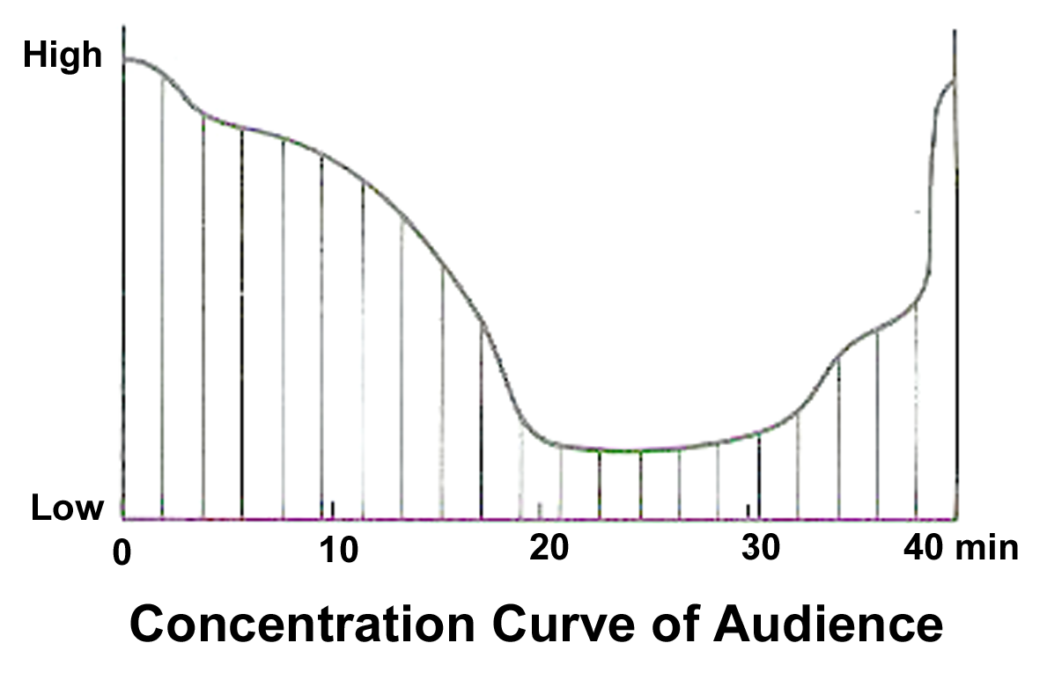
Maintaining Attention – Normal Attention Patterns
Attention normally varies over time
Make the low times particularly stimulating
Try to regain attention

Slide 18
Catching them! – Introduction
Pre-opening (catch attention)
  Can you hear me? Thank you for inviting me.
Brief Introduction – Name, Title
  Conversational; where/how work performed
  What I will show/what I did
Humor (optional)
Background/overview of field (15- 1 to 2 slides; 60-more)
  Length/depth/focus determined by audience
  Slide of model if have
Objectives/Experiments - Bulleted (1 slide)
Notes:
Brief Opening- this represents work that I did ………………
Don’t give away results

Slide 19
Part III - Practicing

Slide 20
Practice- Effective Rehearsal
Start early
  Can deal with behavioral distractions
  Can assess impression/body language
  Can learn how to pronounce words
  Time to alter presentation
Multiple times
Out loud
With microphone
Whole talk
In front of people
Recorded (audio or video)
Rehearse verbal responses to questions
Now, refine and do again
Good for confidence

Slide 21
Practice- Create Final Notes
“Confidence Cards”
3x5 cards good
Number them
1 card per slide recommended
Briefly summarize main points for each visual
Write out whole first sentence of talk
Key phrases
Reminders about transitions

Slide 22
Part IV - Presenting

Slide 23
Present - Preparation
24 Hours – 1 Hour
  Presentation in hands and safe
  Don’t indulge in excesses
  Have appropriate clothing ready (not jeans)
  Know about laser pointer access
  Get enough sleep
  Travel arrangements solidified
    On time for airport
    Enough gas in car
Notes:
Trevor Archer – Histone phosphorylation and histone remodelling

Slide 24
Present – Preparation cont’d
½ hour until start
  Get your AV working
  Get water or drink!
  Assess size/shape of room
  Learn equipment, lights, etc.
  Mentally practice
  Get centered/calm
  Remember things that you require
    Notecards
    Pointer
    Something to drink
    Pen/pad for ideas, contact info
  Sit quietly near front, until after introduction
Notes:
Trevor Archer – Histone phosphorylation and histone remodelling

Slide 25
Present- Doing it
Be confident with your preparation
Take deep breath
Exude enthusiasm, sincerity, vitality
Remember to make eye contact
Control nervousness
Keep in mind “How to Speak”

Slide 26
Answering Questions
Give ground rules of when
Find out who will be controlling question period (generally you)
Give alert/interested body language
Control with voice, eyes, when monopolized
Make sure that you understand question
Re-state the question
Pause to think
Answer concisely
Plant a colleague

Slide 27
Question Don’ts
Get defensive
Rush to answer (understand)
Bluff (admit when you don’t know)
Embarrass questioner
Get into a long dialogue with one person (break eye contact)

Slide 28
Identifying and Answering Dangerous Questions
Hypothetical
  Avoid doomsday
Leading Questions
  two statements: “I know that you’ve found it difficult being only woman in the group, but do you feel that you’ve achieved much this first year.”
  Refute first statement!
Off the record
  Nothing is
Yes or No
  Don’t do it; give full picture
No win
  “Why did it fail? Your division director or staff?”
  I prefer not to see it that way…

Slide 29
Final Summary
1. Plan
2. Prepare
3. Practice
4. Present
Do all of these early and you should be successful!

Slide 30

Stimulating the Brain
By Gail P. Taylor

Slide 31
How to How to Stimulate the Brain
Stimulating the brain is easy
Anesthetize rat
Put rat in stereotaxic device
Put electrode into brain

Slide 32
Results
Increased LTP
Stereotypical Behaviors
The rats all behaved similarly. They would jump up and down three times, turn around, clean their fur, then roll over. Three died. We subsequently reduced the level fo stimulation and found decreased morbidity of subjects. Those who lived had a tendancy towards cross-eyedness, but we do not attribute this regretable side-effect to the experimental treatment. We believe that this system could easily be altered to be used in humans having trouble jumping up and down.

