Slide 1
Stimulating the Brain
By Gail P. Taylor

Slide 2
How to How to Stimulate the Brain
Stimulating the brain is easy
Anesthetize rat
Put rat in stereotaxic device
Put electrode into brain

Slide 3
Results
Increased LTP
Stereotypical Behaviors
The rats all behaved similarly. They would jump up and down three times, turn around, clean their fur, then roll over. Three died. We subsequently reduced the level fo stimulation and found a decreased morbidity of subjects. Those who lived had a tendancy towards cross-eyedness, but we do not attribute this regretable side-effect to the experimental treatment. We believe that this system could easily be altered to be used in humans having trouble jumping up and down.

Slide 4
Powerful Oral Presentations
Dr. Gail P. Taylor Assoc. Director of STEM Initiatives
Asst PD MBRS-RISE & MARC U*STAR
University of Texas at San Antonio

Slide 5
Acknowledgements
Beth Fischer & Michael Zigmond University of Pittsburgh Survival Skills and Ethics Program
C. Stuart – How to be an Effective Speaker
L. Schloff and M. Yudkin – Smart Speaking
C. Turk
M.H. Briscoe
Toastmasters
Notes:
1.5 hours
Questions

Slide 6
Who Cares if You Speak Well?
Your audience
You (should)!
Your talk represents your material AND you
Notes:
Think back to best speaker whom you have seen…what did they do?

Slide 7
The “Good Thing”
Some folks are “naturals”
All can learn how to present well
Skills can be practiced
Presentations can be carefully crafted

Slide 8
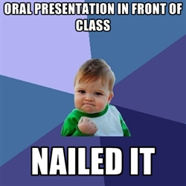
Goals:
Speak well!
Sell/Promote yourself and material
Engage the Audience
Teach, motivate, persuade, entertain
Don’t lose your audience

Slide 9
The “You” Factors

Slide 10
Selling Yourself
Control others’ impression of you
Create strong positive response
Correlated with
School admissions
Successful interviews
Career success
Personal success

Slide 11
Is Selling Yourself Important?

Slide 12
How do I influence impressions?
Get them to focus positively on:
You
Your material
Your presentation

Slide 13
The Importance of YOU
What is more important?
Your information?
You yourself?
Impact of You…
Words (7%)
Visual impression (body language) (55%)
Voice (38%)

Slide 14
Personally - Help Others Conclude…
…that you are:
Intelligent
Confident
Well-prepared
Interested in presentation
Engaged with audience
Professional
Inspiring
HOW CAN YOU DO THIS?
Notes:
Debbie Cassil

Slide 15
What can you do?
PREPARE
PRACTICE
Recognize characteristics of speaking
Control your voice
Have good posture/movement
“Act” confident/Hide nervousness
Dress for the Presentation
KNOW your material and background
Use Professional Vocab!
Avoid Distractors…

Slide 16
Speaking 101
You can be seen and heard (non-verbal)
You and audience interact
You must capture and maintain attention
Less specific audience than journal
Your message must be presented clearly
No re-reading

Slide 17
Voice-Related Issues
Tone:
Excited (Answer phone during argument)
Heightened tone to avoid monotony
Volume:
Grow out of too quiet
Don’t drop off at end of sentences
Clarity:
Be sure to pronounce
Notes:
Debbie Cassil

Slide 18
Voice-Related Issues (cont)
Minimize vocal distractions
“Uh”
Actually
Perpetual throat clearing
Watch talking speed
Pronounce words correctly
If you have an accent:
Practice pronunciations
Slow down
Notes:
Debbie Cassil

Slide 19
Posture/Movement
Be relaxed
Avoid excess movement
Don’t fidget/twist fingers
Don’t fiddle with rings, etc.
Face audience (glance at slides)
Roving eye contact
Stand on both feet
Don’t lean
Arms relaxed with movement
Avoid crossed (closed off)

Slide 20
Control Nervousness
T/F – It is bad to be nervous during a presentation.

Slide 21
Practice - Nervousness versus Performance
Medium level of nervousness is beneficial
Try to develop a balance
Performance
Nervousness

Slide 22
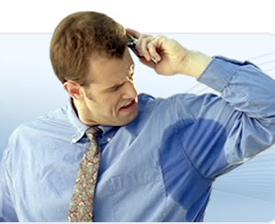
Overcoming Nervousness
It’s okay if not paralyzing
Practice – It fades with time
Usually Audience can’t tell
If in voice, keep going
If shaking – laser point from hip
If sweating
Antiperspirant
Keep arms down
Wear dark colors

Slide 23
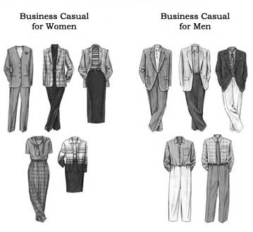
Dress for Presentation
Clothing can convey “professional”
People take you seriously
Suit? – Check out Academic Professional
At least Academic/Business casual
Your own style
Not club clothes
Tight
Cleavage
Fluorescent
https://www.google.com/url?sa=t&rct=j&q=&esrc=s&source=web&cd=2&cad=rja&uact=8&ved=0CCUQFjABahUKEwjH-vXfmO3HAhXLgJIKHeXxAqM&url=https%3A%2F%2Fmcnair.wsu.edu%2Fwp-content%2Fuploads%2Fsites%2F169%2F2014%2F08%2Fdress-code-guide-for-web.pdf&usg=AFQjCNHEFKtrzFZQwFKQhY7Q4mRkC6nfEQ&bvm=bv.102022582,d.aWw

Slide 24
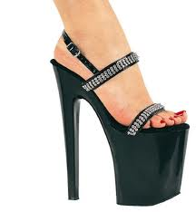
Dress 2 – The shoes
Professional
Must stand for hour
Broken in
Avoid running/basketball shoes
Heals, but not extremely high

Slide 25
Grooming
Look put together
Look like you have self-respect
Look professional
Hair washed (please), brushed/styled
Can do a bit of Grad Student Scruff..but be neat about it…
Not club make-up
Professional, not sexy

Slide 26
Focus on Content

Slide 27
Review Instructions
Saves lots of time
Examine rubric (and work backwards)
Determines approach
Sets duration
Headings?
Required Sections?
Definition, Intro/history, health impact, current application, future directions, conclusions, Questions?
Introduction/background, Gap/purpose, hypothesis, methods, results, conclusions/impact, future directions, acknowledgements, Questions?

Slide 28
Develop Content
Tailor to audience
How long?
Plan written material
Create/develop good visuals
Know each slide’s purpose
Develop transitions
Make solid conclusions
Anticipate questions

Slide 29
Assess Audience
Who is in your audience?
Faculty
Graduate students
Undergraduate students
Jr. High or HS students
Laymen
Potential donors
What do they know (adjust introduction/depth)?
How large is the audience?
What is your goal with them?
What do they want?
Notes:
“Needs” is what you NEED to have a good talk
Seeing you uncomfortable will make them uncomfortable
You note that I use the word audience….well this is a performance
Laymen- don’t even care that much about numbers.

Slide 30
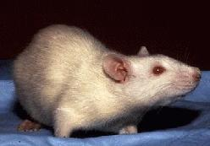
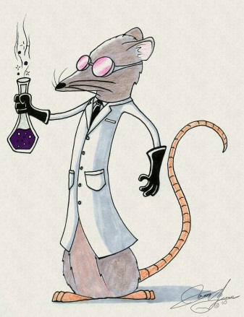
Audience Determines
Formality/dress
Content
Amount of introduction
Depth of information
Goals of presentation
Presentation style
Animations
Visuals/images
Backgrounds

Slide 31
How long is your talk?
Roughly 1 slide per minute
Is question time included in total time?
15 min- 12 slides
 | 15 min
Introduction | 2-4
Internal sections | 7
Closing | 1
Questions | 3-5

Slide 32
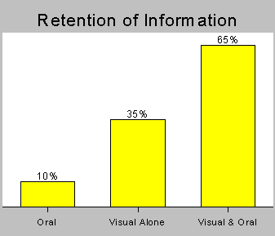
Retention and Modality
(Source: U.S. Department of Labor)

Slide 33
Slides - Consistency
Be consistent
Background
Headings
Font Sizes
Colors
Styles
Units on comparable figures/tables

Slide 34
Good Slide Practices - Text
GOAL: do not lose attention
Large Text (>20 pt)
Phrases, not sentences
Six lines, six words each (avoid wrap)
Use as cues for you
Prevents viewers from reading
Definitions can be longer (but memorize)
ALL IMPORTANT POINTS AS TEXT
Include references

Slide 35
Good Slide Practices - Images
Picture = 1000 words
Must add to story and not distract
How much non-relevant stuff?
Visual can stand alone or accompany text
Use figures rather than tables
Age appropriate
Not too gruesome
Ex – breast cancer pic at beginning
No animals

Slide 36
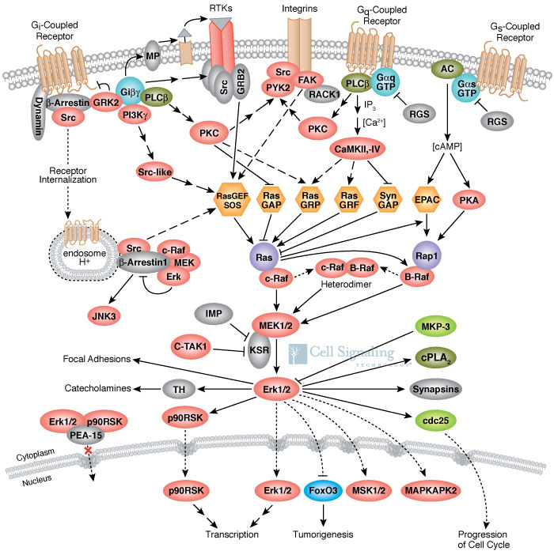
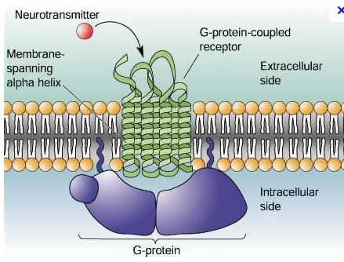
Images - Cont
Beware of text size
Include only needed info
Choose best images

Slide 39
Bad Color Combinations
Green on Red | Red on Green
Brown on Green | Green on Brown
Blue on Black | Black on Blue
Yellow on white | White on Yellow
Blue or blue-green on Purple | Purple on Blue or Blue-green
Multicolors | Multicolors
Modified from: Effective PowerPoint presentations
Aruna Viswadoss, Ph.D.
aruna@virginia.edu

Slide 40
Templates
Automatically control size, background, and color combinations
Should be:
Clear and professional
Not too busy
Relevant to subject matter
Darker in color
Minimally animated
Available in Office defaults
Can also be obtained on the WWW
Notes:
In selecting a template, remember to:
Avoid unnecessary bells and whistles
Avoid unnecessary animations, flashing colors, sounds, distractions
Avoid last minute changes that may counter design or presentation DO’s

Slide 41
Animations
Animations/Videos
Don’t do line by line appearance
Consider audience w Prezi
Should add, not distract
Avoid animated background
Youtube
Don’t replace presentation
Videos should be very short
Should download if possible
Beware – may misfire…
Videos not embedded (must bring)
Internet might not work

Slide 42
Know approach to each slide
Must address ALL that is on slide
How many points on slide?
How approach slide?
You control interaction w slide
You prevent distraction

Slide 43
Approaches
1
4
2
6
7
5
3

Slide 44
Cover ALL on Slide

Slide 45
Content Summary
Pre-opening (catch attention)
Can you hear me? Thank you for inviting me.
Brief Introduction – Title Slide
Name, Title
Conversational; where/how work performed
What I will show/what I did
Body – variable
Audience
Format
Closing
Questions
Notes:
Brief Opening- this represents work that I did ………………
Don’t give away results

Slide 46
Have Strong Transitions
Know opening sentence
Between each slide
Between internal and closing
Develop strong closing
Can I tell you anything else about project?
I’ll be happy to answer questions at this time.
Notes:
Brief Opening- this represents work that I did ………………
Don’t give away results

Slide 47
Prepared Answers to Questions
Remember practiced questions
Research answer
Might modify presentation
Anticipate (may have slide)
Write out responses to practice

Slide 48
Making the Presentation

Slide 49
Remember Goals
Be impressive as possible (sell!)
Engage the audience
Teach, motivate, persuade, entertain
Don’t lose your audience

Slide 50
Create Final Notes
“Confidence Cards”
3x5 cards good
Number them – one card per slide
Write out whole first sentence of talk
Briefly summarize main points for each visual
Key phrases
Reminders about transitions

Slide 51
Delivery Hints
Don’t read off the screen!
Very slowly and clearly
Relaxed, conversational, professional
*Exude enthusiasm, sincerity, vitality*
Pause after new figure presented
Roving eye contact
Hands composed but use gestures
Continue after errors (don’t draw attn)
Avoid distractions
uh…
Physical- mannerisms, posture
Control your laser pointer!

Slide 52
Effective Rehearsal
Out loud (whole talk)
With microphone (if pertinent)
Whole talk
Time it! Don’t go too long!
In front of people
Various education levels/background)
Recorded (audio or video)
Rehearse verbal responses to questions
Now, refine and do again
Good for confidence

Slide 53
Just prior – Half hour
Get your AV working
Remember things that you require
Notecards
Pointer
Something to drink
Pen/pad for ideas, contact info
Get water or drink (long presentations)
Learn equipment, lights, etc.
Get centered/calm
Sit quietly near front, until introduced
Notes:
Trevor Archer – Histone phosphorylation and histone remodelling

Slide 54
Doing it
Be confident with your preparation
Take deep breath
Exude enthusiasm, sincerity, vitality
Remember to make eye contact
Control nervousness
Keep in mind “How to Speak”

Slide 55
Answering Questions
Give ground rules of when
Find out who will be controlling question period (generally you)
Give alert/interested body language
Make sure that you understand question
Re-state the question
Pause to think
Answer concisely

Slide 56
Question Don’ts
Get defensive
Rush to answer (understand)
Bluff (admit when you don’t know)
Embarrass questioner
Get into a long dialogue with one person (break eye contact)

Slide 57
Identifying and Answering Dangerous Questions
Hypothetical
Avoid doomsday
Leading Questions
two statements: “I know that you’ve found it difficult being only woman in the group, but do you feel that you’ve achieved much this first year.”
Refute first statement!
Off the record
Nothing is
Yes or No
Don’t do it; give full picture
No win
“Why did it fail? Your division director or staff?”
I prefer not to see it that way…

Slide 58
You’re Done!
Walk away confident that you did your best!!

