Slide 1
Mentoring
Gail P. Taylor
RISE Program
Survival Skills for Graduate Students
05/25/2007

Slide 2
Acknowledgements
Mentoring- How to develop successful mentor behaviors. Gorden F. Shea Crisp Publications, Inc. 2002. http://Crisplearning.com
The Art of Mentoring: Lead, follow and get out of the way. Shirley Peddy. Bullion Books, 2001.
National Academy of Sciences: Adviser, Teacher, Role Model, Friend: On Being a Mentor to Students in Science and Engineering http://www.nap.edu/readingroom/books/mentor

Slide 3
Exercise:
Who helped you to have an Aha! Experience that give insight into yourself or a circumstance…?
Who said something or gave you a quote that continues to influence your thinking or behavior?
Who helped you to uncover a part of yourself that had lain dormant and unrecognized?

Slide 4
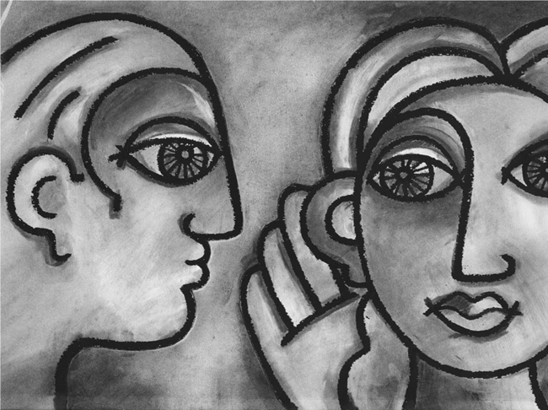
This person likely was a mentor to you!

Slide 5
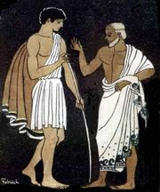
What is a Mentor?
From Homer’s Odyssey
Trusted friend of Odysseus
Was really disguised goddess Athena
Helped run Odysseus’ household
Advised son Telemachus when Odysseus was wandering around on the Odyssey…
Notes:
Son: Took care of Telemachus and the household while odysseus was gone for 10 years.

Slide 6
Definitions
Mentor: a wise and trusted advisor our counselor – encourages human growth
Mentoring: the transfer and transmission of experience, viewpoints and expertise from one person to another
Generally touches personal and professional life
Helps the person to solve their problems or attain their goals
Can be one-time contact, or LT relationship, formal or informal

Slide 7
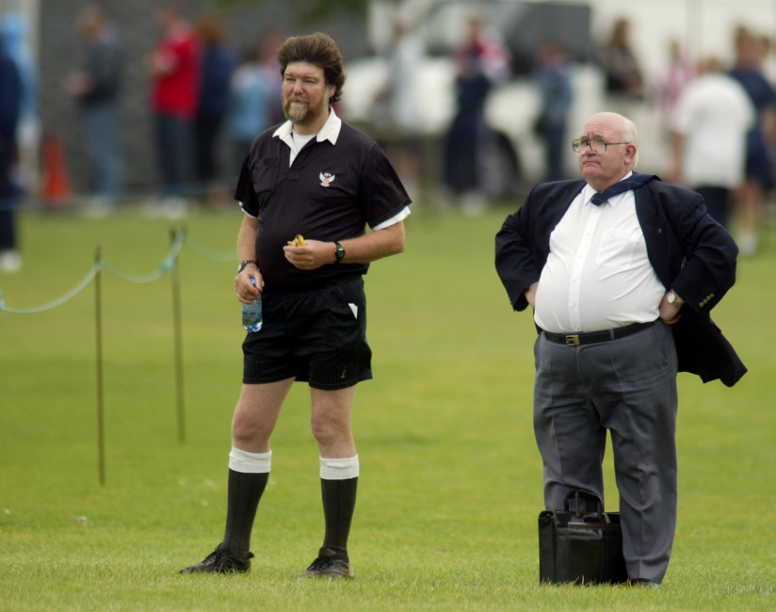
Where Mentoring is Important
Traditionally, on the Job.
It is also throughout education, sports, career and hobbies!
Every major change in your life…
Undergraduate/Graduate Students
Post-doctoral
Junior faculty
Management

Slide 8
Who Can Mentor You?
Someone who has successfully been there, done that...

Slide 9
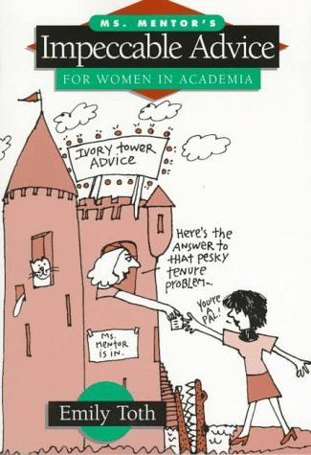
Can Sometimes be
“By the Book!”

Slide 10

Or “Buy the CD….”

Slide 11

Usually more personal, with someone who has
gone where you want to go…and wants to help you!

Slide 12

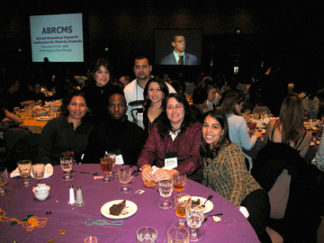
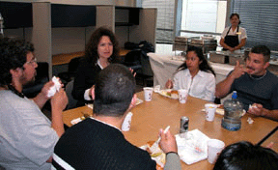
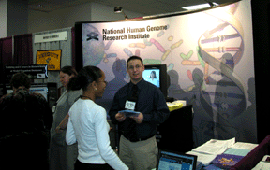
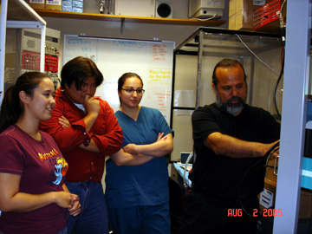


In the RISE/MARC Programs?

Slide 13
“Mentoring” in Academic Education
Advisers vs Mentors
An Adviser:
  Helps the student to acquire and develop the skills needed by independent researchers in their scientific field.
  Guides the student's research project by:
    Communicating effectively with the student
    Reviewing and providing regular feedback on the student's progress
Mentor is often interchanged with Adviser
  An Adviser is not always a mentor
  May not be personally involved.
  A “mentor” adviser is not necessarily the main mentor…

Slide 14
A fundamental difference between a mentor and an adviser is that mentoring is more than advising; mentoring is a personal as well as a professional relationship. An adviser might or might not be a mentor, depending on the quality of the relationship. . . Everyone benefits from having multiple mentors of diverse talents, ages, and personalities.“
National Academy of Sciences: Adviser, Teacher, Role Model, Friend: On Being a Mentor to Students in Science and Engineering p. 15 http://www.nap.edu/readingroom/books/mentor

Slide 15
Types of Mentoring Relationships
Structured/Short term
  New employees, new grad students
Structured/Long term
  Groomed to take over position, master a trade or craft
Informal/Short term
  Off the cuff, brief contact, strong intervention
Informal/Long term
  “friendship” mentoring, available to listen and advise

Slide 16
Match Up RISE/MARC Mentoring Activities!
Structured/Short
Structured/Long
Informal/Short
Informal/Long
Research advisor/mentor
Other students, lab members or neighboring researchers
Formal or informal visit to PD or Asst PDs
Coursework
Seminars/lunch w speaker
Conference interactions
Others?

Slide 17
So…what does mentoring accomplish?

Slide 18
Thought Question:
Say that you were thrown into a completely new work environment.
What type of information do you need?

Slide 19
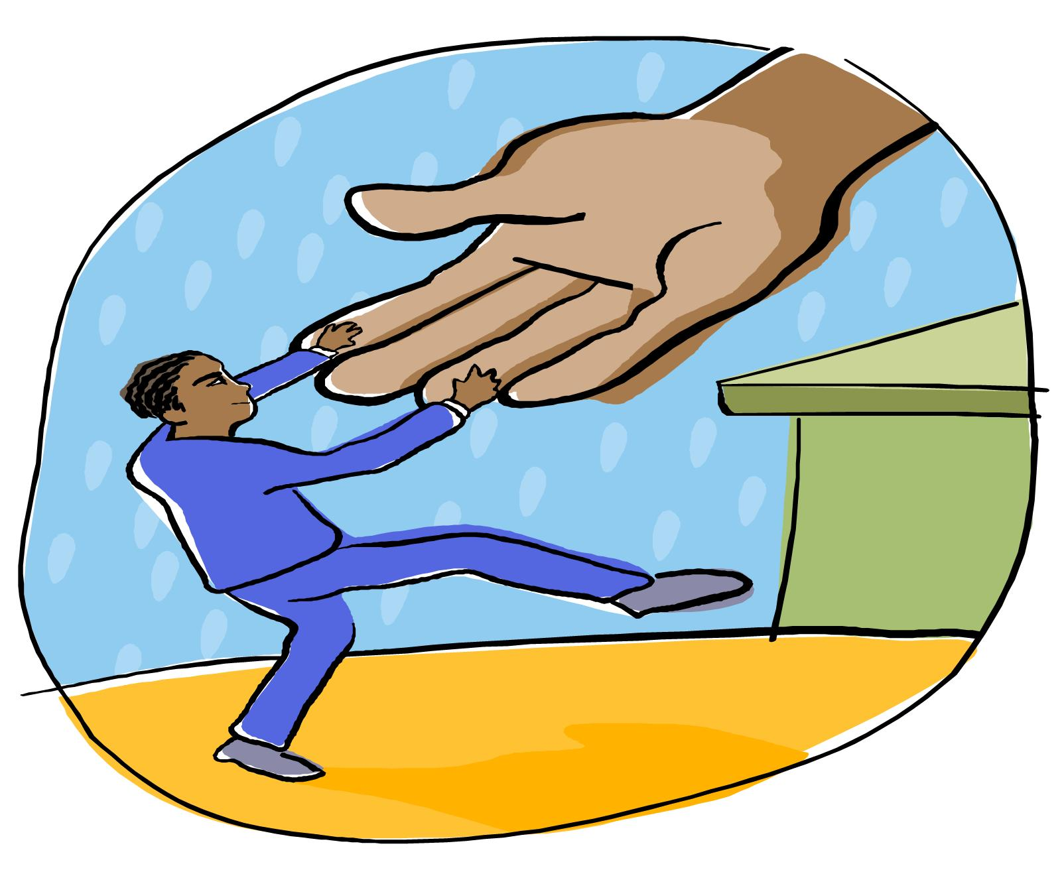
Mentoring Activities
Assist another to develop qualities needed to attain goals
Qualities Developed:
  Knowledge:
    How the system works
    Integration into system
    Technical competence
    Understanding of others’ motivations
  Judgment/Wisdom:
    Helps to understand impact of choices/cause and effect
    Character
    Make good decisions regarding others
  Resilience:
    Accepts and overcomes mistakes
    Emotional component (overcomes insecurities)
  Independence:
    grows into responsibility and challenges
    becomes self-reliant and confident

Slide 20
By themselves, character and integrity do not accomplish anything. But their absence faults everything else…
Peter Drucker

Slide 21
How could a mentor do these things?

Slide 22
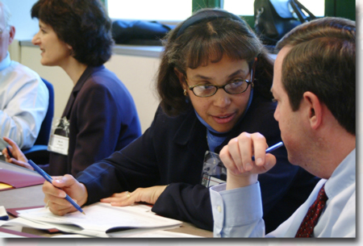
Types of Assistance I
Both Professional and Personal Assistance:
  Listening- Sounding board for problems
  Informing-
    Providing wise counsel
    Suggest possible solutions or information sources.
    Show how organization works
    Explain paths to success
  Encouraging- Help them to develop self-confidence and winning behavior
  Inspiring-
    Direct them towards excellence.
    Teach by example.
  Exploring- what additional options, interpretations or solutions are available?

Slide 23

Types of Assistance II
Both Professional and Personal Assistance:
  “Psychoanalyzing” –
    Identify strengths.
    Identify problem mindsets/behavior that impede success.
  Confronting- non-judgmentally discuss negative attitudes or behaviors
  Refocusing- help mentee to see different future or outcome
  Delegating- Provide mentee with increasing authority and permission to empower self-confidence
  Supporting- Stand by mentee in critical situations

Slide 24
Are you “Mentorable?”
Willing to listen?
Willing to take ownership of their wisdom?
Will you examine yourself and trust?
Willing to employ gained information appropriately?

Slide 25
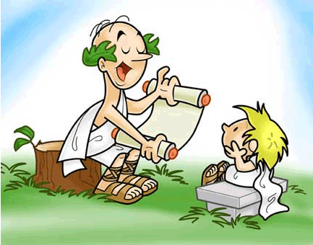
Mentor/Mentee Interactions
In the past, made protégés
  Favoritism
  Clones
Generally not one way
  Minimally, assistance for one, satisfaction for the other
  Commonly: Sharing happens in two directions
  The old dog can still learn new tricks or learn about a changed world…

Slide 26
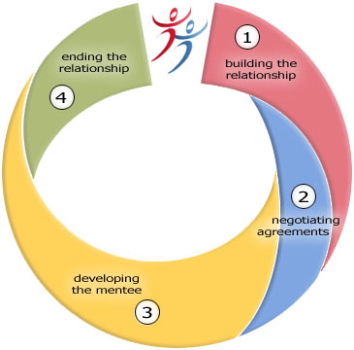
Progression of Formal Relationship
#3 and #4 determined when #2 is accomplished…

Slide 27
Beginning a Formal Relationship
Either start or end with a request for mentoring…
Need to build comfort/trust
Initially small/talk - common Ground
  Background, education, weather, traffic, family, travel
Begin with broad, open-ended questions
  How are things going?
  Not specific (vulnerability issues)
Eventual, personal revelation (often, Mentor reveals about him/herself…even some unfavorable)

Slide 28

Negotiating/Clarifying Expectations
Determine what expectations are
  Essay about what prospective Mentee expects
  Identify perceptions of roles
  Identify needs of both people
  Identify length of commitment
  Developing an agreement
  May be written or not
Negotiate acceptable to both

Slide 29
Mentee Development
Give Assistance as Described Above…

Slide 30
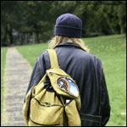
Ending the Relationship
Usually clearly negotiated and defined
May be for period of time
May be associated with transition in role- your mentee has “Grown up” into a Peer

Slide 31
Are You Ready to Mentor?
Ready, willing and able to help another?
  Have appropriate background
    Credibility
      Solid, established background
      Required technical and skills
      Respected for standards
  Emotional/psychological ready for responsibility?
    Communicate high expectations/positive
    Is a good listener
    Is empathetic
  Time, freedom to commit?

Slide 32
Important Characteristics in a Mentor
Active listening
Coaching skills
Effective confrontation techniques
Conflict resolution

Slide 33
Authority without Wisdom is like a heavy axe without an edge, fitter to bruise than polish…
Anne Bradstreet

Slide 34
When a Performance Gap is Recognized…
Should come up with positive, constructive strategies to overcome
Use wisdom and timing, to choose when to confront
A mentors should avoid:
  Criticizing
  Repetition of Shortcomings
  “Absolute” statements - You are ‘always’ or ‘never’ something
  Providing unsolicited advice
  Rescuing people from problems they created

Slide 35
Special Relationships
Cross-gender
  Can be of great benefit
  Very common in science
  Problems include:
    Gossip, envy, suspicion, speculation, sexual stereotypes, charges of sexual harassment
Cross-Cultural
  Can arise from:
    Economic class, race, religious background, regional allegiance, family tradition.
Mentoring by supervisor or manager
  Can be very effective
    Can see properly modeled behavior, including authority
  Possible problems associated with authority/power imbalance
  Must be done “carefully, artfully, fairly

