Slide 1
Finding and Understanding Research Protocols
Angelina Hoefle
The University of Texas San Antonio
RISE & MARC Programs
08/2006

Slide 2
What is a protocol?
A detailed plan of a scientific or medical experiment, treatment, or procedure (Merriam Webster Online)
Indicates specific conditions, such as weight, volume, concentration, temperature, and time
Similar to a recipe

Slide 3
Understanding the theory behind it
More efficient experiments
Makes troubleshooting easier
Helps you optimize conditions to test a different idea/set of samples

Slide 4
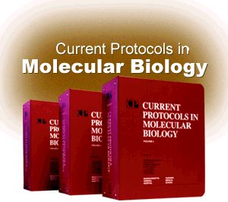
Where can you find protocol books?
Current Protocols in Molecular Biology -reference section of John Peace Library (QH506.C87 1993)
Other Current Protocols titles online (Cell Bio, Immuno, Neuro, Pharmacology, Protein Science) – accessible through UTHSC computers

Slide 5
Where can you find protocols online?
www.protocol-online.org/
  The most comprehensive free online protocol website.
  Type the technique name + “theory,” “introduction,” or “background” to get more information
www.bioexplorer.net/Methods and Protocols/
www.cellbio.com/protocols.html

Slide 6
Where else can you find protocols online?
UTSA JPL netLibrary
  www.lib.utsa.edu
  Click Databases A-Z
  Click “n” – find and click on netLibrary
  (or go directly to http://www.netlibrary.com.libweb.lib.utsa.edu/Search/BasicSearch.aspx)
  Type the technique name and “method”
    e.g. “immunohistochemistry method”

Slide 7
netLibrary
Books of Interest to You
Molecular Biology Problem Solver –
A Laboratory Guide by Gerstein, Alan S.
Practical HPLC Method Development by
Snyder, et. al.
Microscopy, Immunohistochemistry, and Antigen Retrieval Methods: For Light and Electron Microscopy by Hayat, M.A.
Electron Microscopy Methods and Protocols, by Hajibagheri, M.A.

Slide 8
Other Online Resources
Online Books (for background information) http://www.ncbi.nlm.nih.gov/entrez/query.fcgi?db=Books
Helpful Tools
http://www.mgb.pitt.edu/moleculartoolbox.htm
Computational Resources for molecular biology http://molbio.info.nih.gov/molbio/
Collections of books (must enter research field) http://crs.nsdl.org/collection/

Slide 9
Acknowledgements
Dr. Gail P. Taylor
All of you!!!

Slide 10
Questions???

