Slide 1
Research Career Development Part I - Preparing for Doctoral Education
Dr. Gail P. Taylor
Asst. PD RISE & MARC U*STAR
Fall 2015

Slide 2
Confirm and Commit!
Graduate School is Challenging
Clarify to YOURSELF on why you want to go
Understand motivations
Become a Scientist
Science culture
See yourself as a researcher – Develop Identity
Mature into next stages
Talk and and act

Slide 3
What are your thoughts on the prior slide?

Slide 4
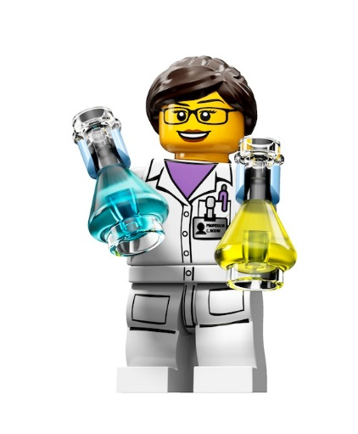
What do grad schools look for?
Think and we will discuss…

Slide 5
What Doctoral Programs Want
SOMEONE WHO WILL SUCCEED!!!
Has background required for success
Coursework (strong performance)
Knows culture of science (frustration?)
Knows research (pubs, presentations, etc)
Has motivation required for success
Programs, summers, internship, presentations, etc.
Has skill or potential to perform activities of science
Performed research
Thinks like a scientist
Communication (oral and written)
Potential for Creative independent thinking

Slide 6
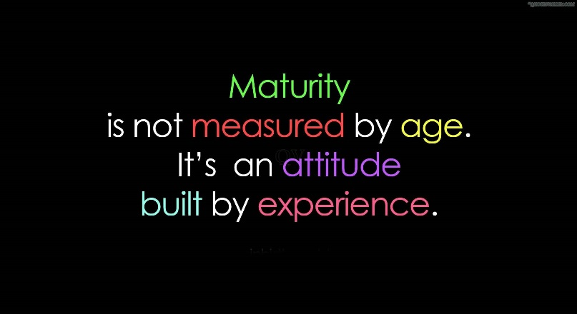
Con’t - What Doctoral Programs Want
Maturity…will grow, but need basics
Reliable, independent, takes instruction
Thinks like scientist
Fits well with their program
Compatible research interests with faculty
Potential for independent investigator
Impact “energy” of school
Good representative forever
Increase diversity?

Slide 7
PREPARE - Make Clear to Others That you want PhD Program!
Set vision early
Self (I am a scientist)
PI (advice, strategize for App)
Become what you want to be
Have Grit!
Become what GS want to induct
PREPARE

Slide 8
PREPARE - Build CV – Research and Related Activities
For GS and Grants
Research Experience
Depth (start early; dig in; literature)
Quality (where and who)
Quantity
Responsibility
THINK
Pubs/Conferences/Presentations
Positive – shows you know culture
Oral Presentations > Poster, but both good
Authorship highly regarded (but not necessary)
Teaching
Meaningful volunteer/science promotion
Leadership

Slide 9
PREPARE - Academics
Grades are a student’s job.
GPA (UD most important)
3.7 very good (but better for Harvard…)
3.5 solid
3.0- Some schools will admit
Sub-3.0 Rare and exceptional cases.
C’s are failing.
Courses/Electives (choose challenging and for field)
Don’t take courses for the first time in GS
CAN make up undergrad courses in GS
Grades are balanced with letters, pubs, interview
Scientists usually weren’t 4.0 in biosciences

Slide 10
PREPARE - GRE
Required by nearly all schools (some ignore)
Will also count on some grants
PREP is possible
Vocab, Practice tests, nail math
Try to get ~300 combined (don’t despair)
Take spring or summer prior to applying, if possible
Can retake
Overcome by letters, pubs, interviews
http://news.vanderbilt.edu/2014/06/grit-better-than-gre/
http://www.nature.com/nature/journal/v510/n7504/full/nj7504-303a.html

Slide 11
PREPARE - Letters of Recommendation
Testimony on your skills and suitability
Research Best.
PI! Summer. Postdoc
Character (tho in Chem Instructors better)

Slide 12
Get your Act Together on Applications!
Plan summer programs
Research due dates
Create planning worksheet
Coordinate recommenders
Investigate schools and possible PIs
Plan Statement(s)
Plan schedule (Final Summer, Fall, Spring)

Slide 13
Strengthening Credentials
GRE: Study for and retake
Grades:
Possibly begin M.S. training and get “A”s
Postbacc with Academic Prep
More Research/Preparation//Better letters
Job as Research Asst.
Postbacc

Slide 14
Research Career Development Part II Choosing a Doctoral Program
Dr. Gail P. Taylor
Asst. PD MBRS-RISE & MARC U*STAR
Spring 2012

Slide 15
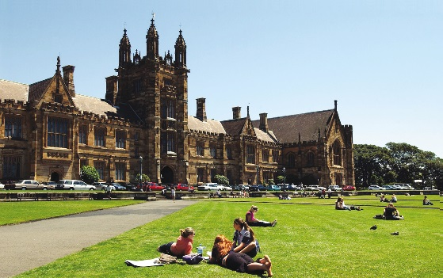
Doctoral (PhD) Training Takes Place
“Graduate Programs” or Graduate School
At “Universities”
http://www.utsa.edu/graduate/
Academic Medical Centers & Vet Schools
http://gsbs.uthscsa.edu/main/
Special Partnerships
HHMI Janelia Farms Research Campus http://www.hhmi.org/janelia/grad.html
NIH Graduate Partners https://www.training.nih.gov/programs/gpp
Avoid online or unfunded programs

Slide 16
MANY MANY FIELDS
Neurobiology/Neuroscience
Physiology
Microbiology/Immunology/Endocrinology
Cell/Molec./Dev. Biology
Biochemistry/Biological chemistry
Biomedical Engineering
Chemistry
Green
Organic
Manufacturing
Pathology/Molecular Toxicology
Pharmacology
Program in Integrated Sciences
Radiological Sciences
Biostatistics
Electrical Engineering
Ecology and Evolutionary Biology
Environmental Health Sciences
Epidemiology
Oral Biology
Biological and Medical Informatics
Biophysics
Civil Engineering
Genetics
Computational Biology/Bioinformatics
Pharmacogenomics
Forestry
Integrative Biology
Translational Research
Molecular and Biochemical Nutrition
Plant Biology
Vision Science
Etc., etc…

Slide 17
Program/School Metrics
Time to Degree
Degree Completion
Degree requirements Courses, research rotations, Qual exams
Location
Size, schools, culture, job for spouse, cost of living, transportation
Size of School
Total size, # Doctoral students
Campus environment
Academic (courses, library, etc)
Retention programs and GS training (grant writing??)
Cultural and social activities
Diversity of student population?

Slide 18
Program Metrics II
Financial Considerations
Funded? Stipend & Tuition?
Fellowships and Traineeships – payment for study
Research Assistantship – Payment for work
Teaching assistantships – Payment for teaching
Med Insurance?

Slide 19
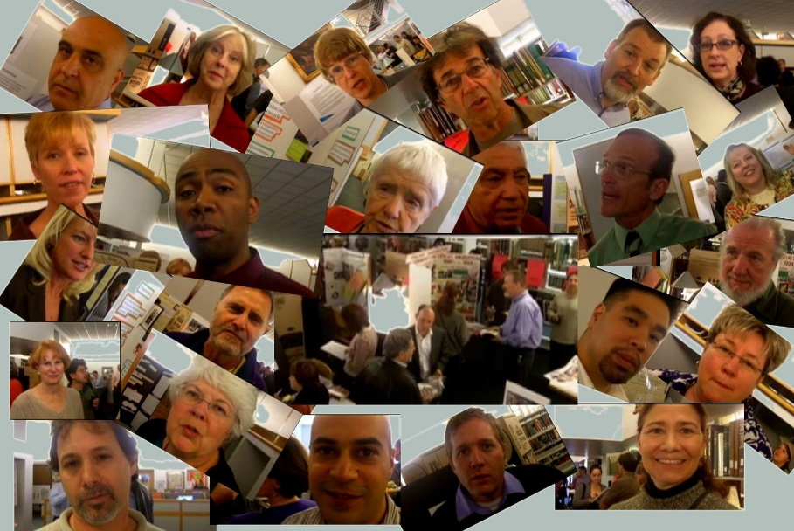
Even more Important -Focus on Faculty
School should have several of interest
Performing research that inspires
Ability as educators and mentors
Ability as scientists
Grants
RO1 http://grants.nih.gov/grants/funding/r01.htm
Publications
Nature, Science
Awards
Nobel Prizes
National Academy of Sciences Members
http://www.nationalacademies.org/
Know how to “Play the game” of science…
Mentoring vs Reputation…

Slide 20
Programs Vary
Quality of Ed
Launch of graduates
Treatment of UR students
Talk to professors/Your Mentor!
Professional Societies
Talk to students
Investigate/meet faculty
Talk to recruiters (grain of salt)
Go to Summer Program
Graduate Fairs
Online (societies, ratings)

Slide 21
Program Descriptions
Descriptions of Schools (take with grain of salt):
http://www.petersons.com/graduate-schools.aspx
http://www.gradschools.com
http://www.cgsnet.org/
http://www.graduateguide.com/
http://www.phds.org/rankings/

Slide 22
Program Rankings (PI Better)
Rankings!
US News Grad School Rankings
http://grad-schools.usnews.rankingsandreviews.com/best-graduate-schools/top-science-schools
PhDs.org
http://graduate-school.phds.org/rankings
Times Higher Education University Rankings
https://www.timeshighereducation.co.uk/world-university-rankings/2015/world-university-rankings#/sort/0/direction/asc

Slide 23
Final Decisions
Often comes down to PI…
Are they supportive to URM students?
Funding?
This is a big decision that you must make on your own….

