Slide 1
Effective Data Presentation Making Figures and Tables
Dr. Gail P. Taylor
University of Texas at San Antonio
Professional Skills Development
02/04/2009

Slide 2
Acknowledgements
Scientific Papers and Presentations, by Martha Davis. Academic press, 1997
Survival Skills and Ethics Program: www.pitt.edu/~survival
Department of Biology, Bates College http://abacus.bates.edu/~ganderso/biology/resources/writing/HTWtoc.html

Slide 3
“Graphic Excellence is that which gives to the viewer the greatest number of ideas in the shortest time with the least ink in the smallest place.”
Edward R. Tufte

Slide 4
Guidelines
Simplify message without falsifying data
Generally need either graph or table
Present with clarity, brevity
Note prior conventions

Slide 5
Guidelines cont’d
What types of data presentation formats do you know?
How are they different?

Slide 6
Data Presentation Formats
Tables
  Specific data
  Exact comparisons between data points
Bar Charts
  Less numerically specific
  Examine differences rather than trends/changes
  Comparisons of size, magnitude, amounts
Line Graphs
  Not numerically specific
  Demonstrate movement, change, trends
  Generally over time or concentration

Slide 7
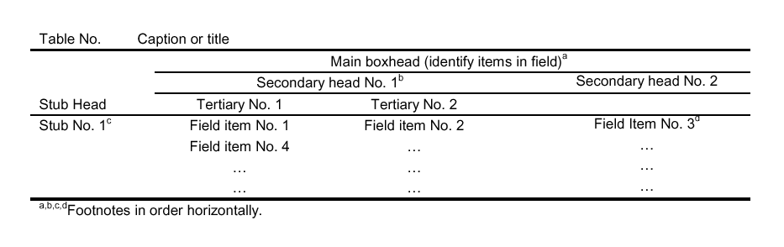
Using a Table
Should be able to stand on its own
Show data, and possible manipulations
  Percentages, totals, means, averages, ratios, etc.
  Columns contain Ind. Variables (that which was manipulated

Slide 8
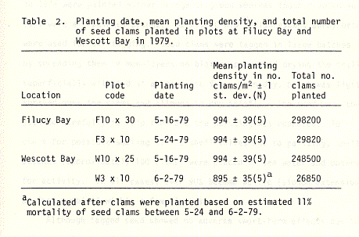
Good Table
Legend- complete
Stands on own
Note capitalization
Period after "Table 2"
Units included
Legend above the table;
Note clarifying footnote
Lines of demarcation separate numerical data from text.
Gridlines not present

Slide 9
More on Tables
Limit total items/columns
  (But more than than 6-8 datapoints)
No vertical lines
Do not overload with headings
Use captions/footnotes for definitions
Strings of “0’s” or unchanging data might not be included
Use restraint with decimal places
Obvious abbreviations can be included
Don’t repeat data in text, just call attention to main points

Slide 10
Preparing a Table
Examine style sheet and examples
One table, one page, double spaced
Use Arabic numerals to number
Group so that comparisons run down column
Logically group data to stress baseline and trends
Round off numbers and align decimals
Create a descriptive caption (no verb required)
Use head- or foot-notes to explain abbreviations
Verify all data
Verify accuracy of use of symbols
Use consistent labeling throughout paper
Proofread carefully

Slide 11
Tables in a Poster/Presentation
Time limitations- make more simple
Utilize color, shapes, to emphasize
Symbols are okay

Slide 12
Actually Making a Table
Use publisher’s recommendations
Can use Word or Excel (I like Word)

Slide 13
Figures
Illustrations
Photographs
Drawings
Flowcharts
Line graphs
Bar graphs
Pie charts
Maps

Slide 14
Figures -2
Figures
Designed to add understanding of information that it difficult to convey with words
Must be clear, accurate, appropriate
Avoid mere decoration
KISS
Need a legend

Slide 15
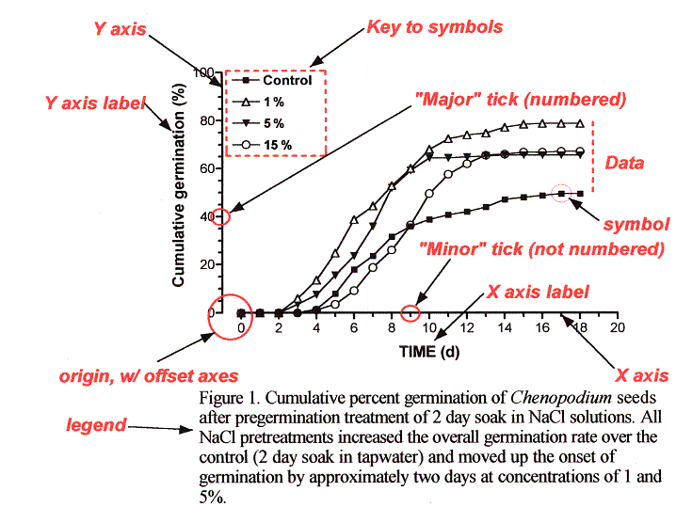
Parts of a Graph (line)

Slide 16
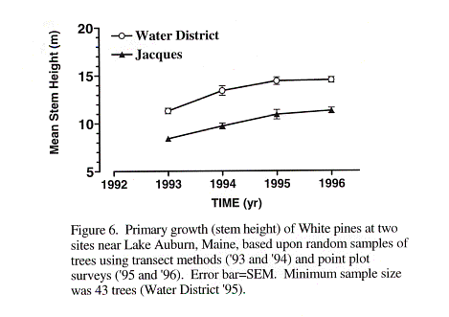
Line Graphs
Should have two axes
Y changes as a function of X
Should show data collected at regular intervals (show trends)
Make curves most bold
Don’t vary line patterns, vary symbols (color on slides/posters)
Plot the length of intervals so that slopes are not too steep.

Slide 17
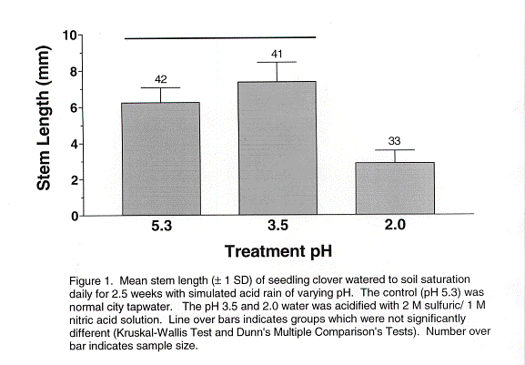
Bar Charts
One measurable axis
Interval doesn’t matter
Make bars wider than the spaces between them.
Use color only in slides/posters. Use conservative patterns for publication
Show significant differences by letter or asterisk above bars

Slide 18
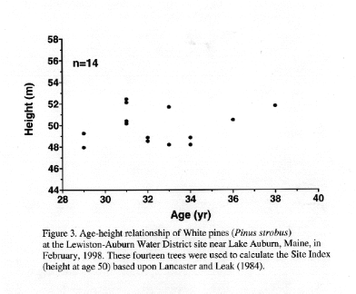
Scatter Plots
Examines individual score on two variables.
Show relationship
Independent Variable on X (“as a function of”)

Slide 19
Recommendations for Figures (Part 1)
Read publishers recommendations regarding size, color, format!
Is it needed?
Do not have a title
Can it be understood at a glance?
Limit curves (3-5) or bars (6-8; 9-10 grouped)
Plot independent variable on X (time, concentration), dependent on Y (what happened?)
Avoid wasted space; legend on field

Slide 20
Recommendations (Part 2)
Label axes and show units of measure. Use tics and subtics, to not crowd with numbers
Position, size, shape, length, symbols, angle, color: all are cues. Use when appropriate, and avoid misuse.
Start scales at “0,” unless you make it clear (tic marks) that you are doing otherwise.
For a journal, type caption on a separate page so that the figure can be photographed and the type set separately.

Slide 21
Figure Legends
Must accompany Figures.
Should give pertinent, clarifying information
  key to abbreviations
  sample size
  statistical results
  a brief description of how the data were acquired
Should allow Table/Figure to stand alone
In the legend, both “Table” and “Figure” are spelled out completely

Slide 22
How to refer to a Table/Figure
Every table/figure must be referred to in the text
It is best to refer to them in parenthesis:
  Germination rates were significantly higher after 24 hr water soak than in the control (Fig. 1) .
  DNA sequence homologies for the purple gene from the four congeners (Table 1) show a strong similarity, differing at most by 4 base pairs.
  Note: Fig., here is abbreviated. Not on headings, though.
Avoid sentences that only direct you to the table:
  Table 1 shows the summary results for male and female height at Bates College.

Slide 23
A little more Info…
Figures and tables are numbered independently, in the sequence in which they are referred.
In a thesis or class paper, place them as near where you refer to them as possible
For manuscripts, follow publisher’s directions (historically, legends were are on a separate page)

