Slide 1
Creating a Scientific Abstract
Gail P. Taylor, Ph.D.
University of Texas at San Antonio
Additional References:
http://www.bio.davidson.edu/Courses/Bio111/Bio111LabMan/Preface%20B%7F.html
http://www.uaf.edu/csem/ashsss/abstract_writing.html
http://www.vimeo.com/3968357
07/01/2010

Slide 2
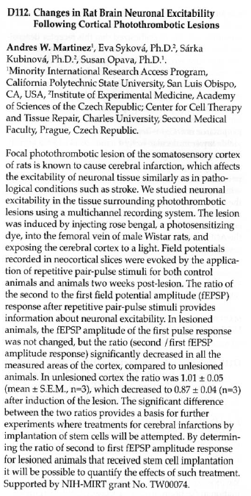
What is a Scientific Abstract?
Summary report of scientific study
Several Types
  Begin papers
  Used at Conferences
Purpose determines format
Conference
  Determines format/style
  Published in books or CDs
Represent you and your mentor
Draws people to your work

Slide 3
For Conferences
Create Abstract
Confer with Mentor (your mentor is always right)
Receive Approval from RISE/MARC program director (SACNAS and ABRCMS)
Submit
  Choose Oral Presentation or Poster (might not have choice)
Conference Responds:
  Accepted or not
  Oral or Poster
Prepare Oral or Poster presentation
Attend Conference
Make presentation

Slide 4
General Abstract Format
Project Title
Author, affiliations (university/department) and Address, perhaps email…
Introduction – Foundation for research & Purpose of Research (can put “overall goal”)
Hypothesis- What you expect
Methods - How studied
Results - Principal findings
Conclusion and Discussion - Success of hypothesis and what findings mean

Slide 5
Following the Rules…
Concise as possible
  Body length determined
    ~300 Words
    ~2500 Characters
  Title length may be determined
Formatting specified
  Font used and its size
  Title capitalization
Single spaced

Slide 6
Advice in Writing
Abstracts are short but time-consuming
Very information-dense, but simply formatted
Write “long” and pare down if needed
Analyze one sentence at a time
  Each sentence has purpose
  Each sentence logically follows another
Use plain English wherever you can
Use active voice when you can
State only your most important conclusion(s)
There is not good writing, only good rewriting

Slide 7
Following Conventions -
Tense in Scientific Writing
Present tense –
  previously published information accepted as fact
    In Intro and discussion: Spatial resolution of MR microscopy can reach 3 microns [ref].
  Refer to other parts of your document
    Figure 4 shows a diffusion-weighted image.
Past tense - methods and results/actions
  What we did, saw, and found
  Rats were anesthetized with isoflurane.
  All animals exhibited significantly diminished learning capacity…
Duke University Medical Center
http://wwwcivm.mc.duke.edu/civmResources/iplHelp/writing.tips/tenses.html

Slide 8
Title
Length and text style determined by conference
Optimally, identical to “paper” title:
  Very brief summary of research
    Omits “A study of,” “Investigations of,” etc
    Put species studied
    Put limiting information
    Avoid “cute” or abbreviations
  May or may not give results
    Topic – Effects of phenobarbital on learning
    Conclusive – Phenobarbatal diminishes learning…
Helps people to choose and find article
Ex: Effect of Owner Education Level on Number of Cats per Household
Ex: FGF-2 Induces Regeneration of the Chick Limb Bud

Slide 9
Introduction
What is the general topic you were investigating and why is it important?
Provide supporting information for title
Generally max 3 sentences
General information to specific

Slide 10
Hypothesis
What are the specific questions you are addressing with this project?
Sometimes you need two sentences, but one is better

Slide 11
Methods
How did you do this experiment?
One or two sentences are needed for short abstract (175 words). Three for longer.
Just to give general idea
No vendor info needed

Slide 12
Results
What did you find out?
One to two sentences ought to be enough: state only you main point(s).
Include your most important data that influenced your conclusion
  mean values, significance, standard deviations, number of samples you studied, etc.)

Slide 13
Conclusion/Discussion
How did hypothesis turn out?
What does your work mean?
What is the big point that you want to take home?
Usually one or two sentences

Slide 14
Acknowledgements of Funding
At end, place recognition of funding source:
  This work was supported in part by
    NIGMS RISE GM 60655
    NIGMS MARC-U*STAR GM 07717
    Work Study Research Training Program

Slide 15
SACNAS Abstract Link
http://www.sacnas.org/confNew/confClient/
http://www.sacnas.org/confNew/confClient/current/register/attendee/abstract_summer.asp#guidelines

Slide 16
Writing an Effective Abstract
http://www.vimeo.com/3968357

