Slide 1
Faculty Mentor Information Meeting
2/27/2023

Slide 2
New Office Name / Logo
Remain in Center for Research and Training in the Sciences
(Before RISE/MARC Office)
Now, with RISE ending…
RISE Office - Research Initiatives for Scientific Equity
Old RISE Acronym – Research Initiative for Scientific Enhancement

Slide 3
PSA #1 We Need Applicants!
RISE – Carryover
All students funded through May 2023
Seeking new UGs – June – May 2024
4 UGs continuing
Recruiting 8 Senior UGs who decided late on PhD
Outcomes: MS (funded program) or PREP (1 year)
MARC –
4 graduating, 4 added in year 2.
Need 8 UGs
Soph – Junior (2 year minimum)
More flexible GPA

Slide 4
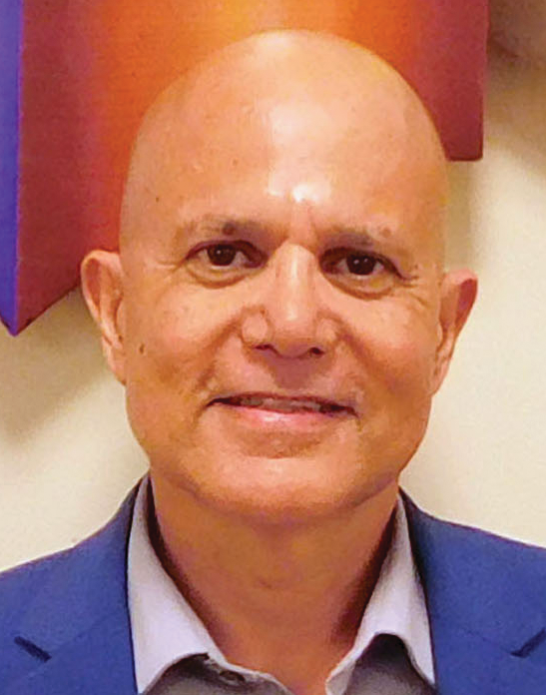
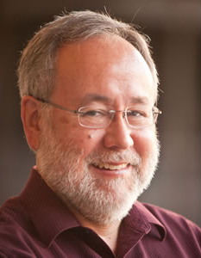
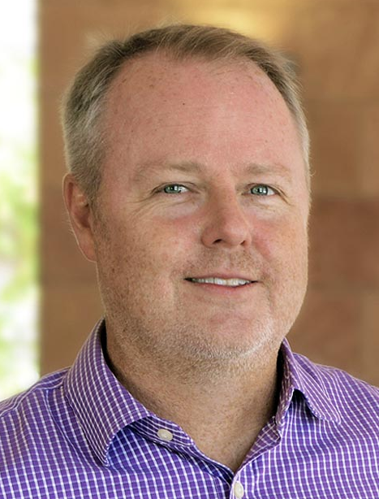
Program Directors & Staff
Edwin Barea-Rodriguez
Professor of Biology Program Director
Aaron Cassill
Professor of Biology
Assoc. PD
Eric Brey
Chair, Biomedical Eng
Assoc. PD IMSD
Gail P. Taylor
Assoc. Dir. STEM Init.
Training Specialist
Diane Elizondo, MS
Program Coordinator

Slide 5
NIH & New Programs
National Institute of General Medical Sciences
Training and Workforce Division (TWD) – Alison Gammie, PhD Director
Branch - Undergraduate and Predoctoral Cross-Disciplinary Training
<7.5M NIH
Res. Funds
G-RISE
MARC
HSI, HBCU
Many had Both
Low $R Schools
U-RISE
RISE PhD
RISE UG
MARC
>7.5M NIH
Res. Funds
High $R Schools
IMSD PhD
Majority Schools
IMSD PhD

Slide 6
Where are the MARCs?
NEW GRANTS
Univ Iowa
Wayne State
UC Denver (old grant)
UTSA
UTEP
St. Mary's
Univ Kansas
Colorado State University
UC Berkeley
UC Davis
Univ. Missouri-Columbia
Univ. Florida
Univ. Nevada Reno
Wash State Univ.
Rutgers
Uconn
Temple University
UCLA (old grant)
UC Irvine
Univ. Hawaii at Manoa
UC Santa Cruz
Washington University in St. Louis
LSU
Mostly Disappearing
San Diego State Univ
Elizabeth City State Univ
Northern Illinois Univ
St. Mary’s University (38 years)
Fisk University
Cal State Fullerton
Brooklyn College
Old Dominion
University of Rhode Island
Georgia State
Savannah State
City College of New York
UC Riverside
FIU Old Grant
Cal State LA

Slide 7
PSA #2 - Undergrads
Realize Your Worth, Power & Success w UGs
UTSA UGs are developing VERY well as researchers
Even two students with ~1 year of research have gotten into top schools for this fall
Repeatedly – Our students “SOUND like researchers”
Most – Which great school will I go to?
Some attributable to RISE/MARC, a whole lot you!!!
Please help!
Help them to develop good school/work/life balance (too many hours)
Please be encouraging to your students while they are applying to PhD Programs…your kids are great & will get into great schools, even without pubs. Let them try “reach” schools…

Slide 8
OUTLINE
MARC – The Basics
IMSD – The Basics
What's new for both??
MER – Methods for Enhancing Reproducibility – Dr. Mickey Stevenson
Training in Mentoring (CIMER) – Dr. Johnelle Sparks
Mentoring Compact & IDP – Intro w Dr. Jesus Romo
MARC – Specific Things
IMSD – Specific Things
What Now?

Slide 9
MARC – Basics
Old – Ended after 40 years
New - Awarded 6/1/2022 - 5/31/2027
T34 GM145507-01
NRSA Service Award – T34 - $1,195 / Month + 60% tuition
Funds 12 then 16 (year 2 and beyond) trainees
Net loss 4 positions
Old grant: ~85% pursued a PhD on 70% goal
New Goal: 80% within 3 years of graduation
2 Years Minimum participation
Must stay appointed (and receive stipend) year round - Xtrain
Annual Stipend (through Financial Aid) Knocks out Financial Aid
Not allowed to work outside jobs
Must go away for one summer at least (stipend continues)

Slide 10
IMSD Basics
RISE Ends after 23 Years
84.5% retention overall; no attrition on ending grant
T32 Awarded 2/6/2023 - 1/31/2028
1 T32 GM148393-01
8 (Year 1), 16 (Year 2), 24 (Year 3-5) – Incoming
Up to 3 years
85% Retention (+ first-year population)
Tuition Amount Pending – Likely 60%
Health Insurance Pending – ~$3500
$2500 childcare

Slide 11
What’s New For Both?
Underrepresented in addition to URM
https://grants.nih.gov/grants/guide/notice-files/NOT-OD-20-031.html
Ethnic/race
Financial Disadvantage
Disability
Emphasis on resilience/commitment in interviews and training
Focus on Wellness / Psychosocial Wellness
Up to 3 Years of Training
$1000 for travel annually
Strict about approved faculty
Programmatic – Most training in inter-semesters; EDR & Computation
Lots of formal coaching in presentations

Slide 12
What’s New For Both - 2?
NIH Faculty Training requirement
MER – Methods for Enhancing Reproducibility – Dr. Mickey Stevenson
Training in Mentoring (CIMER) – Dr. Johnelle Sparks
Mentoring Compact & IDP – Intro w Dr. Jesus Romo
Fundamentals in Programming
Evaluation
Faculty evaluates student, student evaluates faculty
Portfolio Creation

Slide 13
NEW for MARC Training
NIH – Huge focus on publication
Friday seminars + training in inter-semesters/occasional weekend
MARC Trainee -> MARC Scholar -> MARC Graduate
Proposal & Some Coursework (live & recorded) -> Scholar
MARC Thesis Proposal
Preferably Fall / Spring Junior Year
Two semesters of Research for Credit
Independent project
Defense – 5 – 7 slides only 8 min oral
MARC Thesis or First Author Paper (largely written by student)
Thesis – You and 2 Readers
Defense – 15 minute Oral (12 / 3)
Honors College Admission w 1 semester to turn it down
COS Research Distinction, Engineering Honors(?), Psych Honors

Slide 14
New for IMSD Training
Training in Mentoring
Start Strong bi-weekly meetings in first semester
(All PhD Students Invited)
F31 Grants
Elective Activities:
Co-Mentoring (esp w F31 grants)
Extramural Internships
Micro-Credentialing or Certificate Programs
Participation in Innovation/Entrepreneurships

Slide 15
In Conclusion
Personally, get up and running quickly
Training in Mentoring
Mentoring Compact
Training in Experimental Design
Observe trainees for psychosocial concerns
Stay on top of trainees with Proposals progression
UG Thesis Proposal
Consider Publishable work for MARC trainees, or collaboration projects

Slide 16
THANK YOU!!!

