Slide 1
Trees in the Leon Creek Greenway: A Biodiversity Survey
By: Natalie Martinez and Lily Hernandez

Slide 2
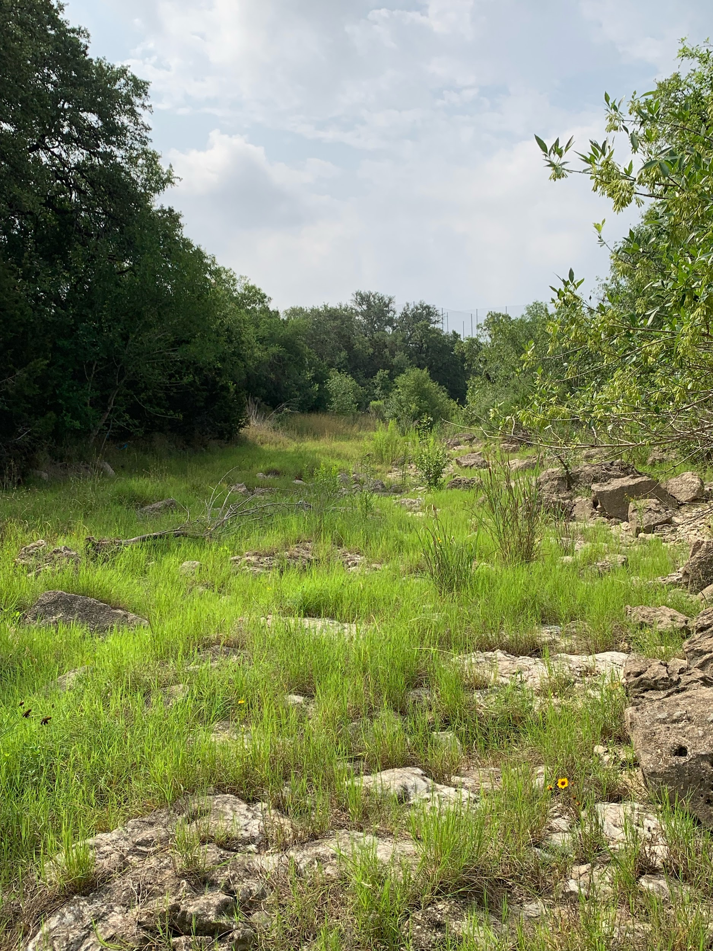
Introduction
The Leon Creek Greenway is an ephemeral stream that stretches throughout the west side of San Antonio. It receives runoff from nearby neighborhoods and buildings.
Runoff is known to contain harmful chemicals and contaminants and releasing said chemicals into the environment. This can affect the surrounding ecosystems, especially plant and tree growth.
Nonetheless, the Leon Creek Greenway is still home to a diverse set of trees and shrubs in both the dry creek bed and upper slopes.
Picture of leon creek, try to use pictures that we

Slide 3
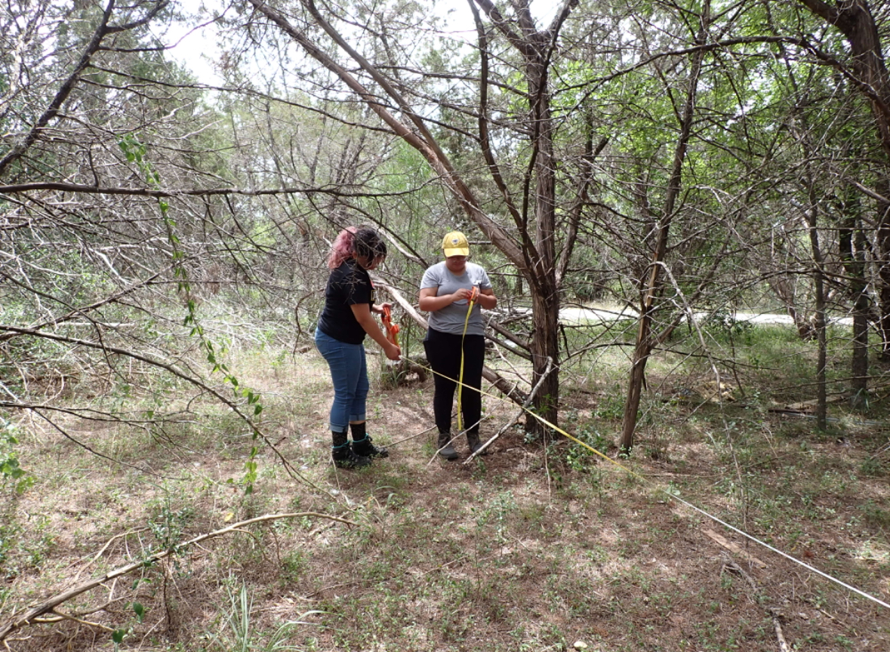
Objectives
Identify the nearby trees and shrubs using the point quarter method in the upper slopes, midslopes, and dry creek bed of the west and east sides of Leon Creek.
Measure the DBH, distance from centerpoint, and canopy height of trees and shrubs
Determine differences in diversity, richness, an evenness along the transects.
Picture of surveying

Slide 4
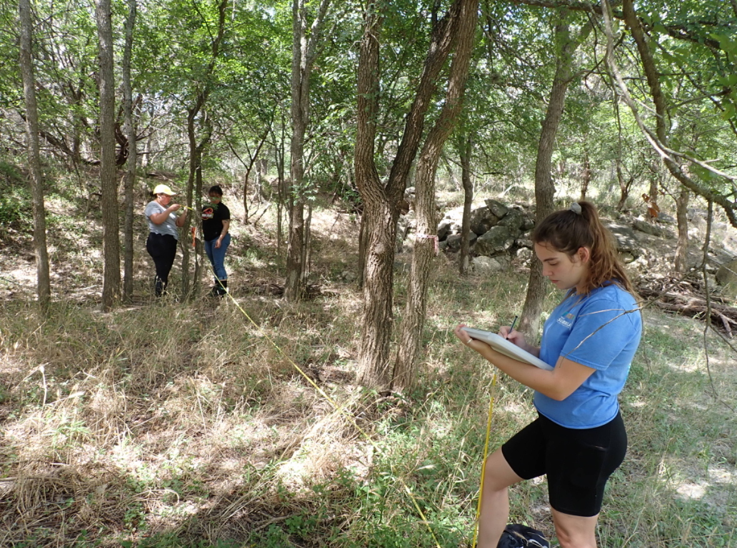
Methods
We surveyed 8 transects along Leon Creek
Each had 6 points that represented the upper, mid, and dry creek bed of the west and east side.
At each point, we picked 3 spots to set up for the Point Quarter Method.
More survey pictures

Slide 5
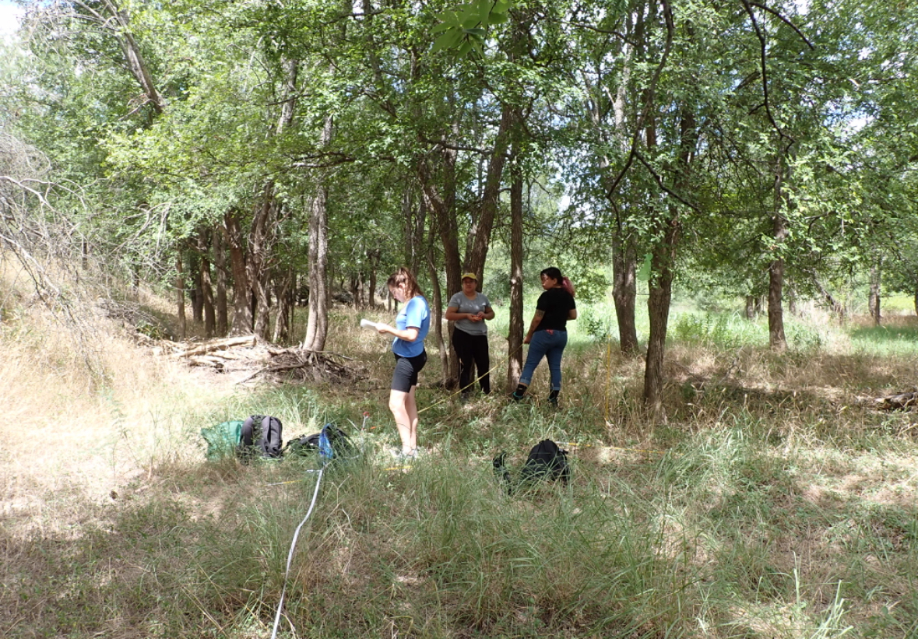
Methods
For this method, we divide the area around us into 4 quarters, and in each quarter we need to find a tree and shrub, along with their species name, DBH, and distance from centerpoint.
From here, we can calculate the species richness and evenness and find out which species are the most dominant in the different areas of the creek
More survey pictures regarding the point quarter method

Slide 6
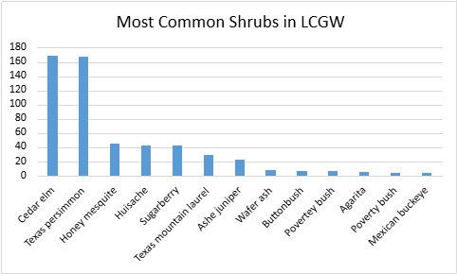
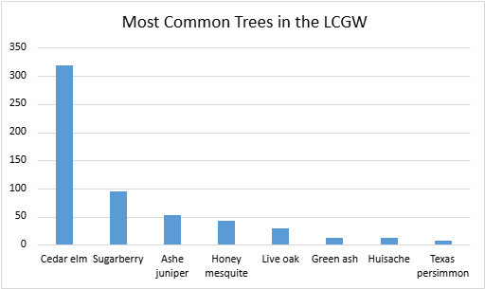
Results (So far)

Slide 7
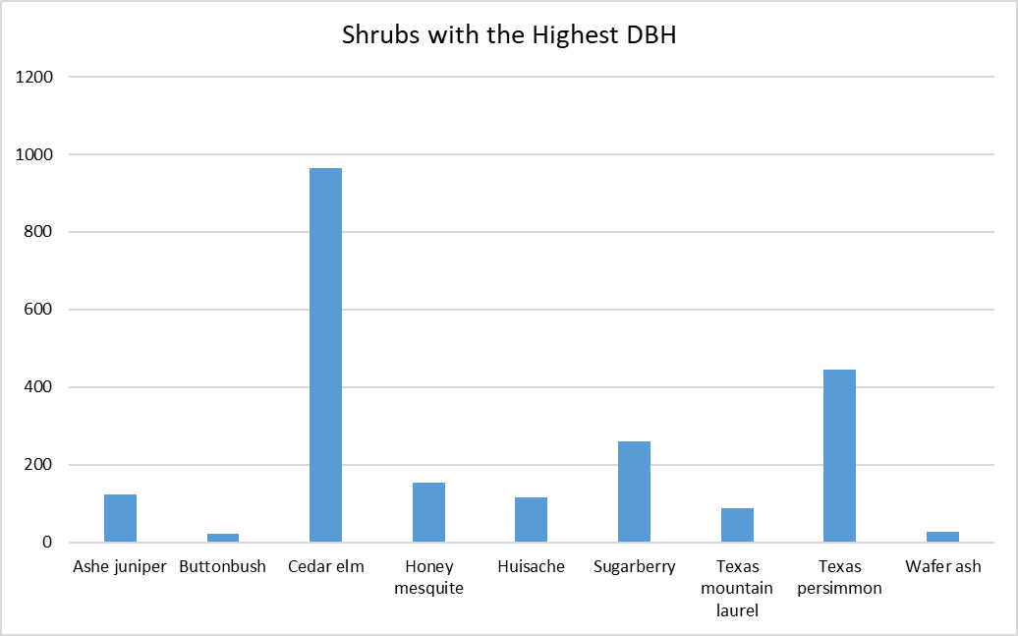
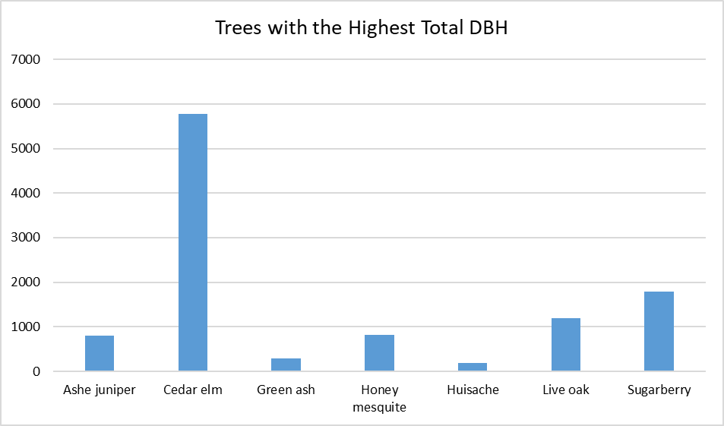
Results (So far)

Slide 8
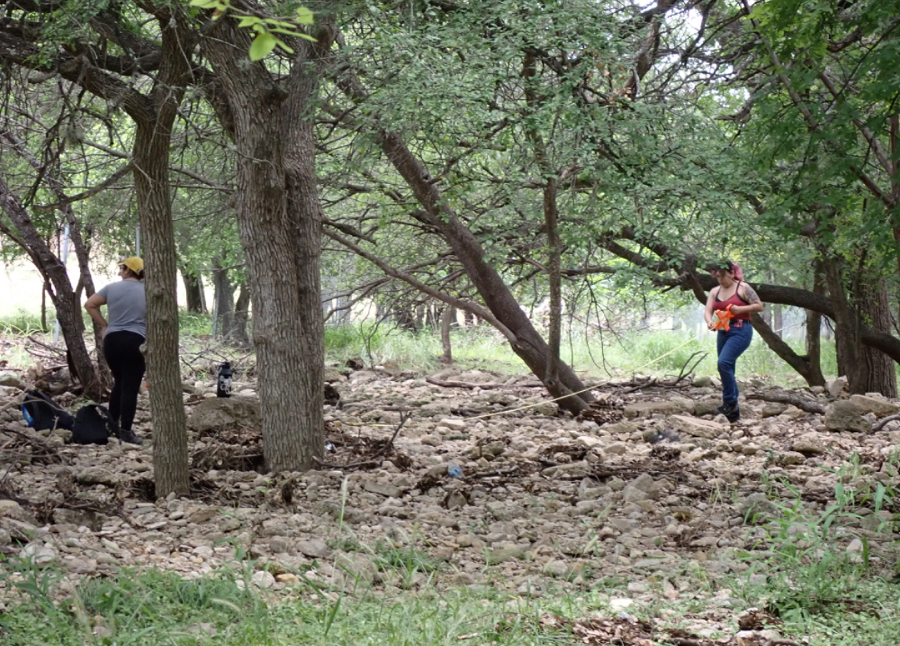
Conclusions
Leon Creek Greenway has an abundant population of Cedar Elm, Texas Persimmon, and Sugarberry trees. These trees also have the highest average DBH compared to the other trees. The trees and shrubs within the creek indicate that there is not noticeable impact on biodiversity by the runoff from the nearby homes and urban areas.
Next, we will be surveying for this same information from Salado Creek, and examine if there are any differences in biodiversity between Leon and Salado Creek.

Slide 9
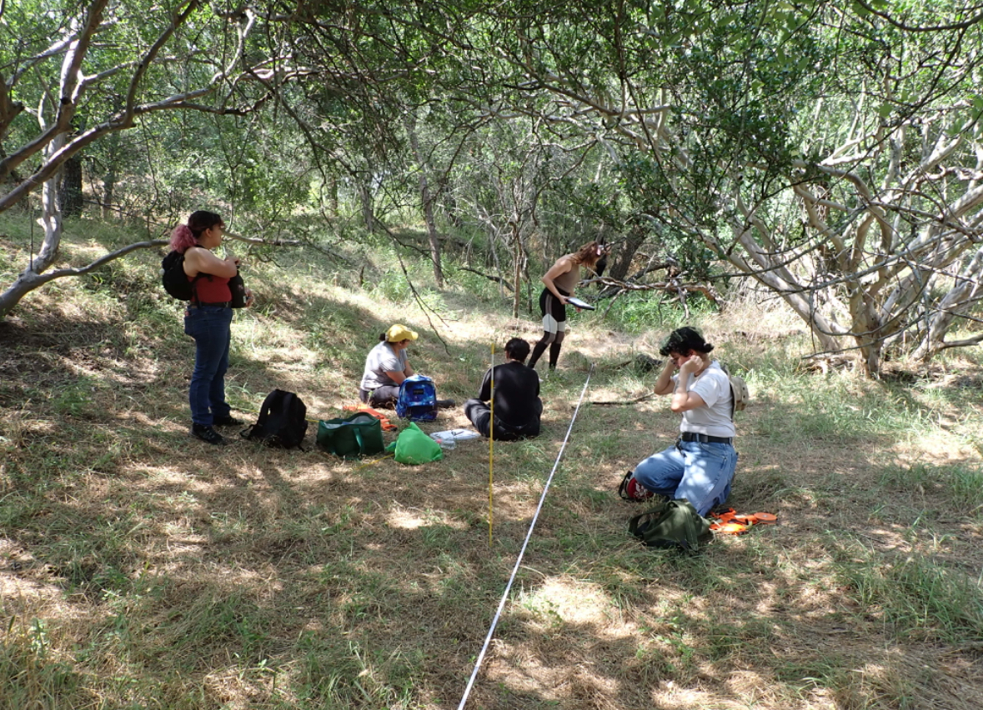
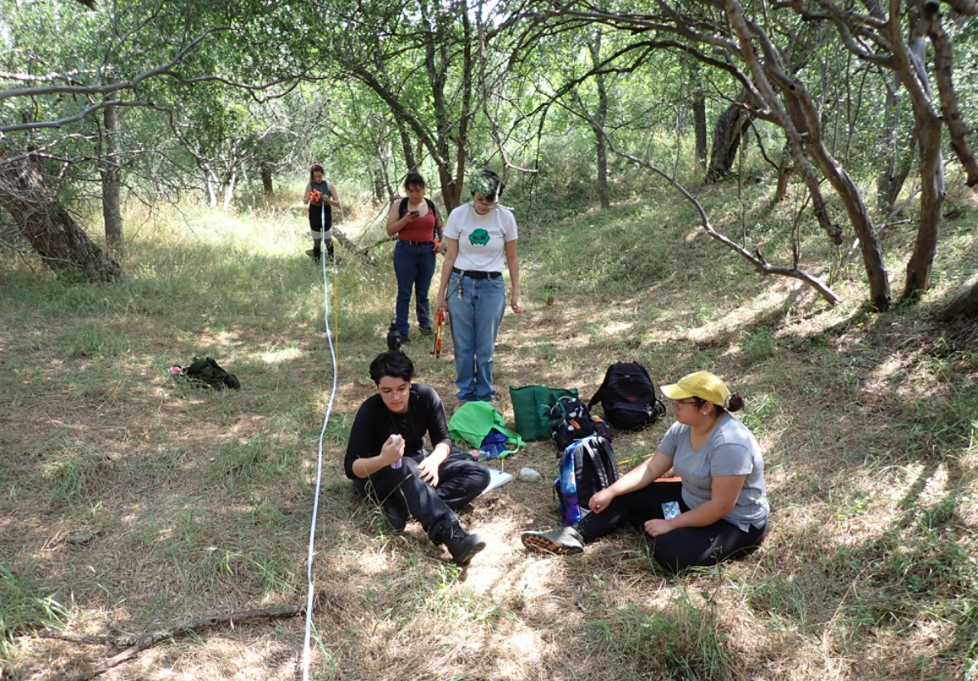
Thanks!
Insert some images here
For any questions email natalie.martinez4@my.utsa.edu or jeffrey.hutchinson@utsa.edu

