Slide 1
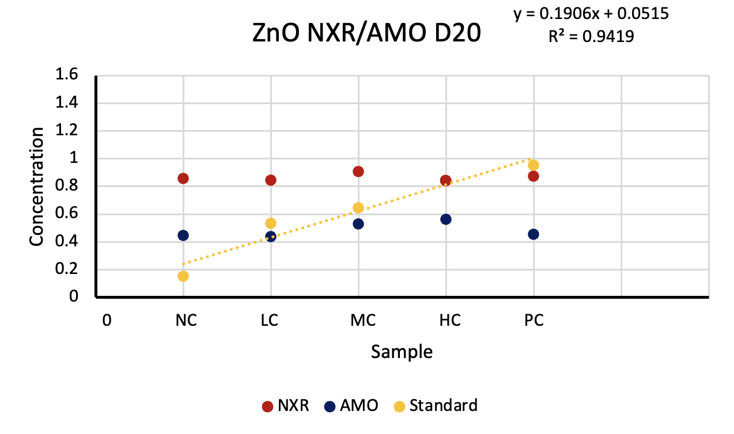
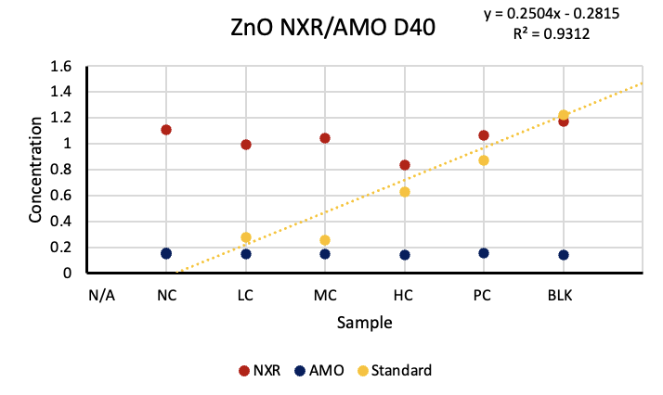
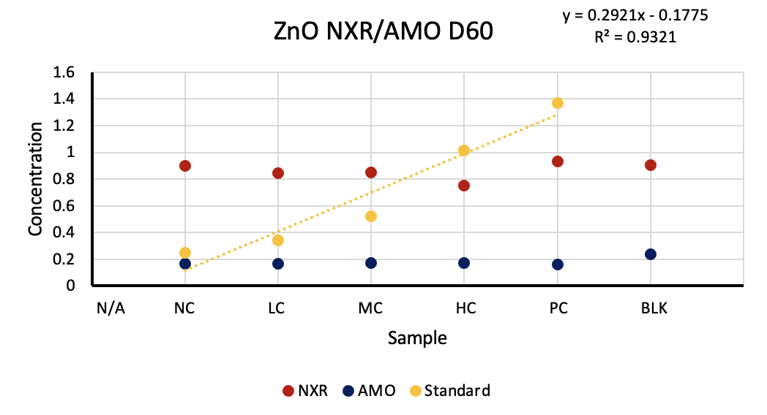
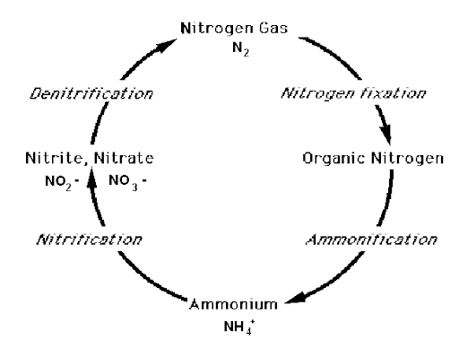
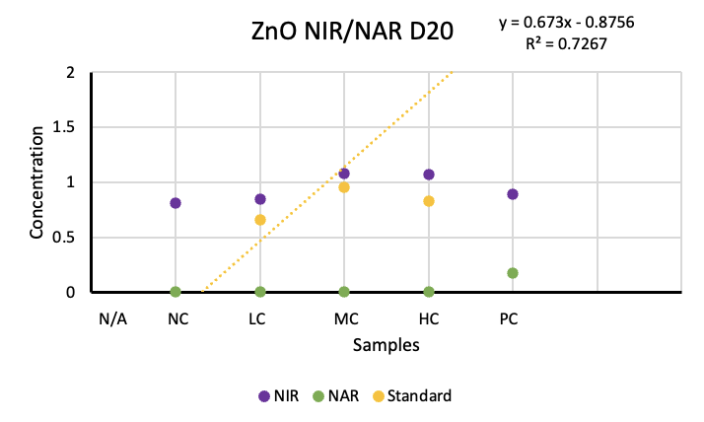
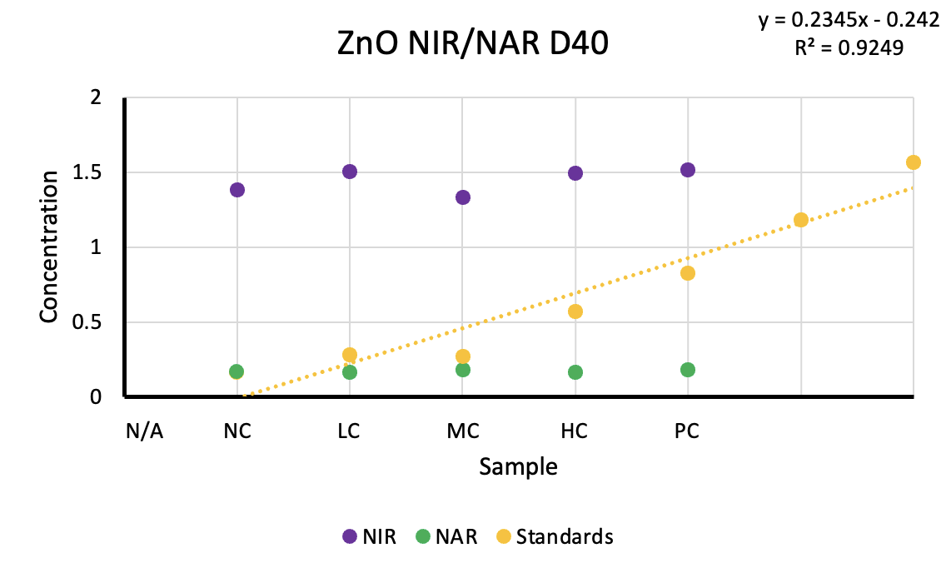
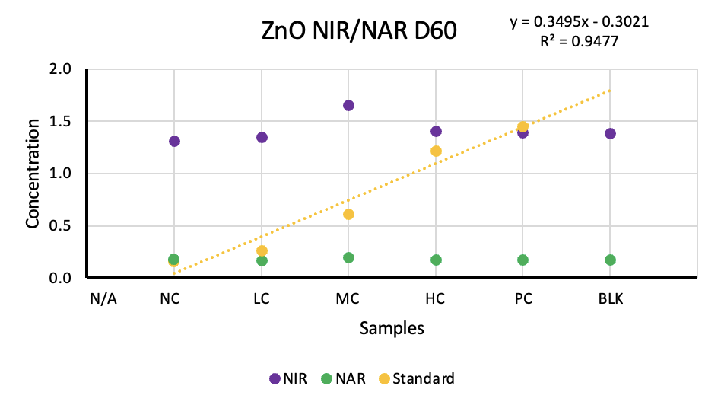
Interaction of Metal Oxide Nanoparticles on Nitrifying Bacteria in Soil
Miguel Rivera¹, Ahmed Hussain, M.A.¹, and Vikram Kapoor, Ph.D.²
Department of Civil and Environmental Engineering, and Department of Chemical Engineering
The University of Texas at San Antonio, San Antonio TX, 78249
miguel.rivera@my.utsa.edu
(512) 284-5631
Abstract
Methods
Results - con’t
Conclusions
This study investigates the impact of zinc oxide nanoparticles (ZnO NPs) on soil bacterial communities, focusing on the NXR, AMO, NXR, and NIR enzymes involved in nitrification processes. Utilizing a 96-well plate method, enzyme concentrations were measured across various ZnO NP concentrations (NC-1 to PC-5) from days 20 to 60. Despite expectations, concentrations remained consistent, challenging the hypothesis that higher ZnO NP levels would decrease enzyme activity. Notably, the AMO enzyme showed slight variation, critical for ammonium conversion to nitrite in the nitrogen cycle. These findings underscore the need for further research to validate and understand the implications of ZnO NPs on soil microbial ecology. Insights gained could inform the development of nanoparticles designed to minimize adverse effects on soil fertility, emphasizing sustainable agricultural practices.
Sample Preparation
Five ZnO concentrations prepared: Low (10 mg/kg LC), Medium (100 mg/kg MC), High (500 mg/kg HC). 100g soil per flask, 3 replicates each.
Controls: Sterile soil (negative NC) and natural soil (positive PC).
Opened samples on days 20, 40, and 60 as of now. Kept in dark at 25°C, aerated weekly.
Analysis Method
We measured the activity of four types of enzymes in soil samples. AMO, NIR, NXR, and NAR.
1-2. For AMO and NIR
Nitrite concentration is measured after incubation to assess how much ammonium (AMO) or nitrite (NIR) was converted.
3. For NXR
Nitrite disappearance is measured by comparing the nitrite concentration before and after incubation.
4. For NAR
Nitrate decrease is measured under anaerobic (no oxygen) conditions to see if nitrate was consumed by the NAR bacteria.
We used 96 well plate smart reader to measure the concentration of the enzymes and exported it to Microsoft Excel to simplify the data.
Real world Issue
Impact essential biogeochemical processes like the nitrogen cycle, affecting soil nitrification bacteria.
Results
Despite higher ZnO NP concentrations expected to reduce bacterial activity, results from days 20 to 60 showed consistent enzyme concentrations.
Hypothesis
Higher ZnO concentrations would reduce bacterial enzyme activity. The results showed slight, inconclusive changes, mostly consistent enzyme concentrations.
Importance
Understanding ZnO NP impacts helps design nanoparticles that minimize adverse effects on soil microbial communities, crucial for maintaining soil fertility.
Direction of the Project
Conduct further testing to draw definitive conclusions and develop strategies to mitigate potential adverse effects of ZnO NPs on soil ecosystems.
AMO Showed the Most Difference
Introduction
Zinc oxide (ZnO) nanoparticles (NPs) are increasingly utilized in various consumer products such as agrochemicals, paints, solar cells, sensors, antimicrobial products, water treatment technologies, and beauty products. Therefore, ZnO NPs are frequently introduced into agricultural soils through irrigation, sewage-sludge application, and direct use as nano fertilizers/nano pesticides. These nanoparticles pose risks to soil ecosystems, particularly by impacting essential biogeochemical processes like the nitrogen (N) cycle, specifically nitrification bacteria.
Figures 2.1-2.3 indicate that the NXR enzyme remained consistent from Day 20 to Day 60, with a slight but insignificant decrease observed. Conversely, the AMO enzyme showed a slight decrease, which was more noticeable than the NXR change. However, further testing is required to reach a conclusive understanding of these trends.
AMO: Convert ammonium (NH4+) into nitrite (NO2-). Nitrification
NXR: Oxidize nitrite (NO2-) into nitrate (NO3-)
NAR: Consumes nitrate (NO3-) and convert it to other nitrogenous compounds under anaerobic conditions.
NIR: Enzyme consume nitrite (NO2-). Denitrification.
No Significance Difference Shown
References
Results
Kapoor, Vikram, et al. “Impact of Heavy Metals on Transcriptional and Physiological Activity of Nitrifying Bacteria.” Https://Pubs.Acs.Org/Doi/Epdf/10.1021/Acs.Est.5b02748, ACS, 26 Oct. 2015, pubs.acs.org/doi/full/10.1021/jacs.7b13678.
Stein, Lisa Y. “The Nitrogen Cycle: Current Biology.” The Nitrogen Cycle, 50 Current Biology, 8 Feb. 2016, www.cell.com/current-biology/fulltext/S0960-9822(15)01518-3.
PRIMER ON NITROGEN, ecosystems.mbl.edu/Research/Clue/nitrogen.html. Accessed 16 July 2024.
Figure 1: The Nitrogen Cycle, Necessary for producing nitrogen in the atmosphere. Nitrogen is a key nutrient for plants which naturally sustain all of living life on earth.
Graph Set up
For the NXR and AMO Enzymes, concentrations were measured using a 96-well plate. To optimize equipment usage and minimize waste, we combined the NXR and AMO enzymes on a single plate. The Y-axis represents enzyme concentrations, while the X-axis denotes sample numbers, ranging from samples NC-1, LC-2, MC-3, HC-4, and PC-5. Occasionally, an additional sample (6) served as a blank. A standard line was used to assess bacterial concentration levels.
Graph Results
Our current results show minimal variation. From days 20 to 60, enzyme concentrations remained consistent across most graphs. Our hypothesis suggested that higher ZnO concentrations would lead to lower bacterial concentrations compared to lower ZnO concentrations. However, the data exhibited consistency in most cases.
Purpose
This study aims to fill these knowledge gaps by investigating the effects of ZnO NPs on soil nitrifying bacteria using a combination of physiological, transcriptional, and metabolic analyses. This research aims to develop a comprehensive understanding of how ZnO NPs influence nitrification processes in soil ecosystems. These insights are critical in designing nanoparticles that minimize adverse effects on soil microbial communities and sustain soil fertility in the face of increasing nanoparticle usage. Our hypothesis for this project is that the higher the concentration of ZnO NPs is the more it will kill the bacteria and cause a lower concentration of enzyme activity to appear on the data.
Acknowledgements
Figures 3.1-3.3 show that for day 20, our data was compromised due to human error, resulting in negative concentrations for NAR and NIR. Therefore, the observed concentrations are notably low for this dataset. However, for the remaining days, the data remained consistent. Further testing is necessary to validate these findings and ensure accurate results.
I thank the McNair Scholars Program for providing this opportunity and funding the additional costs associated with this program. Further acknowledgments to the U.S. Department of Education for funding the McNair Scholars Program.
I thank the EcoJEDI Program for supporting my school tuition and extend thanks to the United States Department of Agriculture (USDA) for funding the EcoJEDI Program.

