Slide 1
Journal Club Walk Through…
https://journals.plos.org/plospathogens/article?id=10.1371/journal.ppat.1005522
Presentation by: Dr. Jesus Romo
Instruction added by Dr. Gail P. Taylor

Slide 2
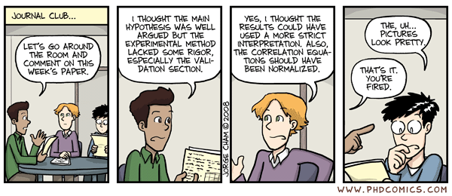
https://phdcomics.com/comics/archive.php?comicid=963

Slide 3
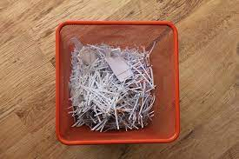
GPT Note: Journal Clubs
Take a Scientific Paper and explain it
Fantastic way to…
Learn about field
Learn to critically approach papers
Students can even form journal clubs
Presentation may take ½ h or more.
Group has paper to read.
One person presents in highly understandable way.
Peers are supposed to have read it to aid discussion
Audience asks questions and tear it apart
TAKES A LOT OF TIME TO PREPARE
Understand experiments, methods, all.
May have to jump to prior papers (methods referenced)

Slide 4
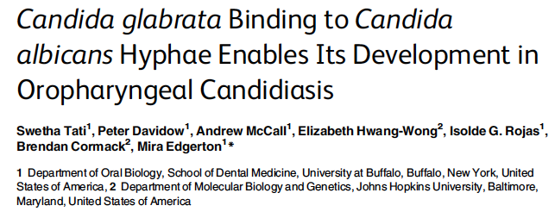
What Topics in Introduction?
Presented by Jesus A. Romo
Bio 7041
09/07/2016

Slide 5
GPT Note:
A Screen capture of title page looks cool.
Make sure to introduce the lab
You can investigate what they normally work on
Look at the lab’s/PI’s website
Don’t introduce yourself
Don’t pretend you’re the author

Slide 6
GPT note: Intro Slides to Follow
This needs to be a great story!!
Foundational slides needed to present main topics (with audience that doesn’t know thrush)
Here…need background on both bugs and candidiasis infection processes and other conditions when two microbiological species interact…
The paper doesn’t have photos in intro. Photos will help audience visualize. Add, but you must explain them.
Note: Points pulled out of Intro
Broad...foundational literature or knowledge
Literature just immediately prior
Gap
Purpose / Hypothesis
NOTE: Maintain Citations!!

Slide 7
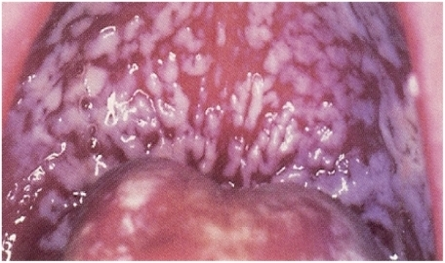
Oropharyngeal candidiasis (OPC)
Oropharyngeal candidiasis AKA oral thrush
Manifests on tongue, palate, buccal mucosa, or oropharynx
AIDS defining infection
31% of HIV/AIDS patients & most common oral infection (Thompson et al., 2010).
20% of cancer patients (Schelenz et al., 2010)
Candida albicans common agent
Also caused by others including…
C. glabrata, C. krusei, C. tropicalis, C. parapsilosis, and C. dubliniensis (Kirkpatrick et al., 1988, Martinez et al., 2002, Redding et al., 2000).
Non albicans species are becoming more common.
Image from NIH.gov

Slide 8
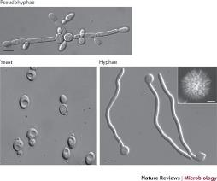
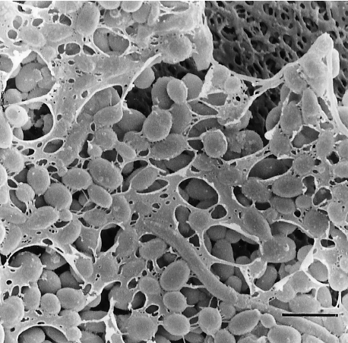
Candida albicans
C albicans - Opportunistic pathogenic fungus
Commensal – In mouth, GI track, but controlled
High threat
Immune compromised (i.e. AIDS, chemotherapy)
Medically compromised (i.e. catheters, stents).
Causes superficial or systemic infections
Mortality rates of 30-60%
Limited therapies & resistance growning
https://www.nature.com/articles/nrmicro2636
C albicans - Pleomorphic
yeast and filamentous morphologies
Virulence Factors:
Yeast to hyphae transition (filamentation)
Biofilm formation
https://www.researchgate.net/figure/Scanning-electron-micrograph-of-a-C-albicans-biofilm-grown-on-a-cellulose-acetate-filter_fig1_13598590
Notes:
Azoles (alpha 14 demethylase), polyenes (bind ergosterol on cell membrane), echinocandins inhibit B-13, glucan sysnthesis.

Slide 9
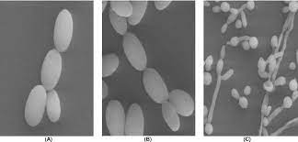
Candida glabrata
Candida glabrata
Also commensal in mouth, gutt (Cole et al., 1996; Fidel et al., 1999).
Not related to albicans – more like Saccharomyces cerevisiae (Dujon et al., 2004).
Second to albicans for infections (Perlroth et al., 2007).
Mainly yeast form, but also pseudohyphae, biofilms (Kaur et al., 2005).
https://www.semanticscholar.org/paper/Pseudohyphae-formation-in-Candida-glabrata-due-to-sassani-Khodavaisy/b0572c66add7a2a43d9716055a775bba0f8b8776
Notes:
CUG is leucine to serine

Slide 10
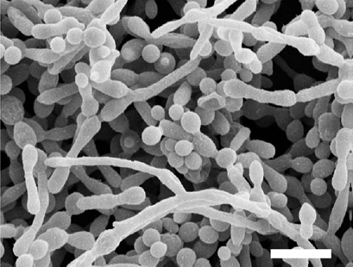
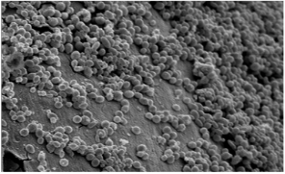
Candida biofilms
Highly complex microbial communities
Attached to a surface
Protected by an exopolymeric matrix.
Candida infections are associated biofilms on inert surfaces (i.e. catheter)
Filamentation is an essential process for the formation of biofilms.
Cells within biofilms are up to 1000 times more resistant to antifungal treatment.
An established biofilm prolongs infection and helps initiate new infection sites
Candida albicans
Candida glabrata
Zahran et al., 2015

Slide 11
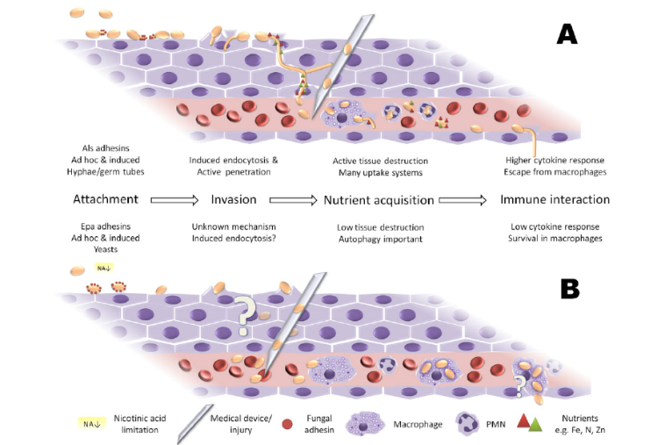
Infection strategies
Brunke and Hube, 2013

Slide 12
GPT Note:
IMRD Intro is done. NOW…how to present the paper?
EACH FIGURE IS USUALLY RESULTS OF ONE EXPERIMENT!!
Papers have multiple experiments that tell a story
How to present?
Either All Methods and then all Expts, or alternate??
A bit confusing.
Might give outline of experiments…or just jump in.
Or Broke out the main Questions of the paper (by figure)
Described Methods/experiments used to answer the questions.
Described results (Figures)
Transition to next (story)
Alternate Question/Purpose, Method, Results...Repeat
Please note: J Romo is a GOOOOD story teller. Methods w pics take time but is good for story....

Slide 13
GPT NOTE PRESENTING:
Expanding on Figures...
The figures tell the story
Answer questions you ask
Define what is IN figure.
Summarize results w Figure!
YOU MUST UNDERSTAND THEM!
If you are confused, your audience will be too
Dig and hunt to understand them
Know how to walk through them!

Slide 14
Do C. albicans and C. glabrata have any cooperative growth effects?

Slide 15
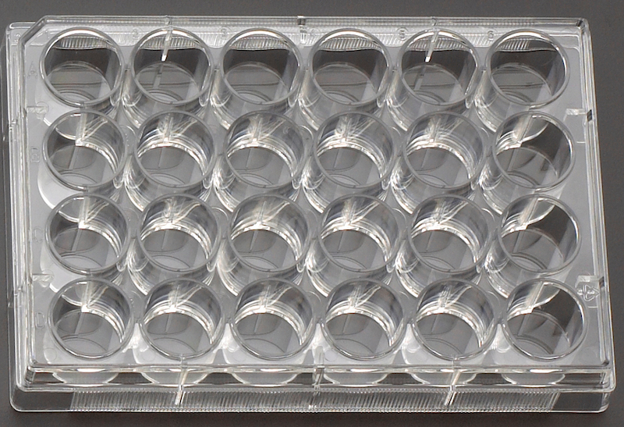
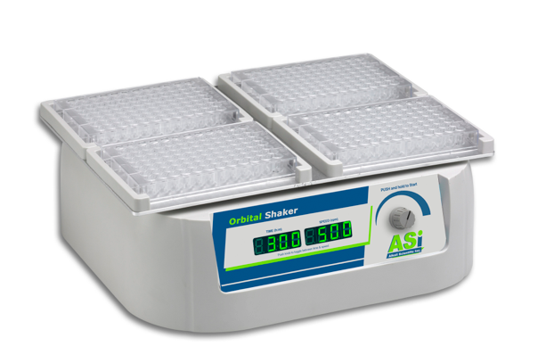
Figure 1 Experimental design
Dry weight experiments:
2X PBS Wash
Measure
dry weight
Incubate for
3 h at 37°C
20mL YPD
Overnight
30 °C
150-180 rpm
(OD₆₀₀ 2.0)
1mL of 1.0 X10⁶ cells/mL
YNB
Aspirate 1mL of media
to remove non-adherent
cells and add fresh media
Incubate biofilms
for 24 h at 37 °C on
an orbital shaker.
Modifications for mixed species:
500 μl of each strain at 5 X 10⁵ cells/ml

Slide 16
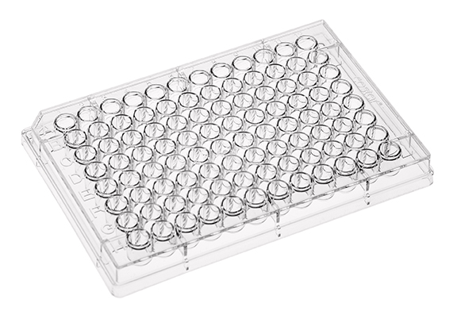
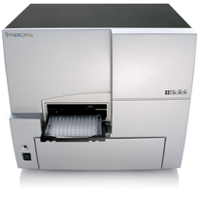
Figure 1 Experimental design
Fluorescence experiments:
2X PBS Wash
20mL YPD
Overnight
30 °C
150-180 rpm
(OD₆₀₀ 2.0)
1.0 X10⁶ cells/mL
YNB
yCherry C.a.
GFP C.g.
Incubate biofilms
at 37 °C
Measure fluorescence

Slide 17
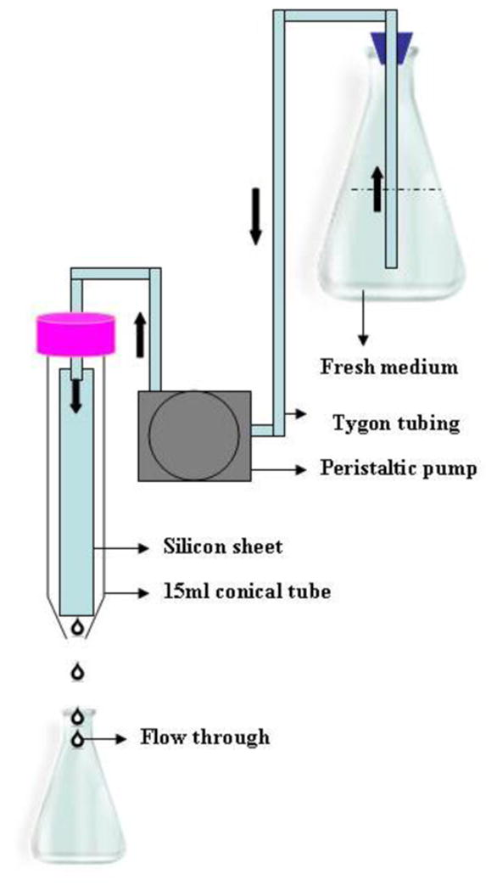
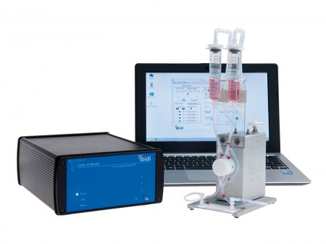
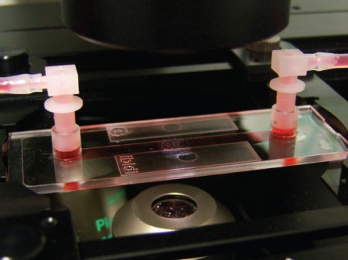
Figure 1 Experimental design
Biofilms under flow conditions
Ibidi flow system
WT C. a. CAF2 (mCherry) 1 x 10⁶ cells/ml
WT C. g. VSY55 (GFP) 1 x 10⁶ cells/ml
2 h at 37 °C
Image
Uppuluri et al., 2009

Slide 18
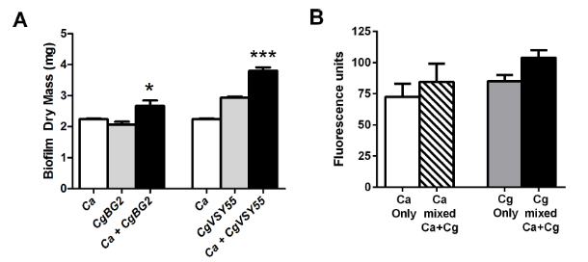
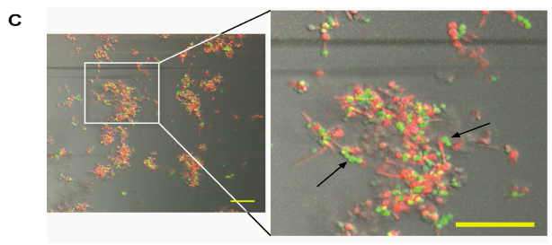
Figure 1. C. glabrata and C. albicans dual species biofilms showed increased biofilm mass that reflects C. glabrata adherence to C. albicans hyphae.
Strains used:
BG2 WT (C. glabrata)
CgVSY55= GFP-expressing C. glabrata
CAI4 WT (C. albicans)
CAF2-yCherry for C. albicans
Results:
Dual species biofilm more massive.
(B) Co-growth resulted in additional growth
(C) In flow, C.g. was unable to form biofilms alone, while C.a. formed robust biofilms.
(D) When grown together, C.g. was found associated with C.a. hyphae.

Slide 19
How are these two Candida species interacting?

Slide 20
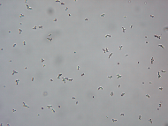
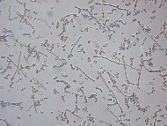
Figure 2 Experimental design
For yeast phase cells
1X wash
in PBS
3 h at 37 °C
C. albicans only in
YNB + 1.25% glucose
C. albicans +
C. glabrata (1:1)
for 60 min
Microscopic examination
Fluorescence
microscopy
For hyphal cells
1X wash
in PBS
3 h at 37 °C
Microscopic examination
C. albicans +
C. glabrata (1:1)
for 60 min
C. albicans only in
YNB + 1.25% GlcNAc

Slide 21
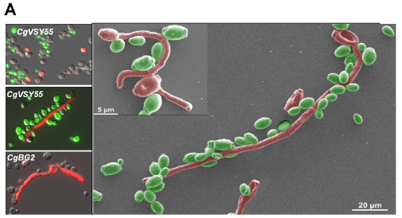
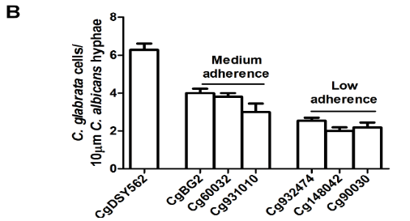
Figure 2. C. glabrata adheres to C. albicans hyphae.
Strains used:
CgVSY55 = GFP-expressing C. glabrata
CgBG2 = WT C. glabrata
CAF2-yCherry = C. albicans
Result: C. glabrata cells did not adhere to albicans cells, but did to hyphae.
Adhesion = # of cells adhering to 10 μm
length of C. albicans hyphae.
Examined 7 C. glabrata strains for
adhesion to hyphae.

Slide 22
To identify the exact mechanism C. glabrata was using for binding.
C. albicans incubated
with concanavalin A (100 μg/ml)
for 30 min.
C. albicans +
C. glabrata (1:1)
Result: C. glabrata adhesion to C. albicans not mediated by mannose or β, 1-3 glucan binding.
PBS Wash
C. albicans incubated
with β, 1-3 glucan Ab (10 μg/ml)
for 30 min.
C. albicans +
C. glabrata (1:1)
Notes:
Concanavalin is a lectin that binds mannan
May also be why they did not see glabrata binding to each other (expresses both β, 1-3 glucan and mannan)

Slide 23
C. glabrata binding is not mediated by mannose or β, 1-3 glucan. What causes the binding? Are adhesins involved?

Slide 24
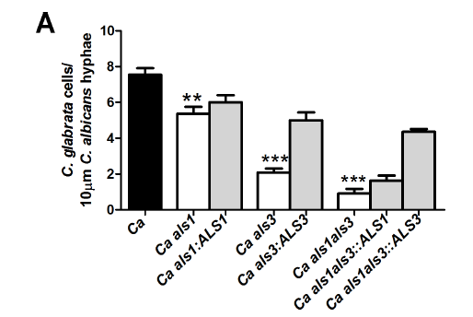
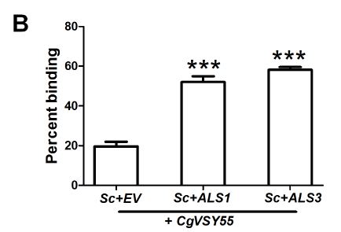
Figure 3. C. albicans Als3 and Als1 hyphal cell wall adhesins are involved in C. glabrata adherence to C.albicans hyphae.
Strains used:
C. albicans als3Δ/Δ
C. albicans als1Δ/Δ
C. albicans als1/als3Δ/Δ
ALS1 and ALS3 complements
als3Δ/Δ = 72.3% reduction in binding
als1Δ/Δ = 28.8% reduction in binding
als1/als3Δ/Δ= 86% reduction in binding
Reduction restored closer to WT levels upon
complementation.
Strains used:
CgVSY55 (GFP)
S. cerevisiae EV (empty vector)
S. cerevisiae ALS1
S. cerevisiae ALS3
Result! S. cerevisiae expressing Als1 and Als3 showed
significantly higher binding compared to the
empty vector.

Slide 25
Is this relevant in vivo?

Slide 26
GPT Note:
Above...left out a few figures, but those shown tell whole story...
Gave a little more introduction below (note citations)
Explaining model helps to visualize paper
Is it better here or in intro?
Experiment and see what is best story....
Also note: If presenting to a non-lab group don’t include animals.

Slide 27
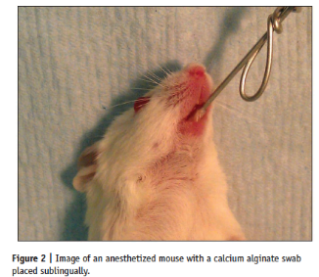
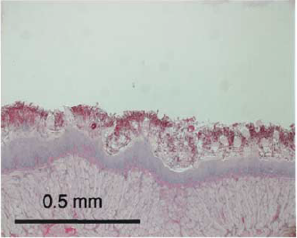
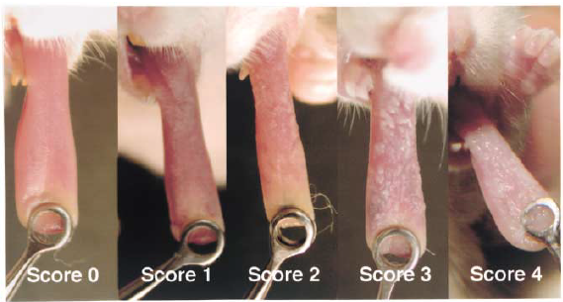
Oropharyngeal candidiasis model
Solis and Filler, 2012
Solis and Filler, 2012
Takakura et al., 2003

Slide 28
Figure 4 Experimental Design
C. glabrata only
Immunosuppression
Day -1 Day 0 Day 5
Monitor Animals for Survival/Clinical Score
Infection
C. glrabrata (1 X 10⁷ to 1 X 10⁹ cells/ml)
Mixed infections
Immunosuppression
Cortisone acetate (225 mg/kg)
Immunosuppression
Immunosuppression
D -1 D 0 D 1 D 2 D 3 D 4 D 5
Monitor Animals for Survival/Clinical Score
Infection
C. albicans (5 X 10⁷ cells/ml)
Infection
C. glabrata (1 X 10⁹ cells/ml)
Notes:
For the experiments involving C. glabrata alone they tried BALB/c, C57BL/6, and IL17RAk/o mice as well as immunosuppression with cortisone acetate, Triampicinolone acetonide, or cyclophosphamide and were unsuccessful in inducing C. glabrata infection.

Slide 29
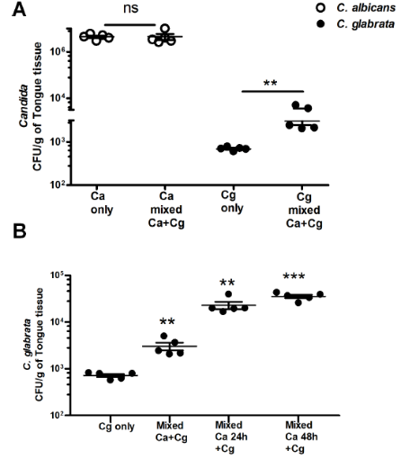
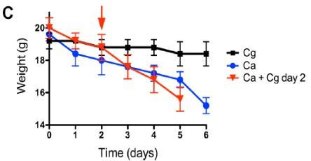
Figure 4. C. albicans enhances C. glabrata colonization in murine oropharyngeal candidiasis model.
RESULTS:
Co-infection with C. albicans and C. glabrata did not
alter C. albicans CFUs/counts
Co-infection with C. albicans and C. glabrata increased
C. glabrata CFUs by 10-fold.
Delaying C. glabrata infection for 24 or 48 h increased
C. glabrata infection by a further 10 fold.
Animals infected with C. glabrata alone did not experience
weight change, but mice with a mixed infection lost weight
more rapidly than those infected by C. albicans alone.
Notes:
Figure A (candida albicans + glabrata co-infection did not alter C albicans CFU) Used CHROMagar for this.

Slide 30
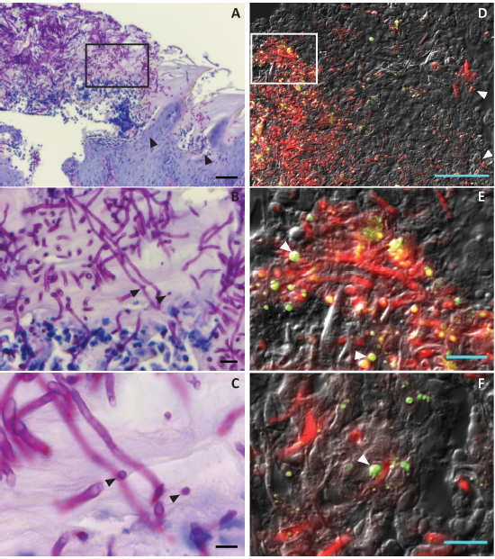
Figure 5. C. albicans and C. glabrata are co-localized and both invade murine tongue tissues in a mixed infection.
Strains used:
CAF2-yCherry C. albicans
CgVSY55 (GFP) C. glabrata
RESULTS:
Tongues from mice with mixed infections
displayed a thick fungal plaque with penetrating
hyphae.
In some areas cells were seen adherent to C. albicans
hyphae. Believed to be C. glabrata.
Fluorescent imaging revealed wide spread C. albicans
hyphae as well as C. glabrata cells associated and
separate from hyphae.
C. glabrata infection alone displayed minimal plaques
and no penetration into the tissue.
Notes:
Tongue tissue collected on day 5. C. albicans added on day 0 and glabrata on day 2.

Slide 31
Figure 6 Experimental design
Immunosuppression
Cortisone acetate (225 mg/kg)
Immunosuppression
Immunosuppression
D -1 D 0 D 1 D 2 D 3 D 5 D7
Monitor Animals for Survival/Clinical Score
Infection
C. albicans (5 X 10⁷ cells/ml)
Infection
C. glabrata (1 X 10⁹ cells/ml)
Flu ^{R}
Flu ^{S}
Flu ^{R}
100 mg/kg Fluconazole daily
(intraperitoneal injection)

Slide 32
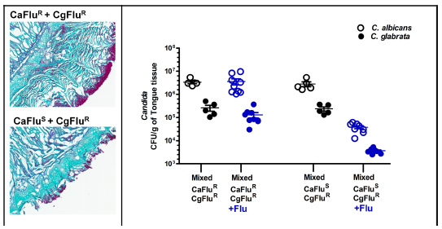
Figure 6. C. glabrata requires C. albicans for early infection.
Strains used:
C. albicans resistant to Fluconazole
C. glabrata resistant to Fluconazole
C. albicans sensitive to Fluconazole
RESULTS: Reduction of C. albicans with fluconazole
also reduced Fluconazole resistant C. glabrata CFUs (2 log).
Notes:
Flu treated animals infected with
CaFluR strains in a mixed infection lost significantly (P< 0.05) more weight (21.2 ± 0.2%) than
mice infected with C . albicans CaFluS strains (18.9 ± 0.3%). Although we could not determine
the co-locallization of C . albicans and C . glabrata histologically due to lack of fluorescent markers
in Flu resistant strains, examination of tongues confirmed the reduction in superficial epithelial
fungal burden and invasion upon Flu treatment

Slide 33
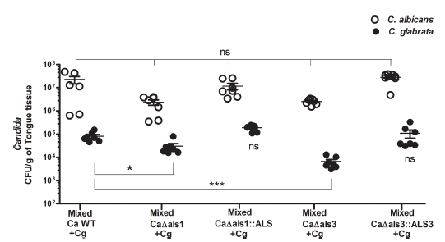
Figure 7. C. glabrata colonization requires C. albicans Als1 and Als3 in murine oropharyngeal candidiasis.
Strains used:
C. albicans als3Δ/Δ
C. albicans als1Δ/Δ
C. albicans als1/als3Δ/Δ
ALS1 and ALS3 complements
RESULTS:
(A) Als mutants were able to establish infection similar to WT.
(B) C. glabrata tongue CFUs were significantly reduced when
co-infected with Als mutants.

Slide 34
What cell wall components is C. glabrata using to bind to C. albicans adhesins?

Slide 35
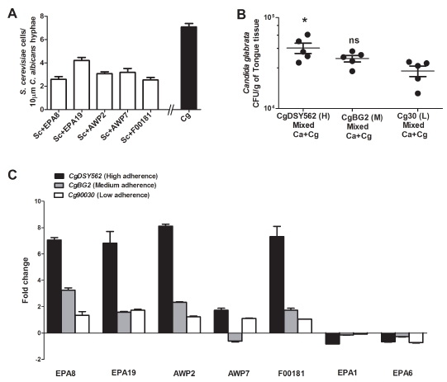
Figure 8. C. glabrata cell wall adhesins are induced in the presence of C.albicans.
Strains used:
S. cerevisiae expressing Cg Epa8
S. cerevisiae expressing Cg Epa19
S. cerevisiae expressing Cg Awp2
S. cerevisiae expressing Cg Awp7
S. cerevisiae expressing Cg ORF F00181
RESULTS:
(A) In vivo, the low and high adhesion C. glabrata strains had a significant difference in infection levels.
(B) CgEPA8, CgEPA19, CgAWP2, and
ORF F00181 transcription were increased significantly
in the presence of C. albicans.
Notes:
Screened 44 S. cerevisiae strains expressing C. glabrata cell wall proteins. Five strains were the most adhesive.
Most other strains, including S. cerevisiae had no adhesion to C. albicans hyphae.
EPA1 and EPA6 were controls since those displayed no binding to C. albicans. These two are highly expressed adhesins in C. glabrata.

Slide 36
Discussion – Overall Why is this Important?
Major Findings:
C. glabrata
able to colonize and penetrate gastric epithelium
non-invasive in the oral cavity unless C. albicans is present.
Hyphal cell wall adhesins (Als3 and Als1) contribute to binding of C. glabrata.
Als3 could be a potential target for disrupting mixed species and inter-kingdom biofilms. ANTIFUNGAL!!

Slide 37
Thank you! Questions?
VERY GOOD JOB!
Told a great story
Solid Rep in Grad School
People happy to listen!!!

