Slide 1
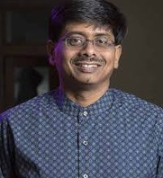
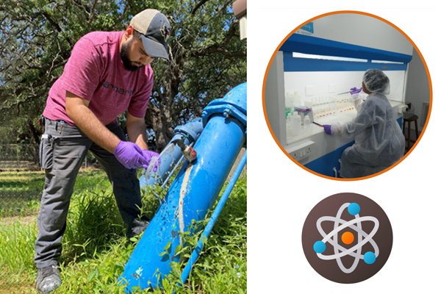

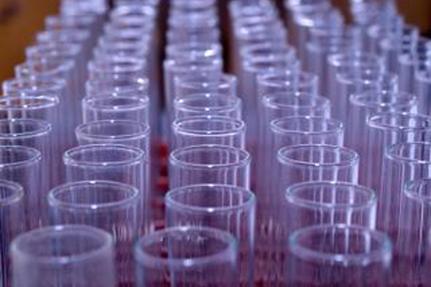
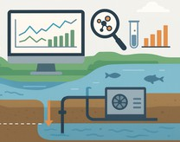
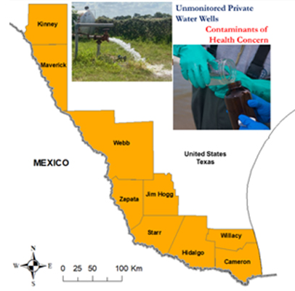
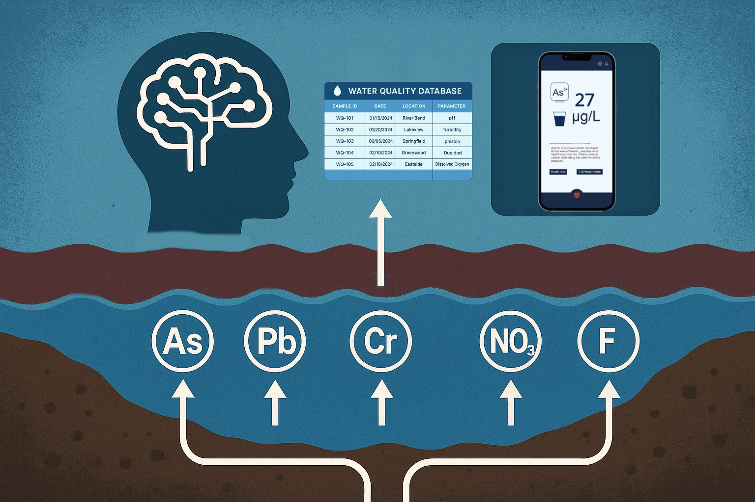
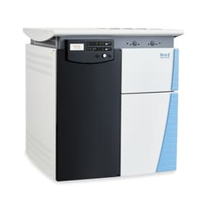
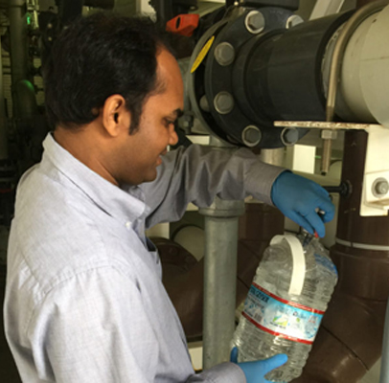

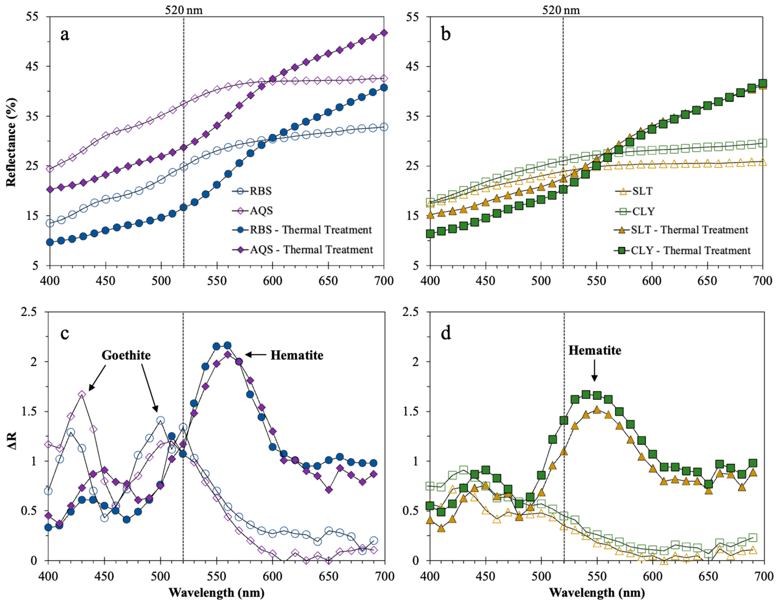
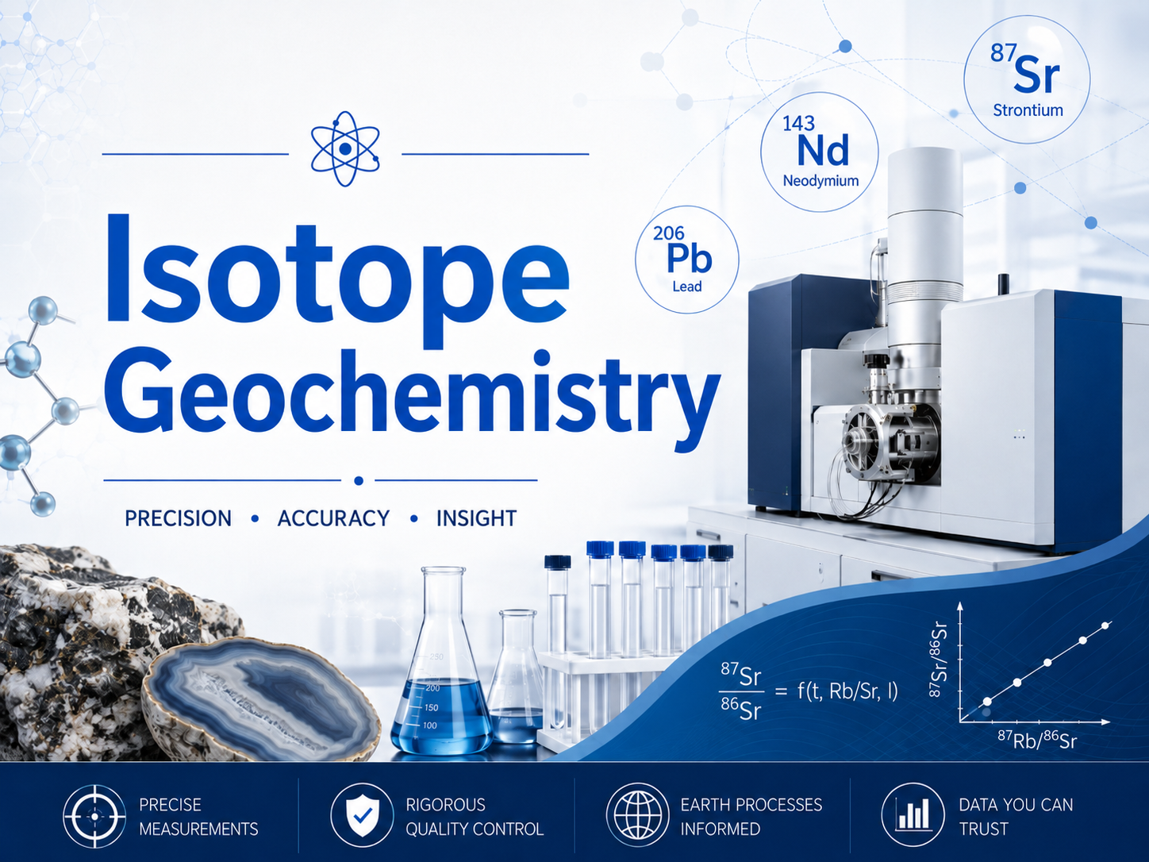
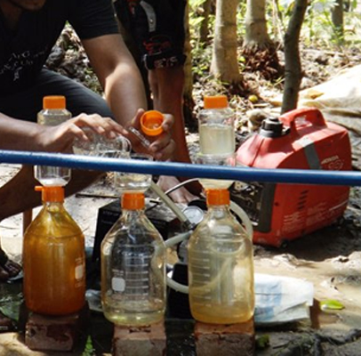

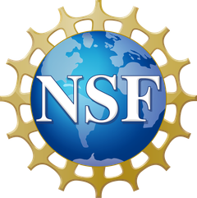

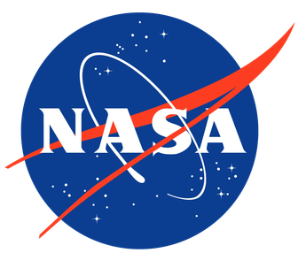

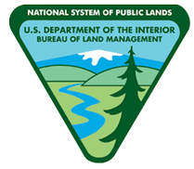

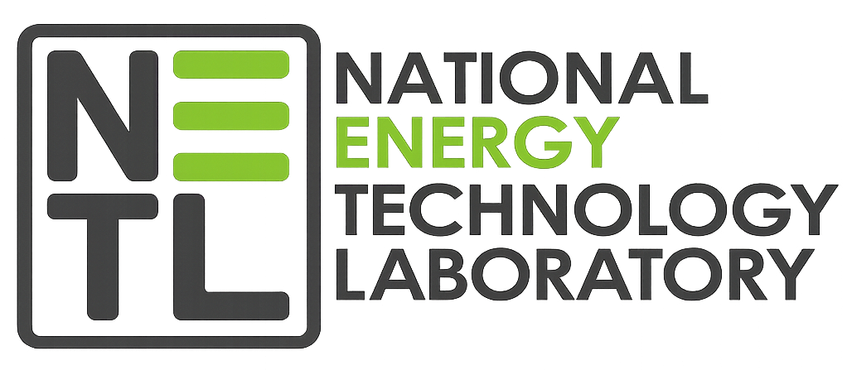

Saugata Datta
Chemical Hydrogeology and
Environmental Biogeochemistry
Professor
Chair, Department of Earth and Planetary Sciences, UTSA
Director, Institute of Water Research Sustainability and Policy (IWRSP)
Water Resources
Contaminant transport
Isotope geochemistry
One Health
Email: saugata.datta@utsa.edu
Research Interests
Current Research
Isotope Geochemistry
Human exposure, environmental forensics, exposure pathways, targeted remediation, biogeochemical cycles, source/fate of heavy metals.
Our research focuses on water resources, water availability, and the cycling of trace metals, nutrients, and toxic organic constituents (microplastics, PFAS, dioxins, organo-nitrates, and TCE) in ground and surface waters and soils. The work links land-use change, pollutant distribution, carbon cycling, and health-impact assessment.
Geologic CO₂ Capture
Drinking-water security, surfactants, HPHT brine - water - supercritical CO₂ systems.
Machine Learning
Random Forest modeling, Edwards Aquifer hydrogeochemistry, SHAP interpretation, Monte Carlo, population exposure, fluoride/nitrate risk.
US–Mexico Border Groundwater
Underserved communities, water-type characterization, inorganic/organic contaminants, mobility controls, spatial prediction, community health risk.
Laboratory Capabilities
Chemical hydrogeology and aqueous geochemistry
Groundwater quality, availability, and sustainability
Contaminant transport and trace-element mobility
Isotope geochemistry and environmental forensics
Human-health and ecosystem-health risk assessment
Mineral–water–sediment–organic matter interactions
Field research in India, Bangladesh, Argentina, Mexico, and the U.S.
Desalination & Purification
Advanced water purification and trace-element biogeochemistry in waters: As, NO₃, W, Pb, F, Cu, Mn, Cr.
Soil Nutrients & Sensors
Phosphates, graphene-based sensor development, electrochemistry, and real-time measurements.
Groundwater Contamination & Oxyanion Speciation
Investigating the sources, transport, transformation, and long-term fate of inorganic and organic contaminants in groundwater systems. Our work integrates aqueous and solid-phase geochemistry to determine oxyanion speciation, trace-element bioavailability, and the geochemical controls governing contaminant mobility in water, soils.
Awards: Geological Society of America Fellow 2022

