Slide 1
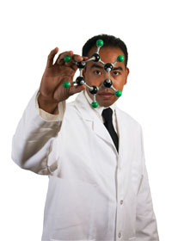
Research Training as a UTSA Undergraduate!
Starting Strong in a Lab
Dr. Gail P. Taylor
Asst. Program Director
MBRS-RISE &
MARC U*STAR

Slide 2
OVERALL How to Impress Faculty and Satisfy Yourself
TAKEN FROM RECOMMENDATION FORMS FOR GRAD SCHOOL…
Strong grasp of your course work
Strong work ethic and productivity
Responsibly finish what is assigned to you
Pick up techniques fast (Take NOTES!!!!)
Work to solve own problems
High level critical thinking (take time to think!)
  How do you approach problems?
  What is the next step of your project?
  What are the implications of your project?
Show enjoyment of what you are doing
Teamwork
Respect self and others
Good communication
Teaching ability
Honesty/Integrity

Slide 3
You have an Amazing Opportunity – RESEARCH!!
Cool experience! Woo! Confirms path?
Contribute to knowledge
Connect w faculty and advanced students
Opens Doors…future positions or Graduate School
Reinforces / brings coursework alive.
Letters/Recommendations
  Next experience
    Summer at….Harvard? MIT? Penn? Sooner!
  PhD Programs, MD/PhD Programs
BURT??
Goldwater Scholarship?

Slide 4

Your Job? Start Strong in the Lab!
Complete early mandatory training
  Safety
  Responsible Conduct
Dig in and learn!
Take full advantage of experience
Don’t hesitate to use machines properly, etc.
Remember…it’s common to feel like a fish out of water. Just Surf on top…

Slide 5
Lab Orientation
You’ve been offered a position in a lab…
And told where/when to show up
…and who you’ll work with
You’ll been handed reading materials
You’ll been given information/training on…
  Basic Laboratory Safety
  Additional training needed
  Communication (Text, email, Slack, etc)
  Expectations for time spent in lab
  Lab Meeting times
  Equipment operation & locations of things
So….How do you shine?

Slide 6
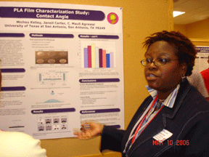
How to Shine - MOST IMPORTANT
Don’t Approach Lab with the wrong attitude:
  “I’m just an undergrad”
  Don’t minimize yourself because you think you’re “Out of Your Lane…”
Step up and show what you can do
Most labs will allow you to stretch yourself and grow!
Growth can happen quickly
Follow the Be-s of Laboratory Success!

Slide 7
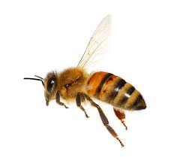

Be-s of Laboratory Success

Slide 8
Be Aware - Who is in the Lab?
The Principal Investigator (P.I.) – Lab “owner”
  CEO of Lab. Oversees All. Direction of Lab
  Research Mentor vs person who mentors you…
Research Scientists – Often PhD working for PI
Laboratory Manager – Oversees lab function
Postdocs – PhD doing post-grad work
Technicians / Research Assistants
Graduate students
  M.S. (UTSA graduate “means” M.S.)
  Ph.D.
Undergraduate students
High School Students
These are your
Immediate Hierarchy

Slide 9
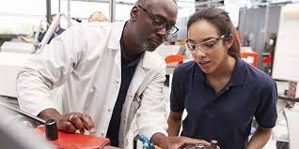
Be Aware – Labs are an Apprenticeship
Each lab is different. Nearly all have Hierarchical (Levels) training
New Undergraduate members…
  Start at basic levels
  Will often observe and be trained by near-peer, PhD student or Postdoc
  You will seldom work day-to-day directly with PI (Except in lab with few people)
  Must PUSH YOURSELF independently to grow
  Can PROVE YOURSELF through engagement/responsibility
  Work to fit into lab and become scientist
More mature UG members (UT San Antonio Great Environment for this!!!)
  Greater autonomy
  Own project or independent part of project
  May be “given” a High School or Summer student
  May train new Graduate Students…
  Essentially prove they are ready for Doctoral Training

Slide 10

Know and Be Known to Your PI
PI – “Research Mentor” - CEO of Lab
  Principal Investigator
  Bring in funding and Direction of lab
  Responsible for all that happens in the lab
  Hires and fires
  Delegates responsibilities downward
You pick up their reputation
  Science is about people
  Scientists elsewhere know your PI
  “Who is your research mentor?” Your PI, not postdoc
You must get to know them
  They are your Mentor
  May have Mentoring Compact / Contract with you
    What they expect? What do you want from experience and them?
  They can help you to reach your goal
Their letter of recommendation, even ghost written by your trainer, is what counts.

Slide 11

Be Respectful
Your PI, Postdoc or other PhD is “Dr. ____________” unless you’re told otherwise
You’re in the lab as a favor but considered a good investment!
Your Trainer / Mentor also has other commitments
  Be polite but get the help you need
Your PI has many other commitments
  Ask for some of their time to speak with you…
  They are Ultimately your “Mentor”
Others are giving you time
  Listen, etc.

Slide 12
NOTE: Communicating w PhDs…
They have a natural level of respect as PhDs in a university
  Polite but don’t grovel
Assume they are more busy than you
  You must accommodate their schedule
Emails – Short as possible. They read beginning and end.
Missing Lab? – Always communicate about missing lab, even if you already told them about a conference.
They may forget what they told you…

Slide 13
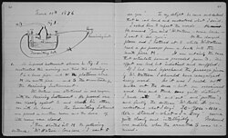
Be a Quick Technical Learner
Ask about lab notebook & keep one
Pick up Techniques Fast!
  Take detailed notes!
    Equipment Settings
    Incubation times and temps
    Location of reagents and chems
    Analysis used
    Special instructions!!
  Make sure to ask clarifying Q’s during instruction
  You’re expected to be nearly able to do it after being shown once or twice, but if you take notes, follow-up questions will not be resented…
  Do NOT mess up because you don’t want to ask a question!

Slide 14
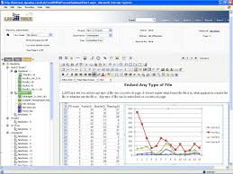


NOTEBOOKS…
ELN – Electronic Lab Notebook
LES – Lab Executive System
Duplicate Sheets – Carbon paper build in
Standard grid paged Notebook

Slide 15
Type and Format…NOTEBOOK
Ultimately dictated by your PI/company
Type | Advantages | Drawbacks
Bound book (stitched) | No lost sheets Proof against Fraud | Entered as done No logical order
Duplicate “Bound” Book (yellow sheets) | Double record. Easy copies | Diff. To Read. Not true duplicate
Loose Leaf (folders/notebooks) | Order by expts Easy recording | Lost sheets Authenticity prob.
Computer | Easy to read Easy calculations | Lost data Authenticity prob

Slide 16
Preparing a New Lab Notebook
Save Space for Table of Contents
First two facing pages at least.
List experiments by:
  Title
  Date
  Page Number
Particularly helps when more than one project

Slide 17
For Every Experiment, Record:
Start Date on all pages
Title
Why: Brief statement of purpose
How:
  Description/protocol with reference of origin Calculations (on empty adjoining page): MW, concentrations, dilutions, etc.
What Happened:
  All that happens (protocol changes; on floor, kicked)
  Taped in Information (if it does not fit, keep an associated folder)
What It Means:
  Your interpretation (summation with oddities and comments)
What’s Next

Slide 18
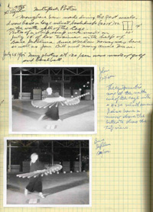
Attached Materials
Computer generated data
Photographic data
All other data
Printed graphs (make as you go)
Datasheet templates
Product labels
Who provided plasmids, etc.
Notes (or pasted copies) of discussions, conversations, emails, readings related to exp’t design or goals
Archive locations of plasmids, probes, etc.
X-rays and other large items may be kept in a separate folder if they don’t fit in the lab notebook.
Always write on these materials the date and other identifying information in case they get separated!

Slide 19
Remember the little things…
Lot numbers
Other people involved
Incubation times
# washes
Machine Settings
Unexpected delays
Problems Encountered
Media and Buffers
Calculations
Problems with individual subjects

Slide 20
The importance of timing…
Always record, update, review…
Record as you go
Input paper towel and post-it info ASAP!
At the LATEST, insert data the next day!
Do a weekly checkup
  1 hour to review
  Make sure everything is attached securely, all summaries written, future directions written, record in table of contents

Slide 21
More Helpful Tips
The institution owns “your” notebook
Do NOT remove your notebook from the lab (unless this is an acceptable lab practice)
You may get permission to take copies at graduation, but do not take original pages
Do NOT read another person’s notebook without permission (even the PI won’t look at advanced researcher’s notebooks secretly).
Should be kept for at least 5 years

Slide 22
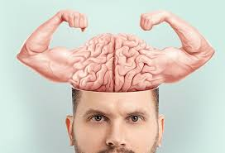
Be an Intellectual Stand-out
Review pertinent coursework or read online as needed…
Read any paper given to you immediately
  TEST!!!
  Scientific Papers are the ultimate goal of any project
  Shows Interest / Devotion / Level of engagement
Seek to understand your project
  What does your experiment have potential to show / help?
  Where does it fit into other experiments in lab (Multiple in a paper)
  Where did any prior data come from?
  Hit the literature!!
    What research lead to your project? In lab and in literature
    Where is similar research taking place?
Display critical thinking:
  Take time to think
  Ask questions in lab meetings
  What outcome means & What’s next?
  Politely point out problems you see with others’ data (papers or meetings)

Slide 23

Be Responsible and Proactive
Let your yes mean yes
  Show up when you say!!
  Go to lab meetings
Take charge of your project as much as you can
Clean up your own mess
Limit phone calls and texts, tweets, etc.

Slide 24

Be Honest
EVEN IF YOU MESSED UP…
  Do not alter data
  Do not make up data
  Do NOT mislead mentor or PI
Avoid plagiarism
  Near Word for word copying
  Also…not giving others credit for ideas / discoveries
Admit when you make a mistake

Slide 25

Let Your Presence Be Known
Do readings that you’re supposed to
  Build vocabulary - Look up unknown words!!
Meet regularly and reliably
  Call/text if you have to miss a scheduled session
BE A LAB MEMBER
  Go to lab meetings…
  …and even to nights on the town.
  Connect in every way possible
  Keep yourself in their mind
If online…
  Turn on your camera

Slide 26
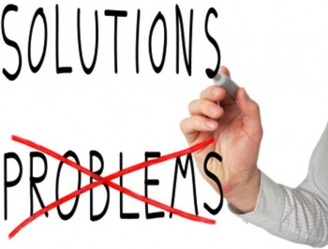
Be a Problem Solver
If something doesn’t work, figure out why
It didn’t work…
  Possibly because of ________ or ________
Even consult internet, similar papers, people

Slide 27
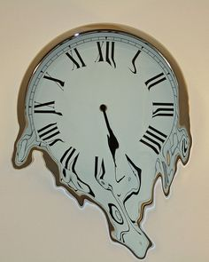
Be Aware of Time
Know that…
  Research happens when it must
  Work late if needed (if allowed)
  Work on weekends if needed & Allowed
DO NOT Walk out in the middle of something!
During AY…don’t overdo it!!
  Do NOT kill your classes
Do NOT burn yourself out!

Slide 28
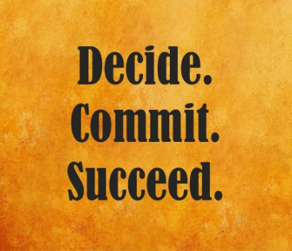
Be Committed…
It takes time to shine in a lab
A lab will take your training seriously
Are you willing/able to put in the time needed?
  This may vary by lab…
  10+ thru 20 h/week In academic year
    More = greater growth
  More in summer?
Is the time worth it to you?
  Explore a strong interest
  Job training (absolutely!)
  Enrich your degree
  Knowledge building / Your field
  Pre-MS/PhD
  Pre-HRP (MD, DDS, Etc) with desire for research?
  Honors thesis

Slide 29
Be Safe
Physically – Take safety training and follow it.
  Clothing, Gloves, Eye Protection, Hoods, Lab Coats…
  Glassware, Toxins, Biosafety, needles…
  Animal use
Emotionally – Professional Environment
  Make others comfortable
  No sexual jokes / innuendo
  Beware of teasing / microaggressions
  Beware of politics
  Be KIND to odd ducks

Slide 30
Be Aware when it’s not Safe
Lab is a subset of the world
There may be “problem” people
There may be “problem” practices
Talk to Trainer and/or PI
  Basic incompatibilities with a trainer
  Someone repeatedly too close (tell them & tell Training Mentor and/or PI)
  Someone obviously harasses / touches - Tell them, also report to EOS
  Racial / ethnic / gender jokes
  Altering/Making up data
  Doing something illegal in lab
  Doing something dangerous in the lab

Slide 31
Other Variables to learn quickly…
Dress practices for that lab
Eating areas and food storage (NO FOOD IN FRIDGES!!)
Computer use policies
Chemicals: location, who makes stock solutions, pH measurement, weighing conventions, ordering
What to do when a chemical or solution is gone
Trash disposal: sharps, biohazard, recyclables, glass, etc…
Glassware policies: where found, washing, autoclaving
Laboratory coats: required, provided, cleaning
Common Use pipettors, reagents, chemicals VS Personal
Lab notebook: provided, format, copies, non-removal
Photocopying and printing

Slide 32
OVERALL How to Impress Faculty and Satisfy Yourself
TAKEN FROM RECOMMENDATION FORMS FOR GRAD SCHOOL …
Strong grasp of your course work
Strong work ethic and productivity
Responsibly finish what is assigned to you
Pick up techniques fast (Take NOTES!!!!)
Work to solve own problems
High level critical thinking (take time to think!)
  How do you approach problems?
  What is the next step of your project?
  What are the implications of your project?
Show enjoyment of what you are doing
Teamwork
Respect self and others
Good communication
Teaching ability
Honesty/Integrity

Slide 33
Small opportunities are often the beginning of great enterprises….
~Demosthenes
Notes:
Greek orator,

