Slide 1

How To Get Involved in Research
September 22, 2026

Slide 2
Speakers
Gail P. Taylor, Ph.D. –
  Associate Director STEM Initiatives, COS SSC
Lindsey Macpherson, Ph.D.,
  Associate Professor, Neuroscience, Developmental and Regenerative Biology.
Kathryn Mayer, Ph.D.
  Associate Professor, Physics and Astronomy
Philipp Schmidpeter, Ph.D.,
  Assistant Professor, Biochemistry.
Hector Aguilar, Ph.D.
  Professor of Instruction and Distinguished Teaching Professor, Chemistry
  Associate Dean for Undergraduate Studies, College of Sciences
  Associate Dean for Academic Affairs, Honors College

Slide 3
Obtaining Research Experience as an Undergraduate!
College of Sciences
Student Success Center
Gail P. Taylor, Ph.D.
Pre-doctoral Training Specialist

Slide 4
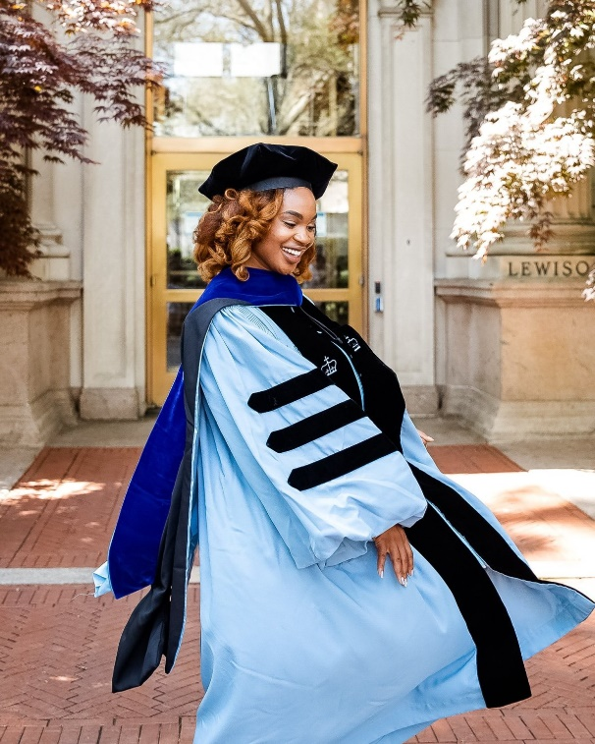
VERY IMPORTANT PSA about PhD Training…
Can apply/enter straight from UG
  In Sciences usually don’t need a Masters
  In Math you MAY need a MS, but may be offered a funded MS to PhD.
PhDs are free (but not easy) – You are paid to get one
  You are usually paid thru institution (tuition & Fees as well!)
    Stipend from TA, Research Assistantships, Fellowships
  You can get your own funding… (ex: NSF GRFP, Gilliam Fellows)
  In some cases, a company where you’re working might pay for it...

Slide 5
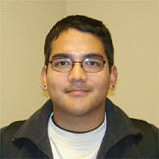
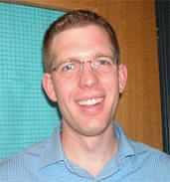
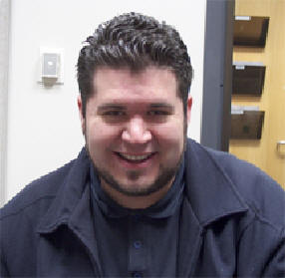
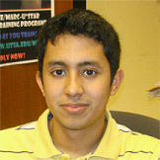

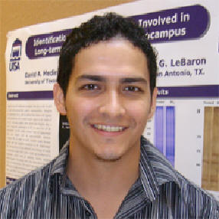
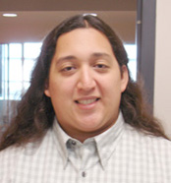
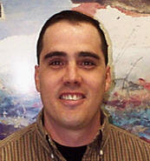
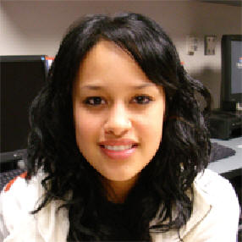
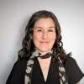
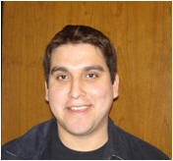
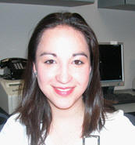
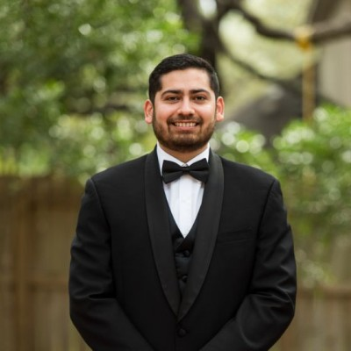
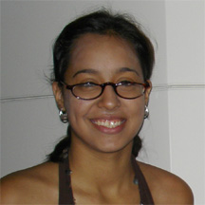
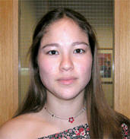
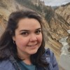
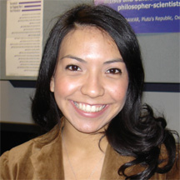
What Do They Have in Common?
https://sciences.utsa.edu/student-programs/marc/students/alumni-with-phd.html

Slide 6
What Research Gives You…
Build Credentials / Skills
  Can bring degree to life…
  Research Techniques / Experimental Design
  Professional Skills (speaking, writing)
  Coursework assistance and credit
Integration into Science Culture
  Pick up a little “cultural capital” How-to
  Many unwritten rules and preferences…
Faculty, Postdoc, Grad Student Mentoring
Build Identity – Become a Scientist…
Opportunity to Cultivate letters of Recommendation

Slide 7
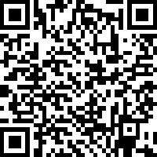
Structured Intro to Research & Foundations…
F 2027 Transfer Academy - https://sciences.utsa.edu/student-programs/stem-academy/
Spring 2027 Rising Researchers - https://sciences.utsa.edu/student-programs/rising-researchers/
  12 Week Introduction to Research, PhD and Professional Skills

Slide 8
SSC Research Training Series
COS SSC Research Professional Development Training Series 4100 a, b, c, d
  COS Signature Experience - Professional Development
  https://catalog.utsa.edu/undergraduate/coursedescriptions/sci/
  Two years, four semesters
  0 Credit (free)
  Progressively intensive mentoring/training topics for students in research labs

Slide 9
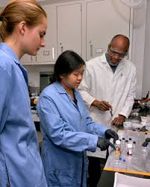
Unfunded Mechanisms – Gain Research Experience on Campus
Course-based research experiences (CUREs)
  https://sciences.utsa.edu/bhe/students/cures.html
Unpaid:
  Volunteer in UTSA / HSC Research Labs
    https://sciences.utsa.edu/ugresearch/volunteering.html
    For UTSA: Just volunteer and department will coordinate…
    For UT Health: https://outreach.uthscsa.edu/programs/visiting-students/
  For Credit:
    Honors research (HC or COS) 4991,2,3
    Independent study 4911,2,3 (Can be used; not as common)
    Major-associated research – 4921,2,3 or whatever their numbers are
  COS Signature Experience
    https://sciences.utsa.edu/student/undergraduate/signature-experience.html

Slide 10
Funded AY Mechanisms of Entering labs @ UTSA
PURF: Provost’s Undergraduate Research Fellowship: https://provost.utsa.edu/undergraduate-research/opportunities/scholarship-application.html
Hired as Research Assistant (usually in lab where you’ve volunteered)
Work Study (federally funded…awarded through financial aid)
  You must be awarded Financial Aid & lab / program must be awarded positions
  Departments, teaching labs, faculty
    Make sure it refers to RESEARCH not just cleaning
Work Study Research Training Program: https://sciences.utsa.edu/student-programs/wsrtp/
    In COS Student Success Center
    Fund several additional students
    Funding for travel & lab supplies
  COS Research Training Program (STAY TUNED!) ASCEND?? Advancing Science Careers through ENgaged Discovery??
  Keep Applying through the WSRTP Application for now.
Honors College Research Match Program: https://honors.utsa.edu/programs/research_match.html

Slide 11
Funded AY Mechanisms of Entering labs @ UTSA cont.
Funded AY Mechanisms of Entering labs @ UTSA
*McNair Scholars Program: https://www.utsa.edu/studentsuccess/educational-outreach/utsa-mcnair.html - will probably have Summer 2027 Session!
*Pathways Program: Science Education Research: https://pathways.utsa.edu/#:~:text=The%20program%20offers%20fellows:%20*%20Opportunities%20to,and%20the%20program%20starts%20in%20October%202025.
*APPEX: https://www.utsa.edu/crts/appex/ + APPEX-2. May be accepting a few more people for Fall 2027

Slide 12
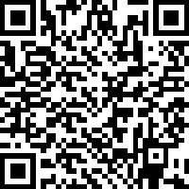
BURT
Biomedical Undergraduate Research Training initiative
PI Dr. Lindsey Macpherson
Focus: PhD in biomedical sciences
Federal training grant, like our old MARC grant
Obtained a very good score! Likely to be awarded for Spring 2027.
Two years of training required
BURT-2 will offer funding to additional students
BURT: Stipend and partial tuition – through financial aid
BURT2: funding plus adoption into program
Interest form:
https://utsa.az1.qualtrics.com/jfe/form/SV_071oUnKUOCF9Rs2

Slide 13
Additional Funded Programs – UT Health Based
Student Internship Program: https://outreach.uthscsa.edu/programs/student-internship/
STUROP: South Texas Undergrad Res Opportunity: https://outreach.uthscsa.edu/programs/sturop/ *Starts Summer, but PT AY pay may be available
MIMG (Micro/Immuno) Undergrad Research Program: (Incoming 1st years) https://lsom.uthscsa.edu/mimg/programs/undergraduate/

Slide 14
More Funded Mechanisms of Entering labs @ UT San Antonio AY or Summer
  Intramural Summer Programs:
    Voelcker Chem REU: https://sciences.utsa.edu/chemistry/summer-reu.html
    UT Health: https://uthscsa.edu/biomedical-sciences/programs/summer
  Najim Center Funding:
    Scholarships to support experiential learning (apply Jan to March!) https://provost.utsa.edu/career/najim/scholarships.html
      Must have set up research experience. Will help with costs such as travel to and from site destinations, housing/accommodations, living expenses, tuition fees for coursework, and/or having an unpaid experience
    Global Summer Institute: https://provost.utsa.edu/career/najim/offerings/the-global-summer-institute.html

Slide 15
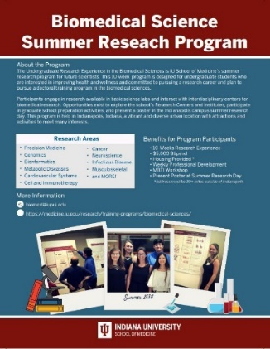

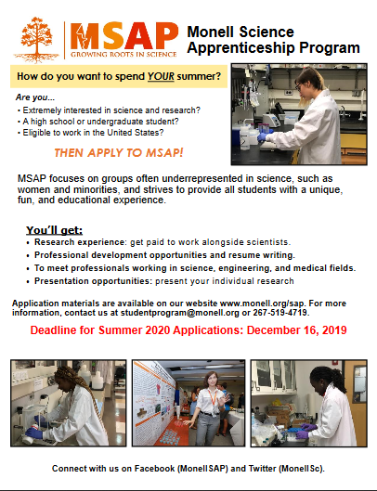
Extramural Summer Programs
8-10 weeks (I recommend 10)
Gain Incredible Experience
Normally are placed in a lab
Held...
  Throughout country and elsewhere!
  Universities
  Medical Schools
  Graduate (Ph.D.) Schools
  Government Research Organizations
  Companies (AMGEN!!)
  Some International Partnerships
They are NOT all REUs (NSF)
  REU = NSF

Slide 16
Extramural Summer Programs contd
Extramural Summer Programs
Fund Travel, housing, stipend ($4K – $8K)
Most Common Links:
  (All Fields, Main Search Page) Pathways to Science: https://www.pathwaystoscience.org/
  AAMC: Summer Undergraduate Research Programs (PREMEDS!!!!)
  NSF REU (all STEM Fields): https://www.nsf.gov/funding/initiatives/reu
    Apply through ETAP: https://etap.nsf.gov/
  NIH SIP: https://www.training.nih.gov/research-training/pb/sip/
  Dept of Energy: https://science.osti.gov/wdts/suli
  Amgen Scholars (Biomed): https://amgenscholars.com/
  Others: Google, “Summer Undergraduate Research”

Slide 17
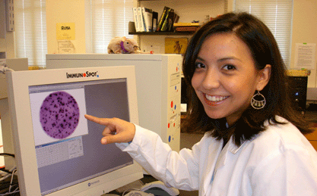
Finding a lab / Research Mentor at UTSA
http://www.utsa.edu/sciences/ugresearch/volunteering.html
Find interesting research
  COS Listing of Depts and Research Types
    https://sciences.utsa.edu/research/departments.html
  Faculty Listings on Departmental Sites:
    Look through them and look at research topics
    Fine some you like and dig deeper
  UT Health Faculty are on several campuses – South TX Medical Center
    https://uthscsa.edu/biomedical-sciences/student-life/ut-health-san-antonio-campus-tour
    Faculty may be listed by Department or by Campus
  Could also try Texas Biomed Research Institute or Southwest Research Institute…

Slide 18
Write to, or approach, a Faculty Member…
Must have a lab. Tenured or Tenure track
  Professor / Chair / Endowed Chair
  Associate Professor
  Assistant Professor
NOT “of instruction” or “of practice”

Slide 19
Email - Be polite and NOT long winded
Something like…
Dear Dr. XXXXX, I am a [first, second, third, fourth] year undergraduate XXXXX major. [I want a PhD... I am thinking about a PhD... I am considering graduate school...] and would love to participate in research. I am looking for a laboratory and am very interested in your research on XXXXX. [Maybe a few sentences on why you like their research.] If you are accepting students at this time, I would like to schedule a meeting with you to discuss your research and possible opportunities in your lab. I plan to work in the laboratory for XX semesters, until I graduate. Thank you.
No typos
Individualized - NOT obviously mail merged: “….I am very interested in gaining research experience in [their field – e.g., neuroscience / microbiology].” (real error I obtained))
Not written by AI.. Use your own voice
May have to write twice. Wait 3 or 4 days. Just send same Email.

Slide 20
You Get a Response!! Woo!
Some Have Application Process! At least start it!
PREPARE for meeting with PI
  Consider questions you may be asked
  Look up their research
    At least look over their website and interests
    Maybe read/skim a recent paper where they are last author listed
  Make a CV? Optional:
    Template: Lines or not…or just make your own!
    https://sciences.utsa.edu/student-programs/marc/_documents/templates/cv-template.docx
    https://sciences.utsa.edu/student-programs/marc/_documents/templates/cv-template-lines.docx

Slide 21
Some Interview questions you may be asked…
Tell me about yourself.
  See next slide
How much time are you able to volunteer each week?
When do you graduate?
Why did you pick your major?
Why do you want to perform research (in general)?
  NOT to check box for XXX professional school admission
Why are you interested in MY lab?
  What did you investigate about lab…or even read a paper? How did it interest you? Also mention reading/investigation
What are your career / education goals?
Describe yourself (maybe 5 words that describe you).

Slide 22
Tell me about yourself…
Start with very brief childhood/family and end asking for lab position
Like…two sentences. Maybe 3. Family of XX, from the Valley, first gen, always wanted college, always fascinated by research….blah blah.
Went to CC (No? Don’t mention). XX Major at UTSA. Junior. Loving it and now want to prepare for graduation. Or something.
Always thought that I would be pre-med but XXX. Never wanted pre-med and am fascinated by discovery. Participated in Rising Researchers and xxxx. Want to explore research. “Had CC professor / HS teacher who said I’d be a great researcher…” Want to really experience my major or always drawn to research. Have close friend XXX who is researcher and loves it. Whatever your reason, tell your story.
Looked up your work and found it very interesting. {{Is there something that draws you to it?}} Read your paper titled. (be ready to explain paper a little)
If pertinent add in you want to complete thesis or Honors and receive course credit, blah blah.
You can also ask them a question about their research…which will get them talking…

Slide 23
Have some questions for them too…
Expectations for UGs
Mentoring style
How many hours to get anything done in Academic year
Whom would I work with?
Would we meet formally/informally? Weekly Bi-weekly?
Possibility for FT volunteering in Summer?
Possibilities for conferences / professional development
Possibility for growing into your own project or publishing as an UG
Research Credit for working in lab (they will help design project).
Former UGs who have gone on to PhD…
Others…

Slide 24
Really Digging in…Whom do you choose?
Good mentoring is usually more important than project…
  Ask about mentoring style? (They may have a mentoring contract to discuss expectations for both!)
  Ask about expectations for UGs or describe their best UG.
Search for how they are publishing
  Google Scholar or, in the sciences, Pubmed. When is the last time they are listed as last (or first) author?
  Ask about possibility of UGs publishing
More on mentoring / lab environment
  Ask to see lab
  Talk to lab members
  Talk to other UGs in Dept
  “Feel” the lab – Too quiet? Too neat? Too chaotic?
  Ask about lab meetings
“Gut” response when talking to people
  Are you nervous but comfortable?
  Do you connect with doctoral student/Postdoc whom you will be working with?
  Does the PI seem interested in you as an individual?
Good Practice for when you choose doctoral mentor/advisor….

Slide 25
Really Digging in…Whom do you choose contd
Tell us a little about yourself and your research? How did you get into research?
What is the best way for students to approach you about research opportunities, and how should they prepare?
What are you looking for in potential undergraduate researchers? What qualities or characteristics make a student stand out?
How long do you typically expect students to commit to a research experience? Should students still reach out if they can only commit for one semester?
What level of time commitment do you typically expect from undergraduate researchers, and how flexible can research schedules be around classes?
What are some common mistakes undergraduate students make when trying to get involved in research, and how can they avoid them?
Once a student joins your lab, who typically trains and mentors them? What can students expect during their first few weeks?
Once a student joins a research lab, what can they do to make the most of the experience and become a valuable member of the research team?
What advice would you give to students who are interested in pursuing research after graduation, including careers in industry, graduate school, or other research-related pathways?

