Slide 1

Applying for Summer Undergraduate Research Programs
Student Success Center
Dr. Gail P. Taylor
Assoc Dir of STEM Initiatives
College of Sciences

Slide 2
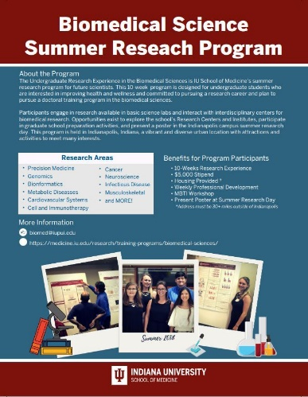

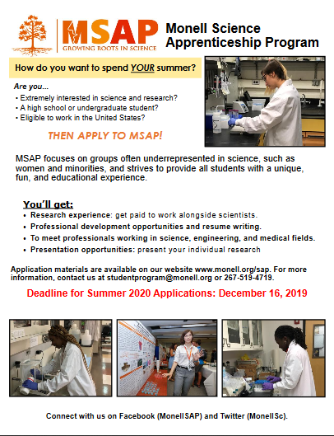
Summer Undergraduate Research Programs
8-10 weeks (I recommend 10 for deeper immersion)
Held at Universities, Government Agencies, Industry
Can be at UTSA, throughout the U.S. and even Abroad…
Gain Amazing Experience and Personal Growth
Common Activities at University SURPs
  Research
  Professional Development training
  Seminars
  Networking/Community Building
  Journal Club
  Local Points of Interest
  Symposia – Oral and Posters
  Rare but valuable:
    Writing? (GRFP)
    Extramural Conference?
    Pre-med rotations

Slide 3

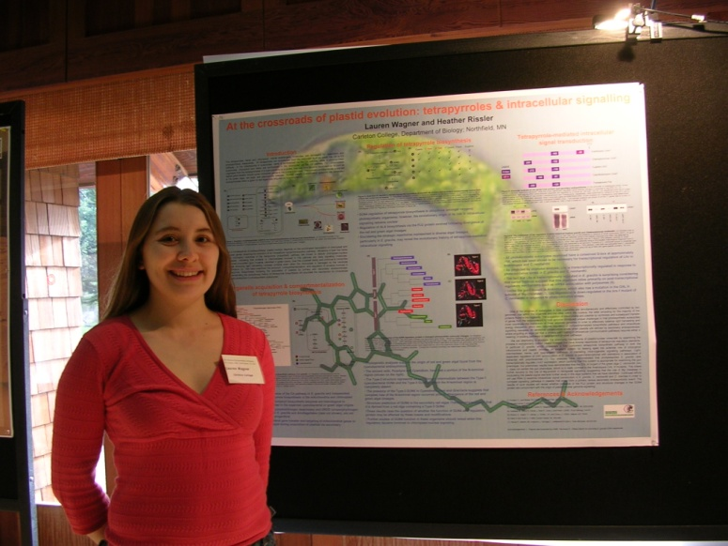
Common Activities
Research
Networking/Community Building
Professional Development training
Seminars
Journal Club
Local Points of Interest
Symposia – Oral and Posters
Rare but valuable:
  Writing? (GRFP)
  Extramural Conference?
  Pre-med rotations

Slide 4

What does it cost?
You are paid
  Stipend (up to $8K…usually $4K+)
  Travel (round trip airfare or mileage equivalent)
  Maybe Housing (Dorm, single hotel room, or find your own!)
  Maybe Food/cost of living (Meal allowance?)
Housing/Food/Travel may vary with Stipend size…
Ex: Amgen Scholars UT Southwestern
  Airfare or Mileage payment
  $5000 stipend
  $500 meal allowance
  1 BR Suite (no roommate) at Hotel
  Events/activities
  Travel, room, board for Amgen Symposium in CA

Slide 5
Goal of Attending
A solid experience with a good research mentor
Fantastic time to build peer and laboratory NETWORK!!
Early – Flat out explore fields! Late – Explore schools!
  Don’t go completely outside your major!! Maintain intentionality
Something that will increase understanding of field
  Govt, Industry, Academics? (BME varies more)
2nd or 3rd LETTER OF RECOMMENDATION / Faculty Connection
Get your foot in the door at that school
  Preadmission? Preferential?
Some PhD Programs (especially BME) Super Competitive
  Will look at location of summer program
  Will even look at prestige of your PI

Slide 6
Why Summer Programs?
Kind and giving back to the world… (Faculty grant writers)
Make more scientists for U.S.
  Invest in future economy, national health
  Workforce Development / Recruitment (Early access to talent!)
Recruit / identify future doctoral students!!! (Universities)

Slide 7
Finding Programs
Many Multi-program sites:
REUs – Government Money NSF.
  Individual Schools listing: https://www.nsf.gov/funding/initiatives/reu
  Often Common APP: https://etap.nsf.gov/
Amgen Scholars – Industry Money, Limited sites (13), High Prestige
  https://amgenscholars.com/
NIH funded – Prestigious. Early App. See instructions – you contact researchers
  On NIH Campus - SIP– https://www.training.nih.gov/research-training/pb/sip/
  On Other Campuses - Usually an R25 or similar grant
School Funded – Possible graduate schools??
  https://www.pathwaystoscience.org/programs.aspx
  Some for Pre-Meds: https://students-residents.aamc.org/phd-biomedical-science/summer-undergraduate-research-programs
Leadership Alliance: https://theleadershipalliance.org/summer-research-early-identification-program
Big 10 Alliance: https://apps.btaa.org/srop/apply
Government Programs: https://www.usajobs.gov/HiringPath/Students

Slide 8
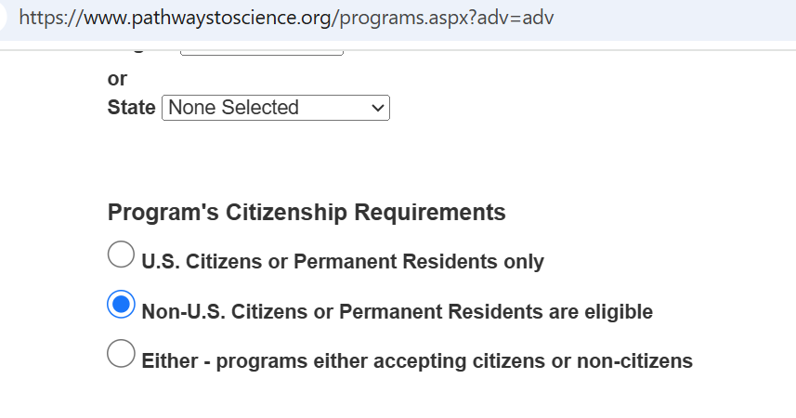
Programs for Non-Citizens
Special search on Pathways:
Cold Spring Harbor
MIT (MSRP)
UCLA RIPS
U. Houston has Links!
  https://www.uh.edu/health-professions-advising/pre-health-resources/summer-programs/summer-programs-for-international-students.pdf

Slide 9
Application Deadlines for Most Programs…
One stated deadline – will look AFTER final due date…usually
Have rolling deadline – Look at apps as they arrive. Might be full by final deadline
Have priority deadline – Look at apps that have come in. Might “ (Above)
Letters are usually allowed a few days after deadline…but don’t count on it.
NIH Deadline different…(See next slide)
If a program is not getting as many apps as desired, may EXTEND the deadline (Look on website)

Slide 10
NIH SIP is Special
Has special instructions, not apply and forget - MUST watch video
Citizens or Permanent Residents
Students who graduate in May are also ELIGIBLE
Apply and Contact Research Mentors
Likely will be interviewed via Zoom
Apps open in November
Can be accepted very early and stop worrying about things
https://www.training.nih.gov/research-training/pb/sip/
Also access sub-programs: https://www.training.nih.gov/additional-summer-programs/

Slide 11
Applying
Pick a bunch of schools (I’d do 7-9 minimally)
  The lower your GPA or low research the more schools!)
  Look for programs that match your interests, level (some might not take 2nd years), similar
  Identify Deadlines
  Ask for letters early (most want 2!)
  Compile a tracking list for Apps
  Look at Application!
    Do they want a standard “Personal Statement”
    Do they have individual questions?
    How long should these answers be!

Slide 12
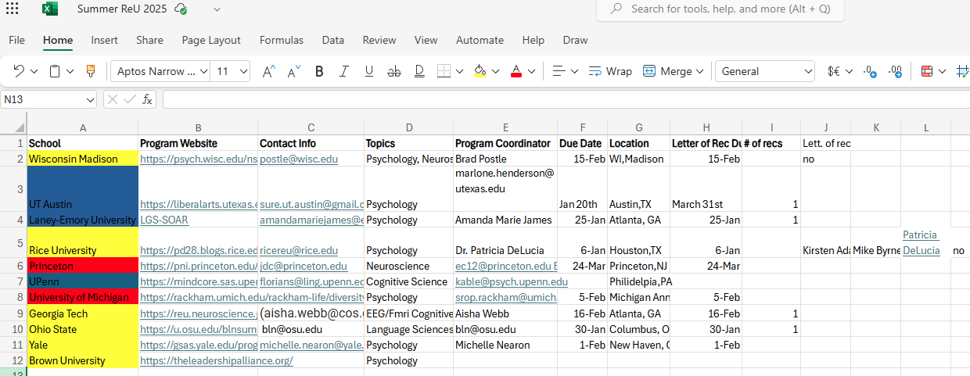
Keep a Record of Where you are applying…
For yourself
For your recommenders
*
*
*

Slide 13
What level of research experience do they want?
Most REUs…
  About ½ and ½, experienced and not
Some serious programs (Amgen, Harvard/Broad, MIT, UC Berkeley/UCSF
  May want considerable experience already

Slide 14
Recommendations 101a
Most programs require two!
Recruit letters early (at least a month, if possible).
  A novel good letter is time-consuming.
  It’s easier if they wrote you one in the past (revisions are fast)
  Ask if they can write you a strong letter of Rec.
  After the letter is made, it’s EASY. They just change the name of school.
  Might not want to exceed 12. Ask about maximum from writer)

Slide 15
Recommendations 101b
Most are two part: Likert ratings and letter.
Always- How well they know you and how long
Likert Ratings asking…
  Likelihood for doctoral study
  Suitability for doctoral study
  Maturity, engagement with research, critical thinking, responsibility
  Design experiments, work independently, communicate science
  Your Level of enthusiasm (highly recommend, recommend, recommend with reservations, do not recommend)
  Rate the strength of the student: One of my strongest ever, top 5%, top 10%, etc).

Slide 16
Recommendations 101c
Prioritize: Research Mentors for whom you did a solid job
Other PhDs who have seen you in action / Faculty from a major course you did well in.
  There is still time to get to know them!!!
Postdoc vs Faculty – Most letters ultimately come from PI of lab.
  Postdoc may write it.
LETTERS FROM Instructors (See next slide)

Slide 17
Recommendations 101d
Ask to meet and discuss letter…
Research Mentors (Generally strongest letters)
  Best if they personally know you, your goals, your strength/progress in the lab / your motivators.
Don’t discount Instructors though…
  They got an A in my very challenging course. Always there, engaged. (This might be enough for some!).
  EVEN BETTER IF YOU’VE CONNECTED: Visited during office hours, diligently pursued info outside of course, asked solid questions and showed critical thinking, strong grasp of the concepts of my course, sought to clarify and learn material, interested in pursuing a PhD, one of my strongest students including grad students in class…

Slide 18
What Makes a School Pick you?

Slide 19
What makes a University avoid you?
Low grades (2.6 or below in UD coursework)
Strong interests outside all fields at program
NOT MEETING GOALS OF GRANT/Funding (Pre-health often excluded)
  NSF, Amgen Scholars want scientists
  Pre-Med
    Build Med School credentials vs true interest in research long term
      Avoid medical terminology Neurology – Neurobiology instead…and similar fields
      Don’t set up whole statement for Pre-Med and then do a short…Then I found research and now I want a PhD, with this PhD part buried.
  For MD/PhD
      If a school doesn’t have MD program, won’t really want them as much
      There are specific programs for MD/PhD aspired students
        AMA site
        Ex: https://shurp.hms.harvard.edu/md-phd-track
        No Admission: below 3.8ish, Career path not clearly understood

Slide 20
Making the Final Choice…
You can apply wherever!!
You don’t need to accept a program when admitted
  You have a week (or two…ask for extensions)
  Examine mentor match and Project!
May help in final choice..
  Mentor / Field to whom you are matched
  Reputation of school or grad program
  Activities of program (schedule)
  Duration: 8 Weeks? 10 Weeks? (10 better)
  Location: Local, National, International
  Less important
    Start / End Dates (vary with schools/location)
    Stipend Amount? Upfront costs (you pay for travel??)

Slide 21
Most Challenging Circumstance…
Bird-in-the-hand problem
Admitted to lower-choice school…
And first choice is still pending. ☹
  Contact first choice school (status, timeline)
  Ask 2nd choice if you can have extension
It’s not great to say yes to one and back out. Considered bad form.
  For you
  Any research training program you’re in
Might need to reimburse for flight, if it’s been bought…

Slide 22
Figure out what the Program wants and Give it to them…

Slide 23
What’s in an Application?
Basic Info – Name, age, schooling, etc.
Transcripts
Possibly a CV or Resume (send CV)
Recommendations
Statement(s)
Statement(s) may parallel graduate school apps…always keep them! ☺

Slide 24
Most Basically…
If questions, explicitly answer them (underline and build Q in)
Or…Research Statement or Personal Statement (divide up important areas)
Sell yourself, don’t minimize any volunteering (UTSA UG researchers are solid!)
Outline on next page for combined statement
Note: Don’t forget any research or pre-research programs…
  I am in the NIH-sponsored UTSA T34 BURT Program
  I am in the COS Work study Research Training Program and completing their professional development series.
  I am a trainee in the NSF S-STEM APPEX (Academic, Person and Professional Excellence) Program
  I am an Honors student…

Slide 25
Possible Questions
Which 2–3 faculty mentors or specific projects in our program interest you most, and why
Describe a specific scientific concept, question, or paper in your field that you find deeply engaging
Why are you interested in conducting research at our institution (rather than elsewhere)
"Please describe any previous research experience, including your specific role, the problem studied, and what you learned." (Note: It is entirely okay if you have none, just focus on lab classes).
How will participating in this specific REU program impact your academic development and future goals? / How do you expect this 8-to-10-week summer experience to shape your post-graduation plans?
What motivated you to become a researcher?
Does your home institution offer undergraduate research opportunities in this field? If not, how will this program bridge that gap?
What are your career goals and how do you plan to achieve them?
"Describe a time you encountered a setback or a failed experiment in a class or project. How did you handle it?
Describe how your background, identity, or unique life experiences will allow you to contribute to the research community

Slide 26
If you need personal stuff…Let’s Think About You
How did you get to the point of applying to an REU?
What is your Story?
Think about this a bit
  Quest to be scientist – some possibilities…
    Knew goal. How you got to now
    Knew goal & encountered barriers, which you overcame to get to now
    Inspired to become scientist by something negative
    Inspired to become scientist by unexpected encounter or circumstance
    Story with MOMENT you knew you would be a scientist
    Etc…

Slide 27
Possible outline in absence of subdividing
General Personal Statement (can be subdivided)
Usually lasts 2 pages (then can tailor) – Single Spaced
Aspirations (Passion!)
  What you want to research. What motivates you to enter a.PhD Program.
How you to go research - Your STORY! Personal attributes/schooling/motivations that got you to wanting a PhD (Your STORY!)
  I want to attend your summer programs because it will allow me to get the experience I need to pursue a PhD (or something similar).
  This can be autobiographical, to demonstrate motivators
  Confirm desire to PhD (or desire to receive experience to confirm PhD aspirations)
Research experience(s) & How you’ve been Prepared
  About one paragraph per experience + Stuff about MARC, etc.
  Research - Like an abstract, but slightly less formal
  Intro, Role in larger project
  hypothesis/purpose, methods, results, discussion
  Implications of findings
  Was there a presentation, paper related to each? Awards?
  How this impacted you?
Participation in training Program & Impact
Why their Program? (Sell This!)
  Attributes that impress you
    Program and activities
    Faculty
    Resources (do not focus on money! ;) But if you’ve been hindered by $ from getting research experience, you can mention this.
Issue or Your Strengths (DEI statements are now hidden)
  (Bad grade in course?)
  Overcame stuff and has made you even more determined. Foundations built made you more determined, etc.
/Closing
  1 paragraph. Swing back to beginning.
  Thank you

Slide 28
Hidden Diversity Statements (you CAN mention your background)
Think of your story. Did you have challenges/archetypes?)
Here are some examples (they don’t flow together)
  You grew up in XXXXX. A bit about family.
  Financial disadvantage if pertinent.
  Did you have a concept of getting a PhD at a young age? (story of how you got there!)
  “Different” or “outsider” in primary/HS. Achiever and loved science, but in my XXX environment,
  Loved science…no role model Hispanics/African Americans in area…found one! Opened door!
  No AP Courses/Crummy School District
  Think about HS Classmates – How many went to college, even though smart?, Think about differential graduation rates, % Hispanic/AA in population vs start or complete HS or College - Challenging.
  Grew up on South TX. Family hard working to make ends meet. No scientists or grad school or college completion. First Gen. Always curious. I had no idea about PhD. Blah Blah. Always drawn to academic success. Put in persistence. Put in resilience. Put in passion for research & PhD. Want to help community, family, etc…

Slide 29
Other Writing Tips…
Keep in mind…someone (or several someones) will be reading this.
They will also be reading another 20 of these.
Let yourself and your passion be present
Avoid typos and careless mistakes: Disorganization, grammar, typos
  Shows you don’t care.
BEWARE AI (See next slide)
Avoid generalities and cliches- give specific examples
Don’t go overboard with a story
Don’t use gimmick- fake magazine article or play
Don’t provide unneeded details in Story

Slide 30
BEWARE AI
AI can give you ideas…
…and help you to avoid grammar mistakes or typos.
It also sounds like AI.
A good reader can pick up the tone of the writer
PhDs are good readers.
If it sounds like it came out of a data center rather than a 20 year old brain, it will be disregarded. And/or scored low and complained about by reviewers.

Slide 31
How Long Should a Statement be?
Follow directions of program!
If no directions and a single statement is requested, no more than two pages single spaced!
  Someone has to read…

Slide 32
How to Start?
Just write.
  Use questions as a guide
  Free writing
  Then Outline
  Then write…
  Allow time for feedback and re-writing!

Slide 33
Don’t Mention:
Don’t dwell too heavily on High School experiences
If taking about an inspiring person, don’t write more about them than you…
Avoid controversial topics
  Best to avoid Religion or politics
  Things that are illegal, excessively unusual or unconventional
  Mundane aspects of past research (buffers or descriptive methods)

Slide 34
Refining…
Can take longer than expected to write- multiple drafts, read aloud
Make each statement will organized, relevant, concise
Does this idea / story contribute to the overall story?
Reviewed by mentor and others before sent in!

Slide 35
Write Like a Scientist
Focus on clarity of thought and expression
Look at each sentence. Summarize it to yourself. Should you change to your summary???
Longer, fancier words unnecessary; go for simple and powerful
Don’t vary sentence structure.
  Before: "Although I did a plethora of activities in college, my assiduous efforts enabled me to succeed.“
  After: "Although I juggled many activities in college, I succeeded through persistent work.“

Slide 36
Write tight sentences
Beware wordy writing
Short sentences:
  Forceful
  Direct
  To the point
Before: "My recognition of the fact that the project was finally over was a deeply satisfying moment that will forever linger in my memory.“
After: “Completing the project gave me great satisfaction."

Slide 37
INTERVIEWS? For a Summer Program?
Most programs don’t interview…but Zoom has made it easier and more are doing it.
Some programs interview all top applicants
Some PIs won’t accept someone in the lab without meeting them
Identify who will be interviewing you!
Prepare –
  Re-examine your application
  Find a working computer and a quiet room
  Or…do your own room but curate what they see. If you’re an artist, let it be shown. Or put a scientific poster behind you on the wall.

Slide 38
INTERVIEWS? What’s asked
Identify interviewer and explore them online. Possibly read a paper by them.
Tell me about yourself: “I’m a second-year biology student interested in how cellular mechanisms contribute to disease. Through my coursework in genetics and chemistry, I’ve realized that I especially enjoy analyzing evidence and asking why results occur. I’m applying because I want hands-on research experience, stronger scientific skills, and a clearer understanding of whether a Ph.D. and research career are right for me.”
OR…I am a second year blah blah. I want to pursue a PhD and currently exploring fields. In a research training program. Blah blah.. Or want to prepare for graduate school.
FACULTY: Why did you choose my lab? How have you prepared for my lab?
  I prepared by this or this (research, training program, etc.
  Or…I am NOT experienced. But that it the purpose of the program. I am a fast learner and very devoted. Curious and hard working. I’ve looked through two of your papers already.
Career Goal
Why is their research interesting to you?
Q’s for them
  Please tell me about the project
  Mentoring style?
  What do they look for in an undergrad researcher

Slide 39
More on Interviews
Or, if interviewed by a researcher or program director…
Q’s:
How are students matched with research mentors?”
  Do you know whom I would work with?
What distinguishes students who thrive in this program?
Something about research experience of applicants..?

Slide 40
Overall…prepare and you should do well…and have a great summer adventure..

