Slide 1
STUDENT DISABILITY SERVICES
MS 3.01.16

Slide 2
Supporting Students with Disabilities In Your Classroom
Presented by: Roselena Balderas, MA
Executive Director, Student Disability Services
University of Texas at San Antonio

Slide 3
Overview of Student Disability Services (SDS)
Mission: We empower students with disabilities to achieve access so they can be successful at UTSA and beyond
What We Do:
Facilitate accommodations
Provide resources for students and faculty
Promote an inclusive campus culture for students with disabilities.

Slide 4
Overview of Student Disability Services (SDS)
Our Impact:
Currently, we have 2013 students registered with SDS
We have sent out 4047 email notification letters to faculty for the current semester
That is an average of about 16,188 academic accommodations being implemented in courses throughout UTSA

Slide 5
Legal Foundations
Relevant Laws:
Americans with Disabilities Act (ADA)
Section 504 of the Rehabilitation Act
Equal Access
Removing Barriers
Non Discrimination Laws That Protect Adults with Disabilities From Exclusion, Discrimination and Unequal Treatment

Slide 6
Legal Foundations…
Faculty Responsibility: Ensure accessibility and equal opportunity to learning. Ensure that approved accommodations are being implemented in their course.
SDS Role: Collaborate and consult with faculty to meet legal and ethical obligations.

Slide 7
Common Disabilities at UTSA
Examples of Disabilities that SDS Supports
Learning Disabilities (e.g., reading disorders, math disorders, writing disorders)
Mental Health Conditions (e.g., anxiety, depression)
Physical Disabilities (e.g., mobility impairments, chronic illness)
Neurodivergence (e.g., autism spectrum disorders)

Slide 8
Accommodation Process
Student Registration:
Students register with SDS and provide documentation.
Accommodation Determination:
Individualized based on documentation and needs.
Accommodation Letters:
Students must request accommodations on a semester basis. Once request is made, accommodation notifications are sent to faculty outlining approved accommodaitons
Faculty Role:
Implement accommodations and collaborate with SDS as needed

Slide 9
Common Classroom Accommodations
Testing Accommodations:
Extended time with instructor, reduced distraction environment
Note Taking Accommodations:
Audio taping, use of assistive technology, peer note taker
Accessible Materials:
Digital formats, captioned videos, accessible presentations
Attendance/Tardiness Leniency:
Flexibility for students with chronic conditions

Slide 10
How Faculty Can Support Students
Foster An Inclusive Environment For Students with Disabilities.
Include a disability statement in the syllabus
Normalize accommodations as part of the academic experience
Utilize Principles of Universal Design for Learning which emphasize proactive strategies to ensure that learning environments are designed from the start to accommodate diverse needs. (Academic Innovation Plug)

Slide 11
How Faculty Can Support Students
Be Proactive
Use accessible course materials (PDF’s with OCR, alt-text for images).
3. Maintain Confidentiality
Never disclose a student’s disability or accommodations needs to the class
4. Communicate Clearly
Have a clear conversation about the implementation of the student’s accommodations in your course and encourage students to approach you with concerns about accommodations

Slide 12
Challenges
Questions?
Would anyone like to share what type of challenges Faculty encounter working with students with disabilities in a physical and/or virtual classroom environment?

Slide 13
RESOURCES

Slide 14
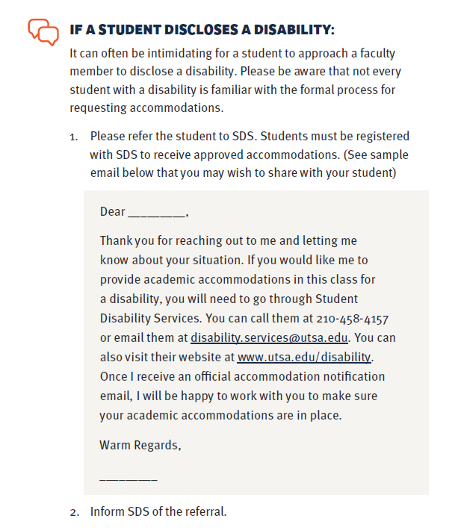

Slide 15
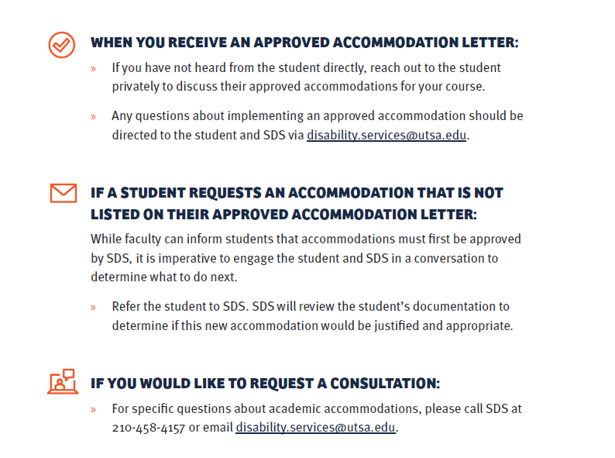

Slide 16
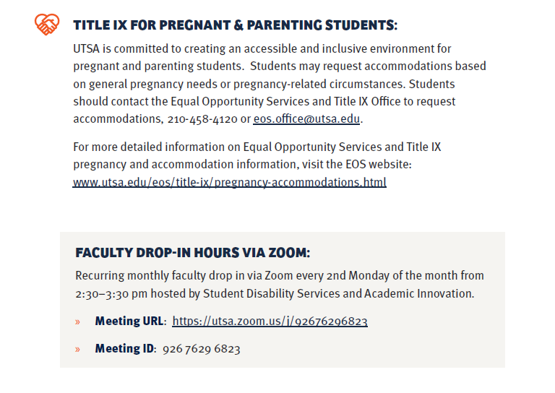

Slide 17
Resources
Faculty/Staff Resource Guide
FAQ’s For Instructors
Digital Learning and Accessibility

Slide 18
Contact Information
Student Disability Services (SDS)
Multidisciplinary Studies Building (MS) 3.01.16
210-458-4157
disability.services@utsa.edu

