Slide 1

COS Branding Style Guide
UT SAN ANTONIO
COS
BRANDING STYLE GUIDE

Slide 2

Introduction
INTRODUCTION
About the COS Brand and Style Guide
Branding is a communication tool that is utilized in both online and in printed publications. The COS brand is useful for faculty, staff, and students to understand what the college represents in alignment with UT San Antonio. We collaborate with the university's communication team to ensure we follow branding and marketing guidelines and provide updates to the college's departments, deans, and offices.
When creating a digital or printed communications (flyer, brochure, presentation, form, or website) it's best to follow the rules provided in the linked branding kit. If you're unsure of where to start, feel free to use one of our flyer templates (available in both Adobe Express and Canva) to start designing your flyer. It is always a good idea to make visual stories user-friendly and easy-to-read. that uses the university’s branded colors.
UT SAN ANTONIO COLLEGE OF SCIENCES | 2026

Slide 3

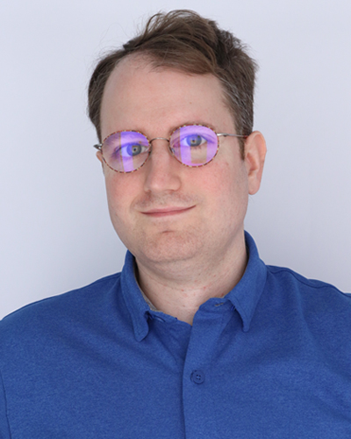
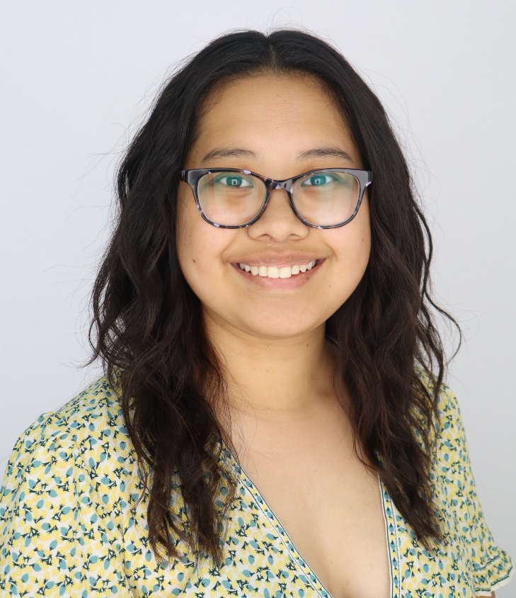

Points of Contact
COS COMMS Points of Contact
Ryan Schoensee or Christina Calvo
Associate Director of
Communications
Administrative Associate

Slide 4

COS Logo
COS LOGO
Contact Ryan Schoensee or Christina Calvo for more Logo Options

Slide 5

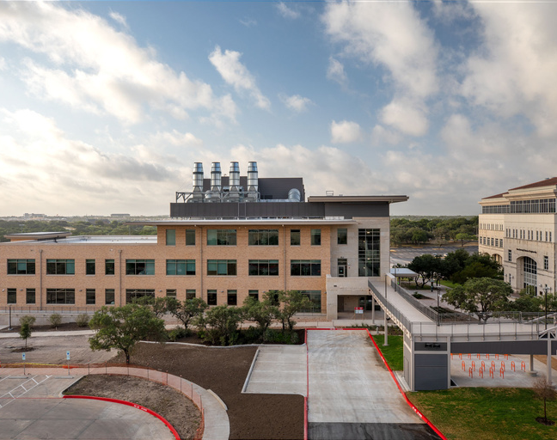

COS Branding Design
BRAND LOGO
Explaining the Design
The College of Sciences follows the branding and marketing guidelines provided by The University of Texas at San Antonio's communications and marketing team and as listed on the Marcom Studio website.
Please make sure you are following UT San Antonio’s guidelines for images, logo, font, color, and university name when designing your communications for online and/or print form. If you need assistance or have questions about using the brand logo, please email ryan.schoensee@utsa.edu or christina.calvo@utsa.edu.
UT SAN ANTONIO COLLEGE OF SCIENCES | 2026

Slide 6
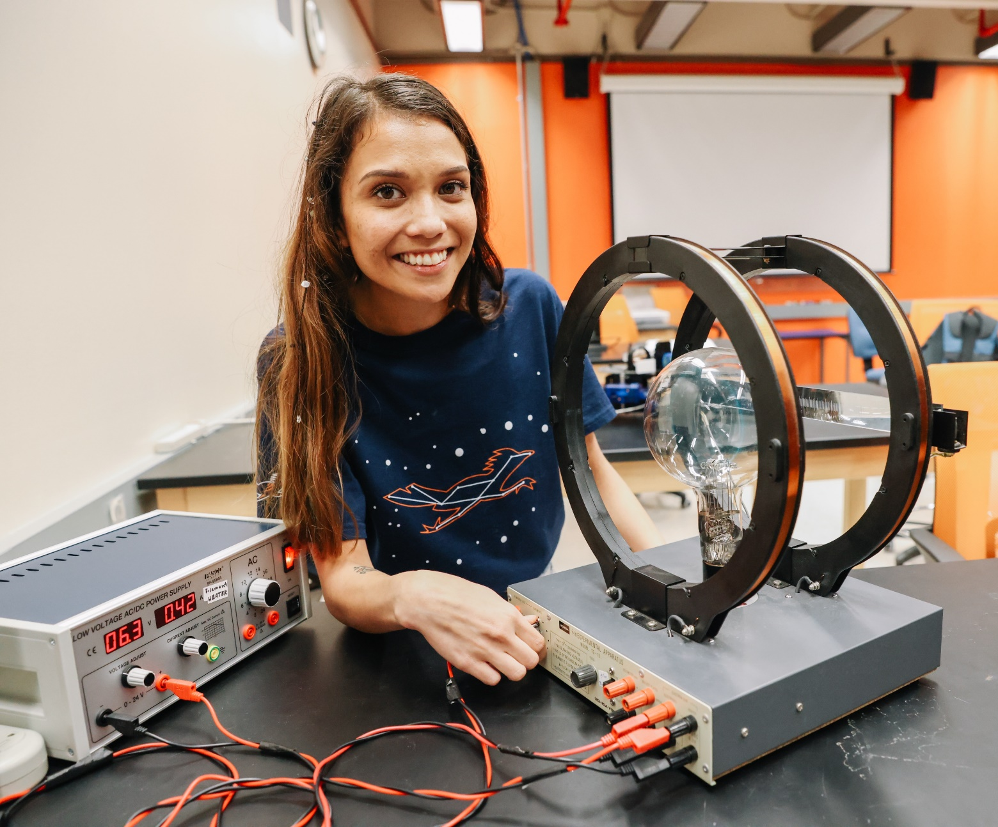

Proper Use of University Branding
Proper Use of University Branding
The purpose of using the official branding guidelines provided by the university's communications team for marketing is to convey a cohesive image and story.
Some common mistakes when designing your marketing tools for COS events:
wrong logo
low-resolution imagery
wrong university colors
wrong font styles
We have created several flyer and social media templates that can be edited by users to fit the information needed for their events. We recommend using Adobe Express for free design templates.
Visit the university's communications and marketing site for more information on guidelines and UT San Antonio's brand identity.

Slide 7

UT San Antonio Color Palette
UT San Antonio Color Palette
The Proper PMS and CMYK For Print and Hex Codes and Online Use
UT San Antonio Orange and Midnight are the primary official colors of the university. Our colors are a distinguishing feature of our identity.
Printing Colors- PMS & CMYK
Printed materials use PMS (spot) colors or CMYK (four-color process)
Use approved CMYK values when supplying files to printers
Avoid automatic PMS-to-CMYK conversions, which can change the intended color
Special color adjustments for uncoated paper (copy paper, envelopes, etc.) are only needed when using PMS colors
HEX: #F15A22
HEX: #032044
On-Screen Colors- HEX
Save web and social media graphics in RGB for accurate on-screen color
Only use approved HEX values
CMYK: 0, 80, 100, 0
CMYK: 100, 66, 0, 76
PMS: 1665
PMS: 289
UT SAN ANTONIO COLLEGE OF SCIENCES | 2026

Slide 8


UT San Antonio Fonts
UT San Antonio Fonts
Brandt typefaces
Fonts (typography) is the visualization of our voice, imbuing all our communications with our unique personality. Beausite is our brand font, used across all communications to create a distinctive and cohesive voice.
Primary Fonts
For external, widely published collateral, the primary typefaces are the following: -
Beausite Fit
Beausite Classic
*Often not readily available on Microsoft, Adobe, or Canva
Fallback Fonts
For internal use or limited distribution when our brand typefaces are not available, it is acceptable to use the following:
Arsenal
Libre Franklin
Aptos Serif
Aptos
Aptos Narrow Bold
Aptos Narrow Regular
UT SAN ANTONIO COLLEGE OF SCIENCES | 2026

Slide 9
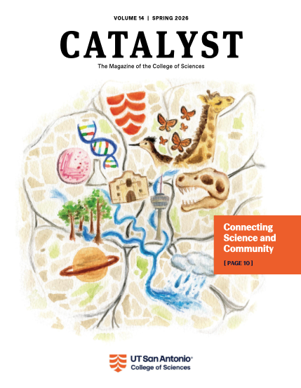

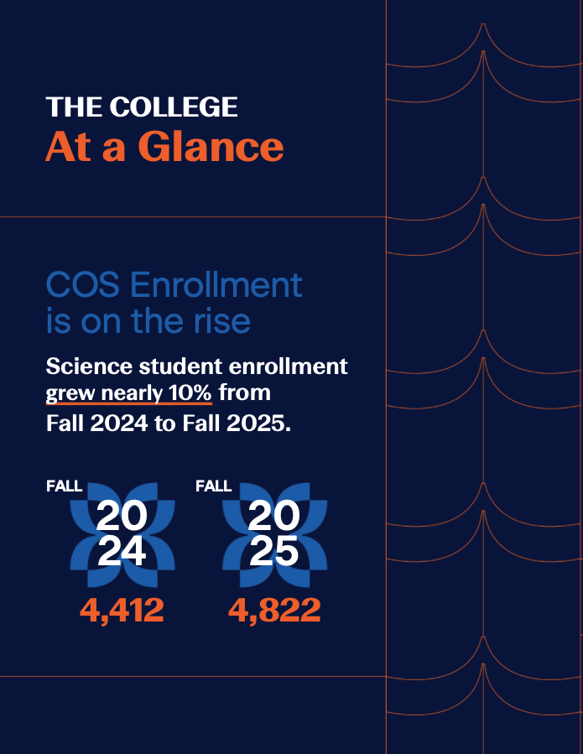
Examples of COS Branding
Examples of COS Branding
UT SAN ANTONIO COLLEGE OF SCIENCES | 2026

Slide 10

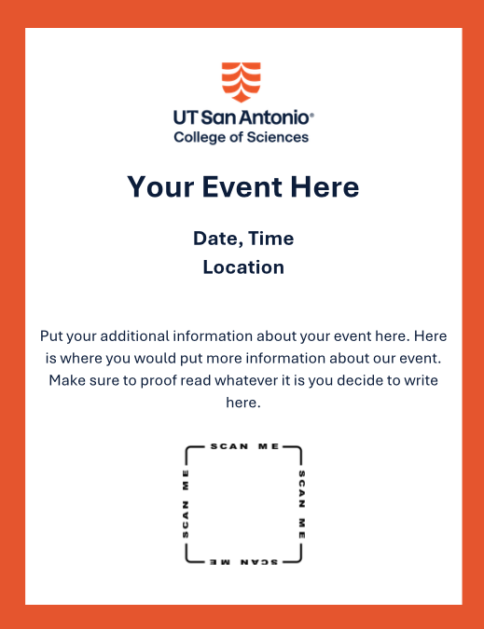

Flyer Templates
Flyer Templates
Email ryan.schoensee@utsa.edu or christina.calvo@utsa.edu for template access on Adobe Express or Canva. Custom templates available upon request.

Slide 11


Postcard Templates
Postcard Templates
Email ryan.schoensee@utsa.edu or christina.calvo@utsa.edu for template access on Adobe Express or Canva. Custom templates available upon request.

Slide 12
Social Media Hashtags
Social Media Hashtags
Use hashtags on social media to increase your reach and connect with the right audience.
General​
#UTSA​
#BirdsUp ​
#AwesomeAlum
#Rowdy​ ​
College of Sciences
#UTSASciences
#ThisisWhataScientistLooksLike
STEM
#WomeninSTEM
#stemeducation
#sciencefacts
#research
#science
#stem
​

